Slide 1
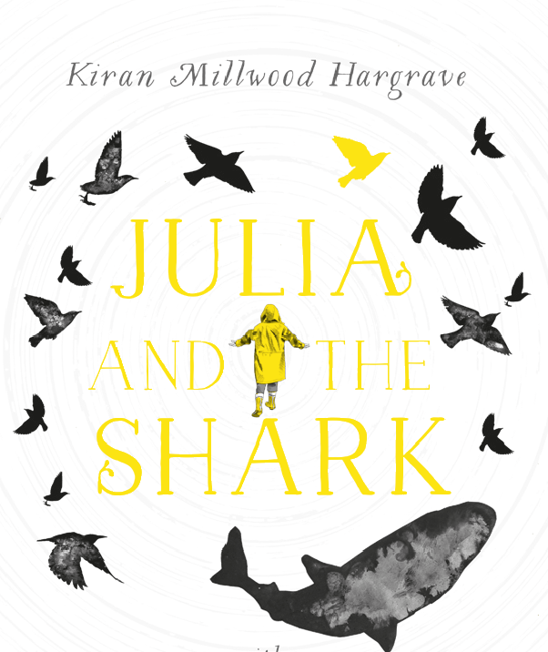
Predict what you think the book will be about and why.

Slide 2
Day 1 pp1-5
What did the narrator try to catch with her crab net?
Look at the last line on page 1 - ‘Perhaps the secrets drowned in the night like a fish in the air.’ Why is this line effective?
Where does Julia live?
Find and record a simile from page 2.
Define archipelago.
Why do you think words change according to whose mouth they come out of?
Why is Julia’s mother’s job useful?

Slide 3
Day 2 pp 6 –8
Why did mum want to move to Unst?
Why does Julia relate to the whale who swam around the world alone?
Define compartment (p8)
Look at p8. Evidence states that Julia tells us that she likes to look at a map so that she can see the whole picture of where she is going, whereas her parents use a satellite navigation system. What question might this information answer?
Why did the journey to Shetland take longer than it takes to get to Australia?
Why was sleeping at the B and B like sleeping in the belly of a whale?
Predict what you think might happen next.

Slide 4
Day 3 pp.9-10
What is a transmitter? Why was it being used?
Identify the different species of whales.
Why did mum never answer questions with a yes or no?
Define rumour.
List 3 alternative names that Julia gives to the motorway. Now record 2 of your own.
Summarise the story so far in 20 words or less.
Predict what will happen when Julia meets the shark.

