Slide 1
Climate Action
By Georgina Stevens

Slide 2
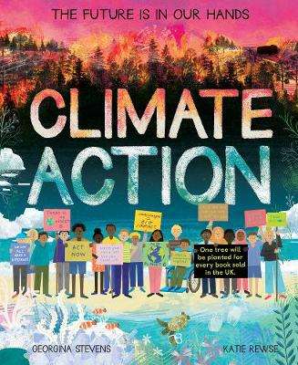
Day 1
Predict
What do you think this book is going to be about?
Do you think it is fiction or non-fiction and why?

Slide 3
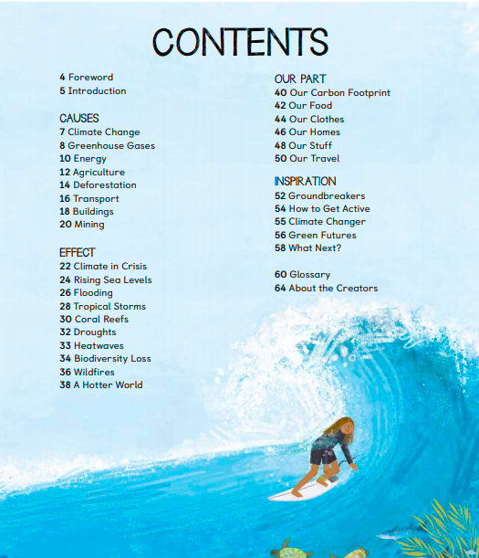
Day 1
What is the purpose of this page?

Slide 4
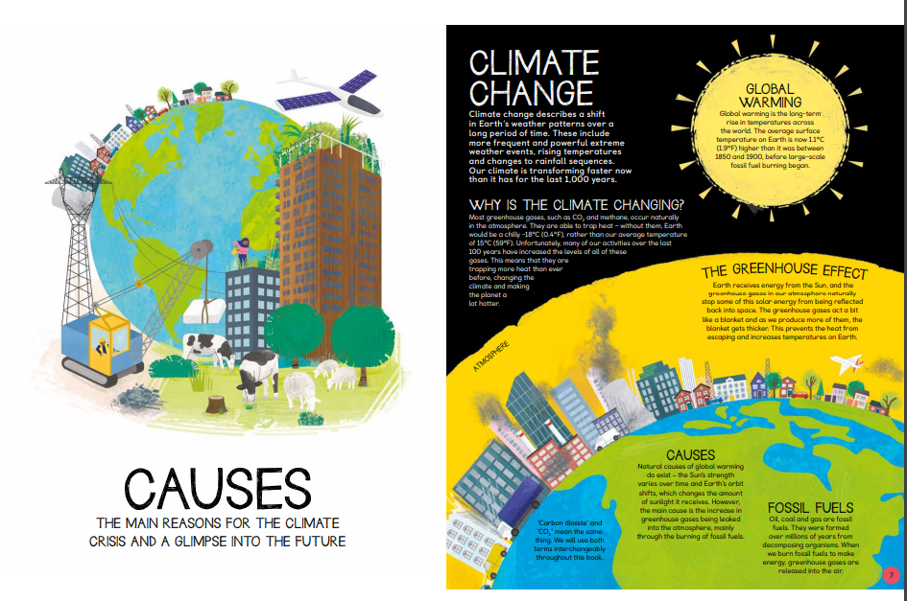
Day 1

Slide 5
Day 1
Reading Skill: Summarise
What makes a good summary?
Your Task: Summarise the information from page 7 using as close to 20 words as you can.

Slide 6
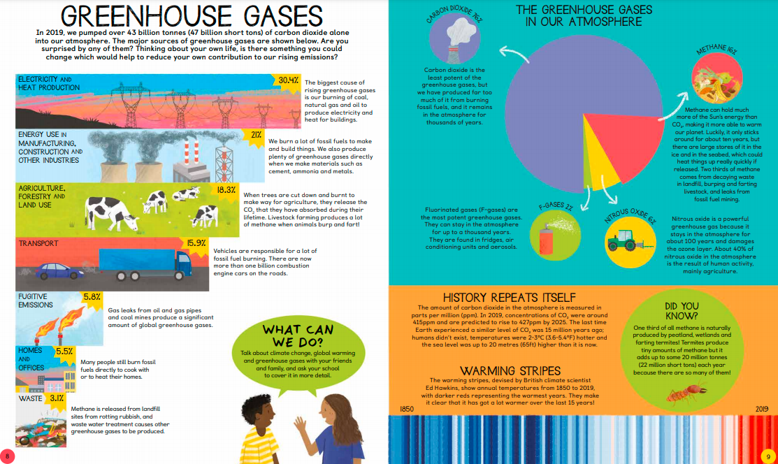
Day 2

Slide 7
Day 2
What are the four greenhouse gasses in our atmosphere?
Which greenhouse gas is there most of in our atmosphere?
Are the statements true or false?
15.8% of greenhouse gases come from transport.
The gas released from landfill sites is called methane.
2/3 of methane is produced by termites.
4) How is carbon dioxide in the atmosphere measured?
5) What is the largest contribution to rising greenhouse gas emission? Use evidence from the text to prove your answer.

Slide 8
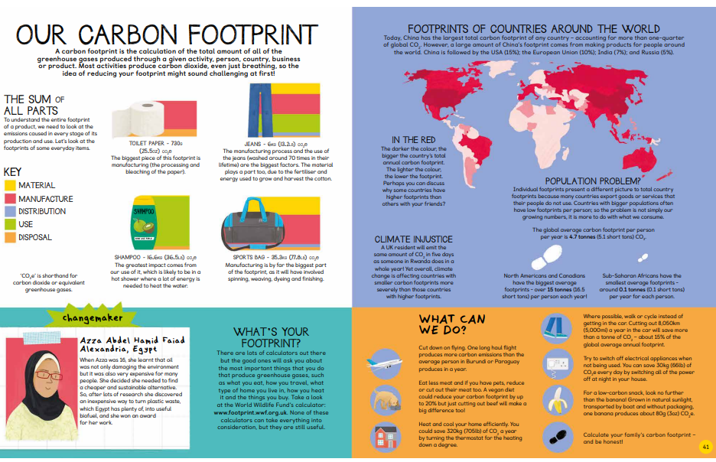
Day 3

Slide 9
Day 3
What do you need to do to understand the footprint of a product?
Which word in this phrase tells you that you need to look at the whole product to find its foot print?
“To understand the entire footprint of a product…”
3) Which country has the largest total carbon footprint? Why do you think this is?
4) Look at the section ‘FOOTPRINTS OF COUNTRIES AROUND THE WORLD’, find and copy a phrase that describes an issue.

