Slide 1
Industry
Tuesday 5th November 2019

Slide 2
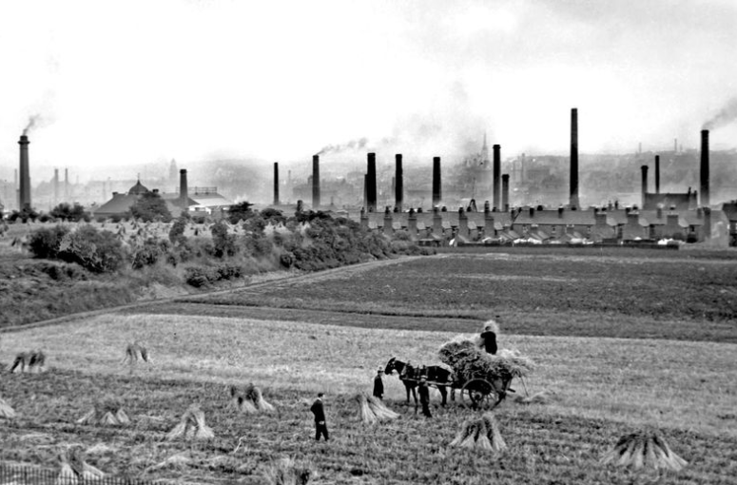
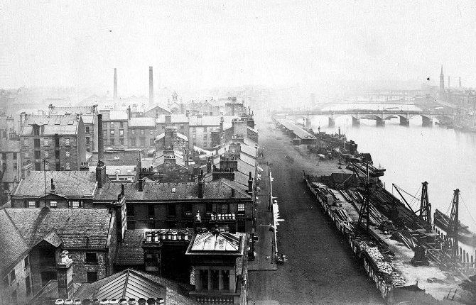
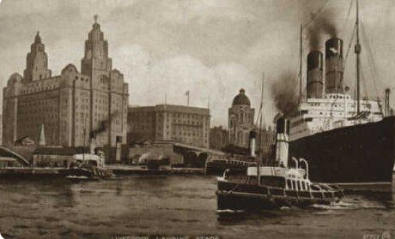
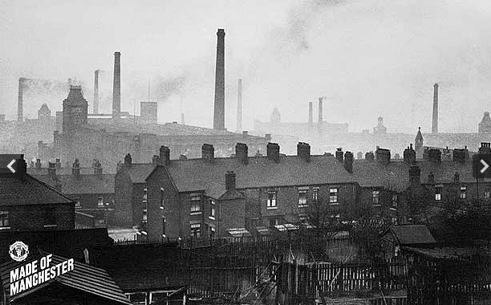
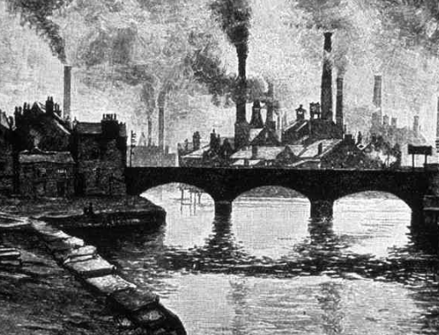
Industrial Cities
Birmingham
Glasgow
Manchester
London
Liverpool

Slide 3
Industrial Revolution
What do you think is meant by this term?

Slide 4
The Industrial Revolution
The 1800s was a time of 'Industrial Revolution'.
The main changes were:
by 1914, England had become a great trading nation with a worldwide empire, which covered a fifth of the globe
a 260 per cent growth in population
a change from agriculture to industry
a move from domestic industry to factory work
a move from water and wind power to steam engines
a revolution in transport and communications, from canals and pack horses, to railways and the telegraph
The growth of towns:
In 1750, only about 15 per cent of the population lived in towns. By 1900 it was 85 per cent. This meant that there were far more people around to work in new industries but also caused problems because many more people needed foods and homes. This meant that poverty was increasing.
By 1900, London had 4.5 million inhabitants. The biggest other towns were Glasgow with 760,000 inhabitants and Liverpool with 685,000. Manchester and Birmingham had more than half a million people each. Much of the population had moved from the South-East to the industrialised coalfield areas in the North and the Midlands.

Slide 5
The main Industrial Cities
Birmingham
Glasgow
Manchester
London
Liverpool

Slide 6
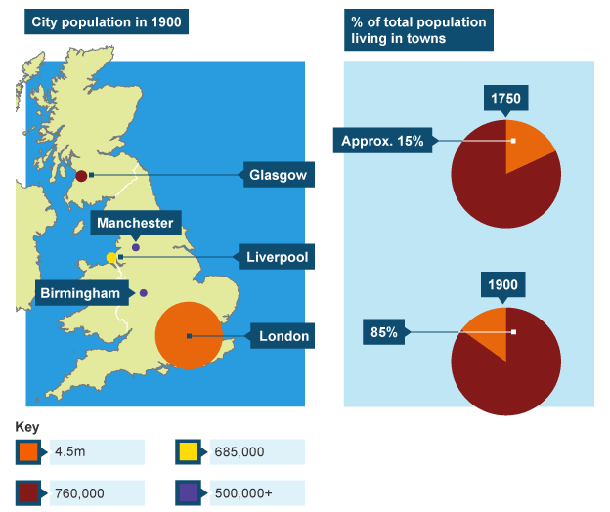
Industrial City Location:

Slide 7
What were the cities known for:
Liverpool and Manchester were known for the production of textiles
Glasgow was know for ship building
Birmingham was known for iron works
London was known for building materials, transport, textiles etc.

Slide 8
Manchester- Lancashire
London- Middlesex, Kent, Hertfordshire
Liverpool- Lancashire
Glasgow- Lanarkshire
Birmingham- Warwickshire

