Slide 1
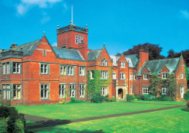
Winmarleigh Hall Lancashire
27th – 29th April 2022

Slide 2
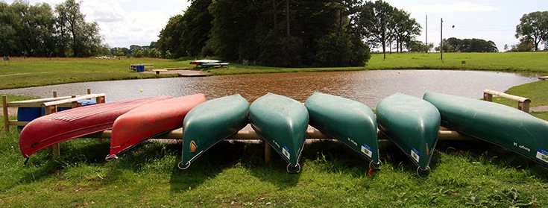


LEARNING OUTSIDE
Winmarleigh Hall - Lancashire
21 fantastic adventure activities to choose from
50 acres of beautiful gardens and woodland
Lake for watersports and floodlit activity area
Explore the 360 Virtual Tour www.pgl.co.uk/winmarleigh360 to see inside the centre and view activity information and videos

Slide 3
General Itinerary
Wednesday
Arrive at school for approximately 11am
Arrive at Winmarleigh Hall
Lunch (packed lunch from home)
Site tour
First activity
Dinner
Evening activity
Bed
Thursday
Breakfast
Activity 1
Break
Activity 2
Lunch
Activity 3
Break
Activity 4
Dinner
Evening activity
Bed (9pm)
Friday
Breakfast
Activity 1
Finishing ceremony
Lunch
Get on the coach
Arrive back at school for 3.15 (very sleepy)

Slide 4
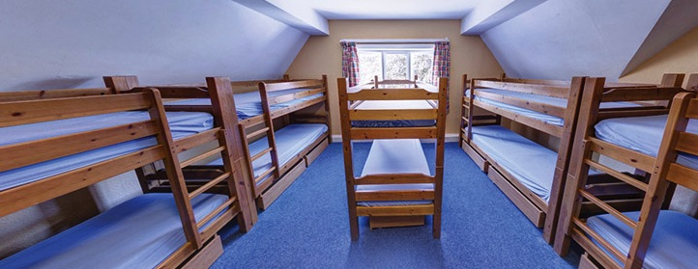
Accommodation
Bunk beds 4-10 children in a room
Rooms allocated by teachers based on children’s preferences. Children will find out their rooms upon arrival.
Teacher and site staff available 24/7
Accommodation for Winmarleigh Hall can be viewed in the 360 virtual tour: http://www.pgl.co.uk/winmarleigh360

Slide 5
Activities
Children split into 4 groups (maximum of 12 in each group), each with an adult from school and an instructor
Children vote for their preferred activities
Find out activities approximately 3 weeks before
Abseiling
All Aboard
Archery
Canoeing
Challenge Course
Climbing
Fencing
Giant Swing
High Ropes Course
Jacob’s Ladder
Low Level Ropes Course
Orienteering
Problem Solving
Quad Biking
Raft Building
Sensory Trail
Survivor
Trapeze
Vertical Challenge
Zip Wire
There is the option to do water sports. We will let you know if we have been allocated one of these options as soon as we know.

Slide 6
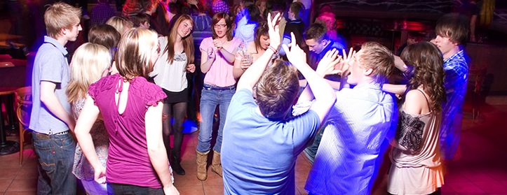
Evening entertainment
50/50
Ambush
Campfire
Disco
Get Your Own Back
Generation Game
Hole in the Bucket
Karaoke
Quiz
Robot Wars
Shelter Build
Splash
Star Auction
Talent Show
The Cube
Wacky Races

Slide 7
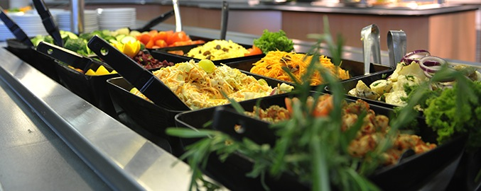
Dining
3 nutritious, balanced meals per day
Self-service salad bar
Vegetarian option
Special diets catered for by prior arrangement
Sample menus available online: www.pgl.co.uk

Slide 8

Medication
Travel sickness tablets should be taken before arriving at school
Any medication to be taken during the stay must be clearly labelled and given to your child’s class teacher on Wednesday morning with a medical form

Slide 9


Kit List
A detailed kit list will be on our Class Page.
Children will need:
Lots of socks
Lots of underwear
At least 2 pairs of sports shoes , 1 pair of evening/dry shoes
3 pairs of tracksuit bottoms (waterproof trousers are also ideal)
Long sleeve t-shirt
Rucksack
Reusable water bottle
Torch

Slide 10

What else to take?
Camera (disposable are best)
No mobile phones please.
In the event of an emergency, you will be able to contact a teacher on the number sent to you closer to the trip.
Any deodorant taken must be roll-on only please as the fire alarms are very sensitive.

Slide 11
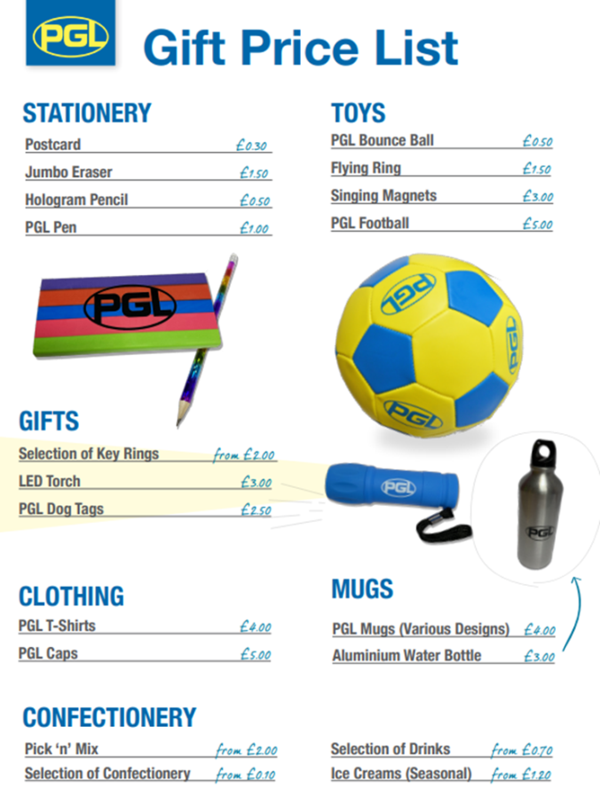
Treats
Spending money
Children will visit the shop at
least once
Most expensive thing is £5
They do sell sweets and treats
Nut free site
The site is completely nut free so please make sure that if you’re sending any treats they don’t contain nuts.

Slide 12
Cost
Total cost is £195
Final instalment to be paid this month

Slide 13
Video
You can watch this video at home with your child to discuss what they might experience on our visit.
https://www.pgl.co.uk/en-gb/school-trips/resources/promotional-videos/primary-schools-videos

Slide 14
Questions?

