Slide 1
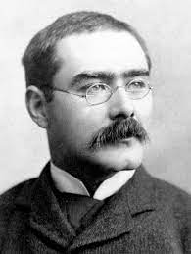
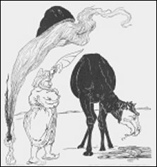
Just So Stories - How the Camel got his Hump
by Rudyard Kipling
When do you think this story was written? Why?
1898 - over 120 years ago
Why do you think the story starts with “Now this is the next tale and it tells how the Camel got his big hump”?
It is from a collection of stories called “Just So Stories”

Slide 2
Column 1 (up to ….At the end of the day…)
When was this story set? What clues are there?
When life on Earth had just begun – it says “ In the beginning of years, when the world was so new and all the animals were just beginning to work for Man”.
The Howling Desert means the “desolate” desert – what does “desolate” mean?
Desolate means it is empty.
What do you think a Howler is in this story?
A Howler is something that is a bit ridiculous.
What did the Camel eat?
The Camel ate sticks and thorns and tamarisks and milkweed and prickles.
What do you think ‘scrutiatingly idle means?
It means he was frustratingly lazy.
What order did the animals approach the camel?
The Horse was first, followed by the Dog, followed by The Ox.
Why do you think the author wrote about 3 animals approaching the Camel?
This is to emphasise he is lazy.
Why do you think he only said Humph?
Take ideas: It was all he could say, he was rude

Slide 3
Summarise in 20 words with your partner, the key parts of the story so far.

Slide 4
Column 2 – From At the end…… to end of column 2
What does the Man suggest the animals must do?
Man suggests the animals must work double time to make up for the work the camel is not going to do.
What do the words Palavar, Indaba, Punchayer and Pow-Wow mean? Use the text to work it out?
All these words mean they had a discussion.
How do you know the Camel isn’t bothered that the other 3 have to work harder?
He laughs at them, says “Humph” and then goes away.
What do you think a Djinn is?
A Djinn is a mythical spirit, like a genie.
How does the horse describe the Camel
He says it is a thing in the middle of the desert with a long neck and long legs.
How does the Djinn say he will deal with the situation?
He says he will Humph him.

Slide 5
Column 3
What does “took a bearing” across the desert mean?
A bearing means a turn.
Where did the Djinn find the Camel?
He was looking at his own reflection in a pool of water.
Why did the Djinn have his chin in his hands?
He was thinking about how he was going to solve the problem.
What nickname does the Djinn have for the Camel?
He calls him Bubbles.
What happened when the Camel kept saying Humph?
His back kept puffing up.
How many days had the Camel not worked for?
He had not worked for three days.
The Camel says he won’t be able to work with his new hump but the Djinn says he will – why?
The Djinn says he can live on his hump – a camel stores fat in its hump which gives it a supply of energy.

Slide 6
Write 2 short arguments:
From the Camels side
From the Djinn’s side
Write in first person – I think......
Think about these questions
Did the Djinn have the right to give him a hump?
Were the other animals right to tell the Djinn?
Was the Camel allowed to be idle?

