Slide 1
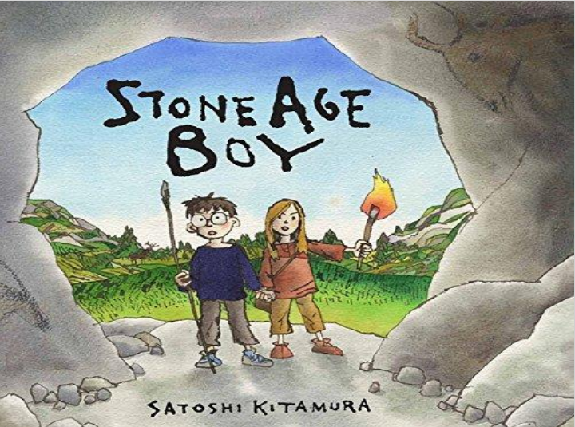
Wednesday the 2nd March 2022
Day 2
LO: To use adjectives, precise verbs and repetition.
Can you write down a sentence that includes a metaphor?
Listen to the story:
ESL Video story book - Stone Age Boy read by Teacher Sabina - YouTube

Slide 2
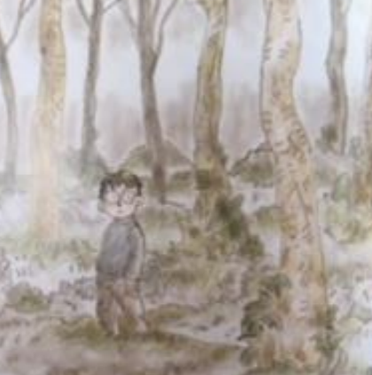
Adjectives
What positive words could you use to describe an adventure?
What words would you use if you went on a adventure?
Try to include an adjective in your sentence like the example below:
An astonishing thing once happened to me.
Notes:
An astonishing thing once happened to me.

Slide 3
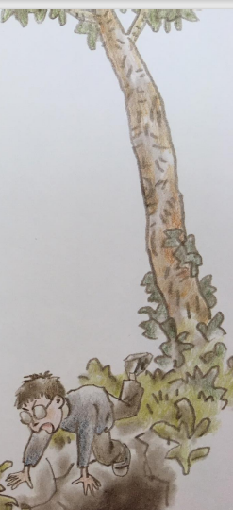
Precise verbs
Which verbs would be good for the beginning of a story?
Write down some verbs that could be used at the start of the story.
Try to include an example like in the following sentence:
Wandering in the woods one day… I suddenly changed direction.
Notes:
Wandering in the woods one day… I suddenly changed direction.

Slide 4
Repetition and feeling
What words could we use for tripped?
What words could we use to repeat?
(The adjective ‘down’ is repeated to emphasis the distance he fell)
Once you have a different word for tripped and a word you can repeat use them like the following sentence:
I tripped and found myself falling down, down, down.
Notes:
I tripped and found myself falling down, down, down.

