Slide 1
Thursday the 3rd March 2022
Day 3
LO: To use complex sentences, prepositions and repetition.
Can you write down a sentence that includes repetition.

Slide 2
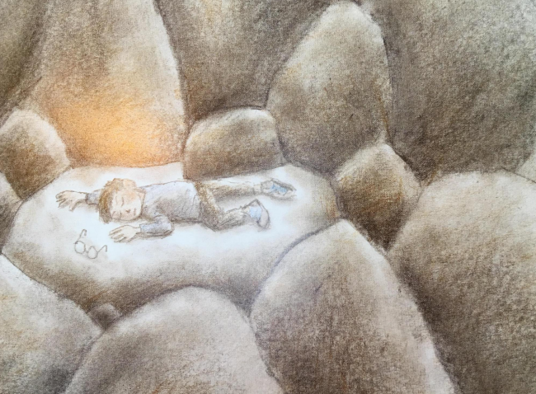
Complex Sentence
What words could you use to describe the cave?
Think of your senses- in particular touch.
Once you have some examples try to incorporate them like the sentence below:
When I awoke, I was in a dark, damp place.
Notes:
When I awoke, I was in a dark, damp place.

Slide 3
Prepositions
What different prepositions can you think of?
What ‘sights’ can the boy see?
Combine to create a prepositional phrase.
across
grassy landscape
Across the grassy landscape
Once you have collected some words and created a prepositional phrase try to write a sentence including them like this:
I could see a patchwork of emerald and golden fields, glistening on the horizon.
Notes:
I could see a patchwork of emerald and golden fields, glistening on the horizon.

Slide 4
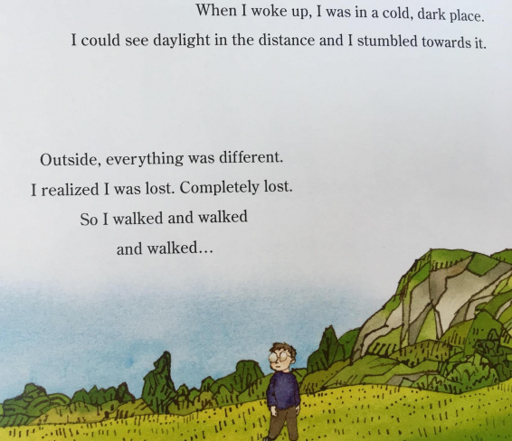
Repetition/Word Families
Look at the boy on this page.
How does he feel?
Adverbs of intensity
(Sort in order of intensity)
Collect words in the same family.
(e.g solve, solution, dissolve)
Try to include these like in the following sentence:
Soon I realised I was lost. Completely lost. Completely, utterly lost. I did not now how to solve this problem or make the problem dissolve. What was the solution?
Notes:
Soon I realised I was lost. Completely lost. Completely, utterly lost. I did not now how to solve this problem or make the problem dissolve. What was the solution?

