Slide 1
Monday the 28th February 2022
Day 1
LO: To explore and understand life in Stone Age Britain
Before starting the lesson could you write down something you would like to find out about the Stone Age.

Slide 2
Middle Stone Age
BBC Two - The Story of Britain, Middle Stone Age (animation)
Watch this animation about the Stone Age.
What do you notice about how people lived?
What did they do?
Where did they live?

Slide 3
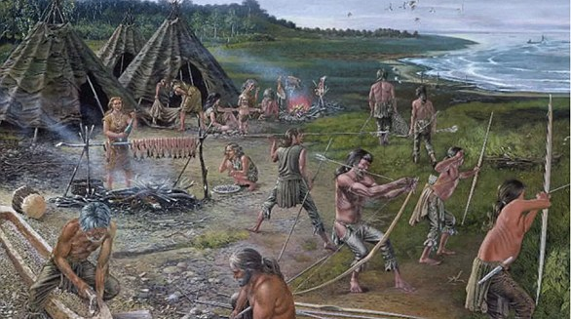
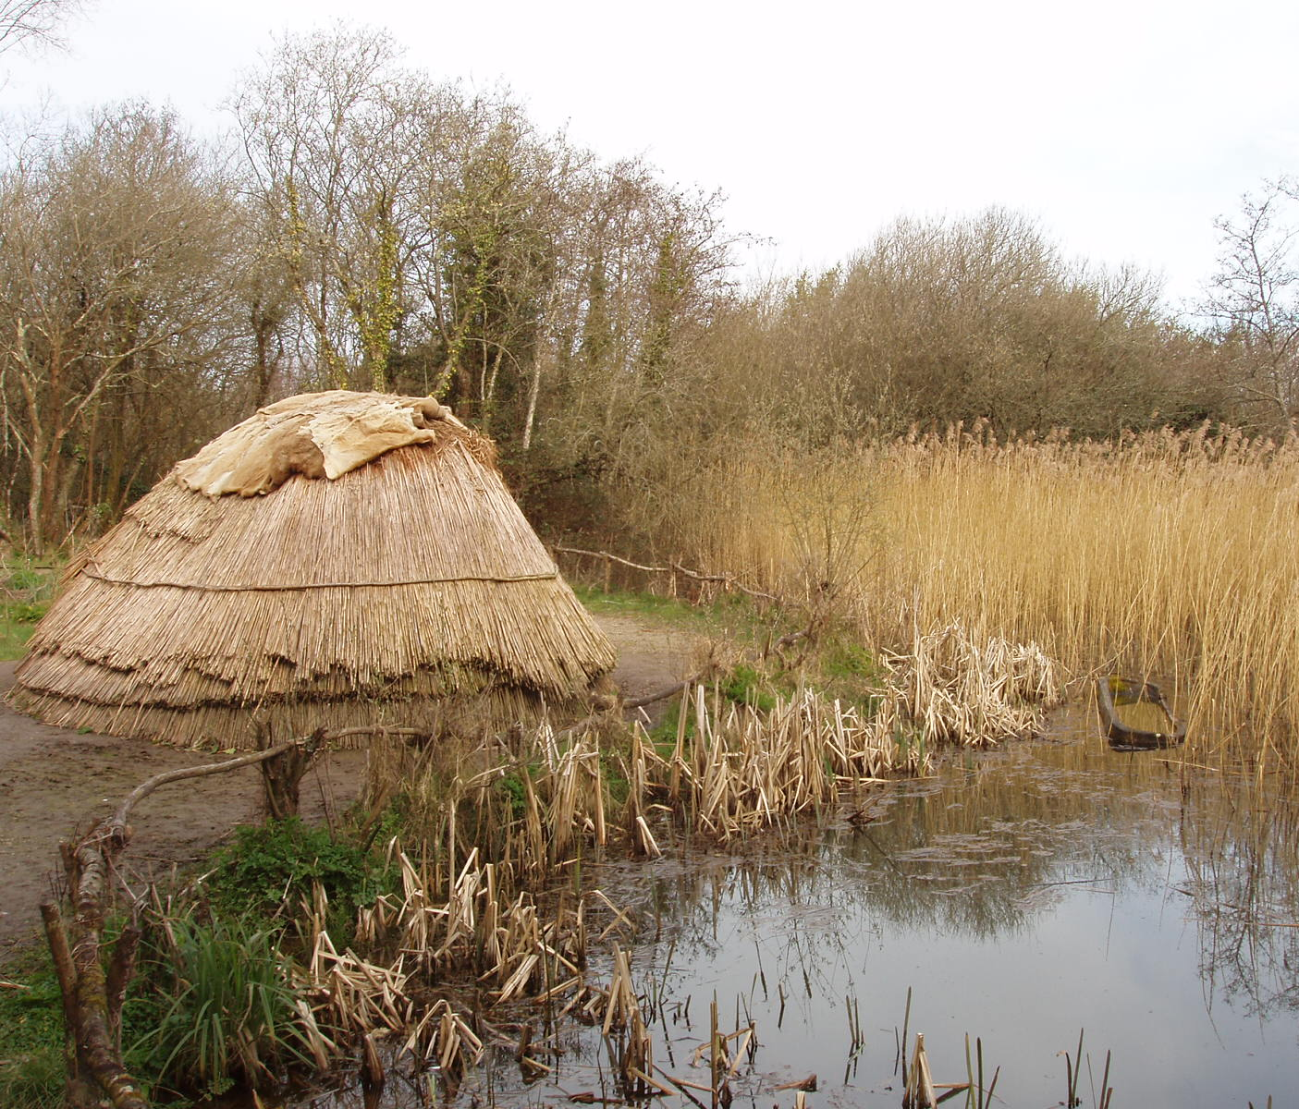
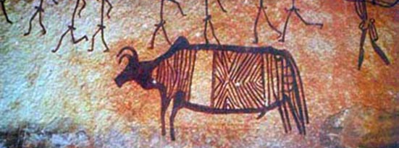
Mesolithic Period
What can you see?

Slide 4
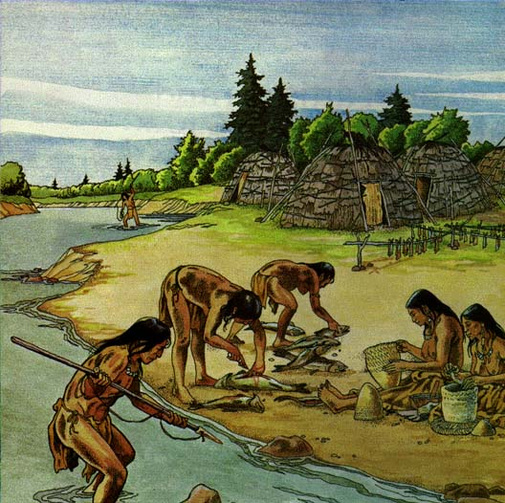
Mesolithic Period
During the Mesolithic period many people hunted wild animals and foraged for wild plants.
They lived in temporary homes (e.g. huts or caves) as they often had to move to find/follow their food.
Made clothes from animal skins.
Painted in caves.
Made weapons from wood and flint.

Slide 5
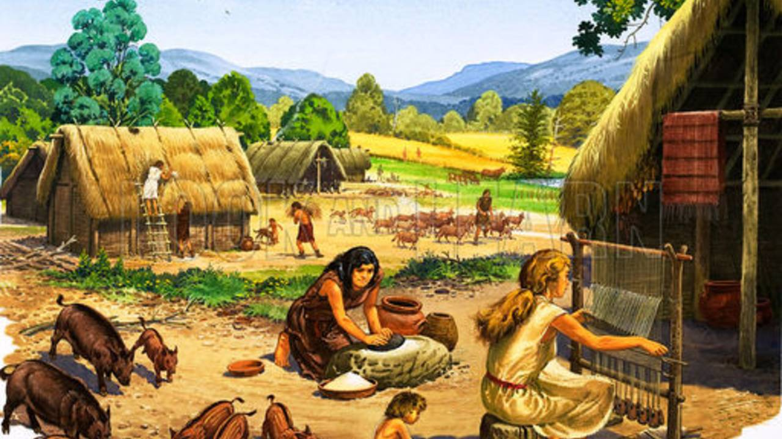
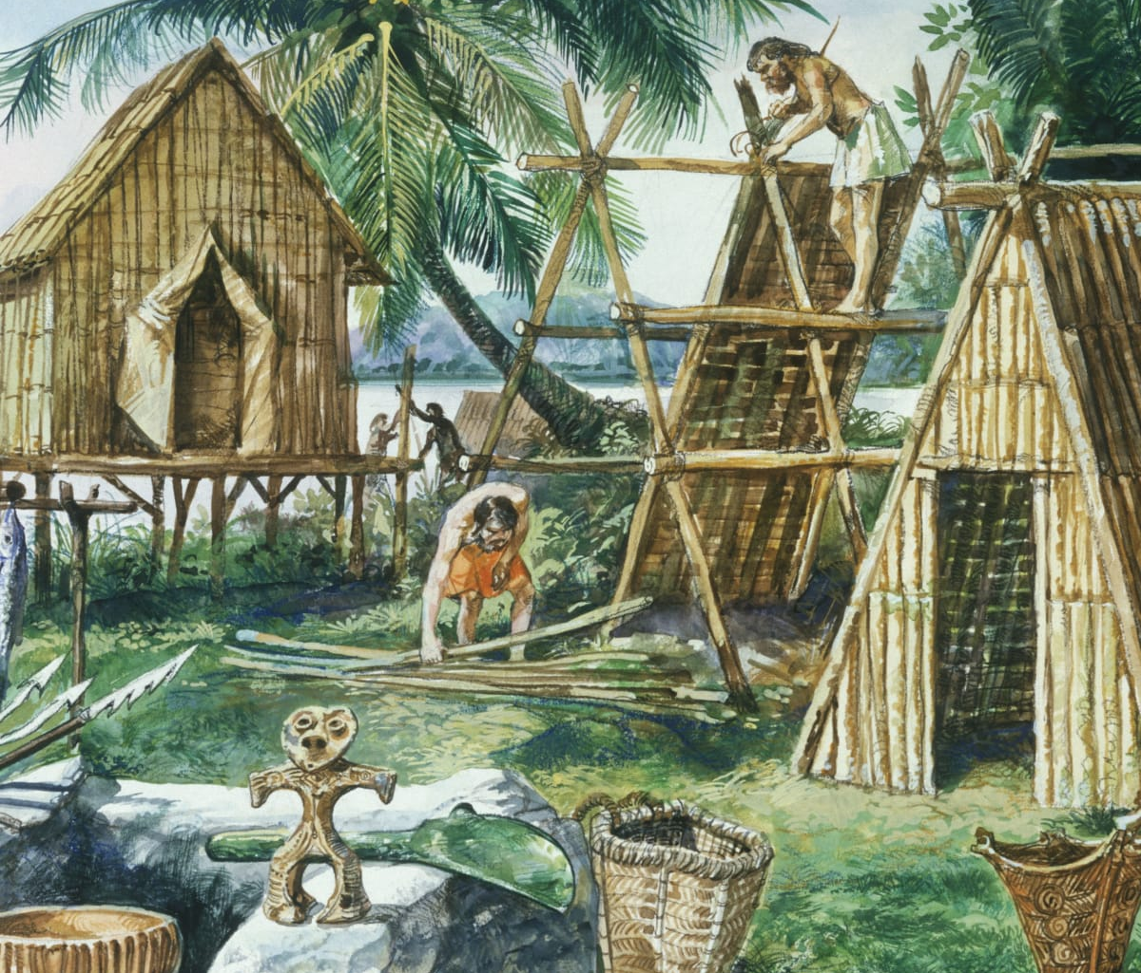
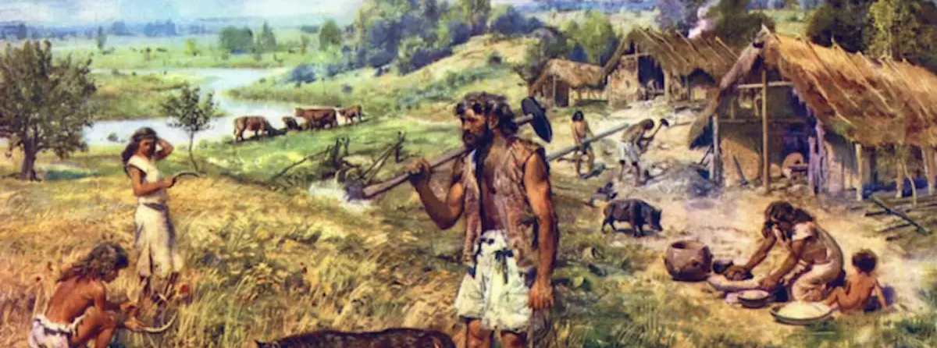
Neolithic Period
What can you see?

Slide 6
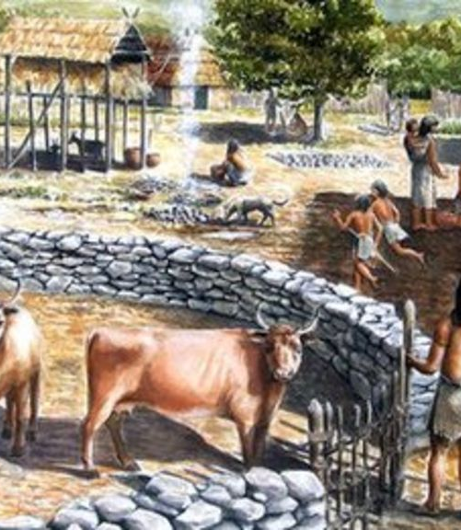
Neolithic Period
Domesticated animals to use as helpers or as food.
Began to farm.
Began to live in small settlements .
Built permanent homes where they stayed.
Made pottery and woven materials.
Still only had stone tools.

