Slide 1

Guided Reading Questions
The Legend of Kevin

Slide 2
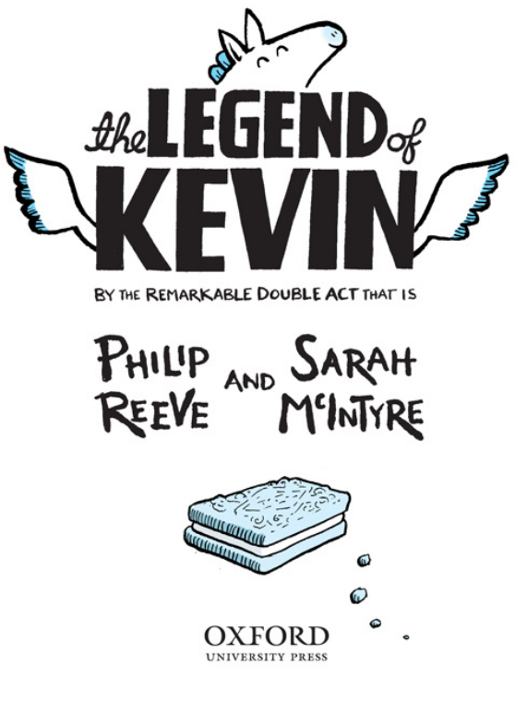
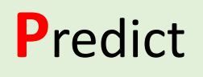
Front Cover
  Have a look at the front cover of this book. From the front cover what do you predict will happen in this story?
  What will happen?
  What characters will we meet?

Slide 3
If you had the chance to design the front cover what would it look like?
Can you design the front cover of this book.
What would you want it to look like?
How would you capture the readers eye?

Slide 4
Page 7 and 8
Q1 – Find and copy a phrase that suggests that the writer in talking to the reader.
Q2 - What 3 negative things do people say about Kevin?
Q3 - What impression of Kevin do you get from these pages?
Q4- What voice do you think Kevin might have?
You may have noticed that already, in which case you are Very Observant.
Slightly odd shape, wings are too small, and his tummy is too big.
Kevin seems like a very loveable character; he doesn’t worry about what other people think of him.

Slide 5
Page 9 and 10
Kevin is very messy.
He likes grass and apples but also biscuits, this tells me that he must be friends with people that often give biscuits to him.
The author uses pictures to help the reader imagine Kevin and what he likes.
The author uses pictures to help the reader imagine Kevin and what he likes.
Q1- What do the words large and untidy tell you about Kevin’s nest?
Q2- Have a look at Kevin’s favourite foods, what do they tell you about him?
Q3-How does the author engage the reader on page 9 and 10?
Q4- What impression of Kevin do you get from these pages?

Slide 6
Page 11, 12 and 13
Kevin, the mermaids and the Sea Monkeys.
Kevin huddled down in his treetop nest and squeezed his eyes tight shut against the rain.
High into the sky, far across the wild wet hills, over roads and rivers and all the way to where ordinary people lived.
Scared and confused
Q1- Who was affected by the terrible storm?
Q2- Find and copy the phrase that suggests that Kevin feared the storm?
Q3-What different places did the storm blow Kevin?
Q4-How do you think Kevin was feeling during this?
Q5- Where do you think he will end up? I think that Kevin will end up at a house where he becomes friends with some nice people.

Slide 7
Page 14 and 15
Q1- What jobs does Max’s mum and dad do?
Q2- Have a look at the drawings of Max and his family. What do you think they will be like?
Q3-Why do you think that the author has used pictures of the characters?
Q4-What do you think will happen next?

Slide 8
Comic Strip
Can you design a comic strip retelling us the events of the story so far?
What important things have happened so far?

Slide 9
What happens next?
From what happened at the end of the last chapter, what do you think will happen next?
Can you write a brief synopsis of what happens next in the story.
Maybe you could think about the ending as well.

