Slide 1
Friday the 4th March 2022
Day 4
LO: To use descriptive noun phrases, direct speech and adverbials.
Can you write down a sentence that includes a preposition.

Slide 2
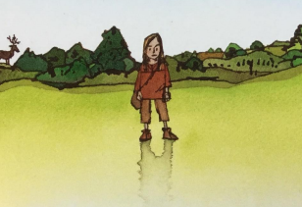
Adverbial
What adverbials could we use to say how/where he saw the girl?
Why do you think that the boy says ‘someone’ at first?
What other words could we use for someone?
Once you have some adverbials written down have a go at including them in a sentence like the following:
All of a sudden, I saw someone-a girl?
Notes:
All of a sudden, I saw someone – a girl?

Slide 3
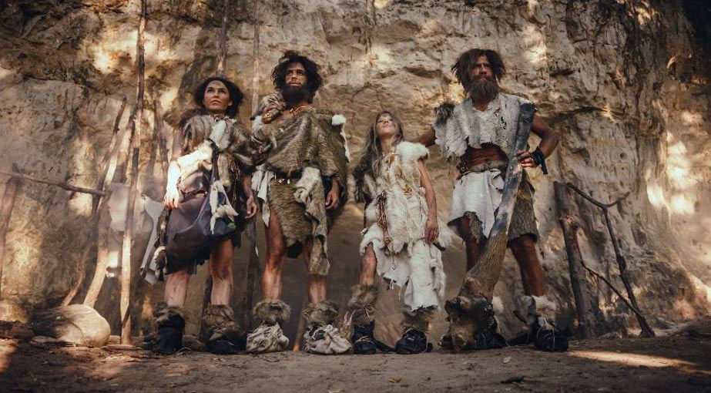
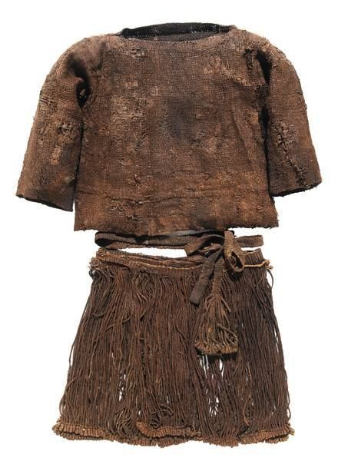
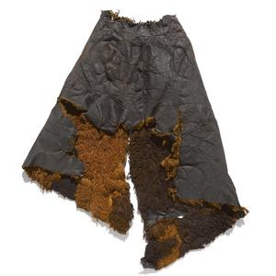
Noun Phrase
Look at the pictures of Stone Age clothing.
What might the girl have looked like?

Slide 4
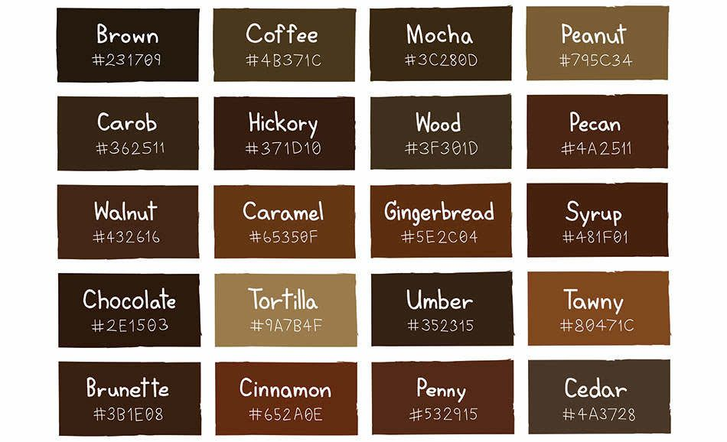
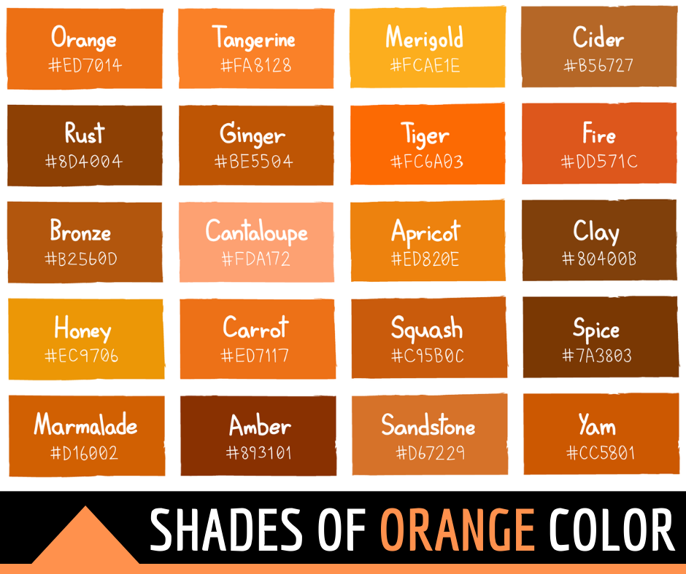
Noun Phrase
Look at this colour chart.
What different colours would Stone Age clothes been?
Now that you have a word bank for how the girl may have looked include them in the sentence like the following:
She wore a sandy-coloured tunic and her long, blonde hair was knotted and wild.
Notes:
She wore a sandy-coloured tunic and her long, blonde hair was knotted and wild.

Slide 5
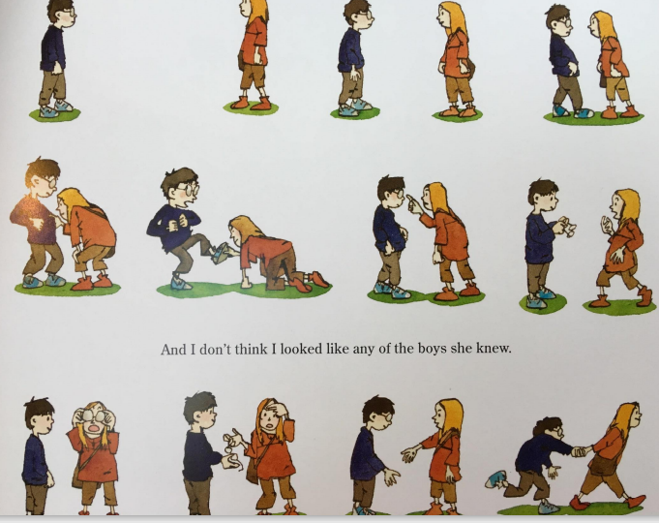
Direct Speech
Look at this page of the book.
Role play with a partner as the two characters.
What might they ask each other?
After role playing as the two characters try to include some direct speech in your next sentence like this:
“Hello! I’m Robert,” I managed. “What’s your name?” Then someone made a noise that sounded like ‘Om’.
Notes:
“Hello! I’m Robert,” I managed. “What’s your name?” Then someone made a noise that sounded like ‘Om’.

