Slide 1
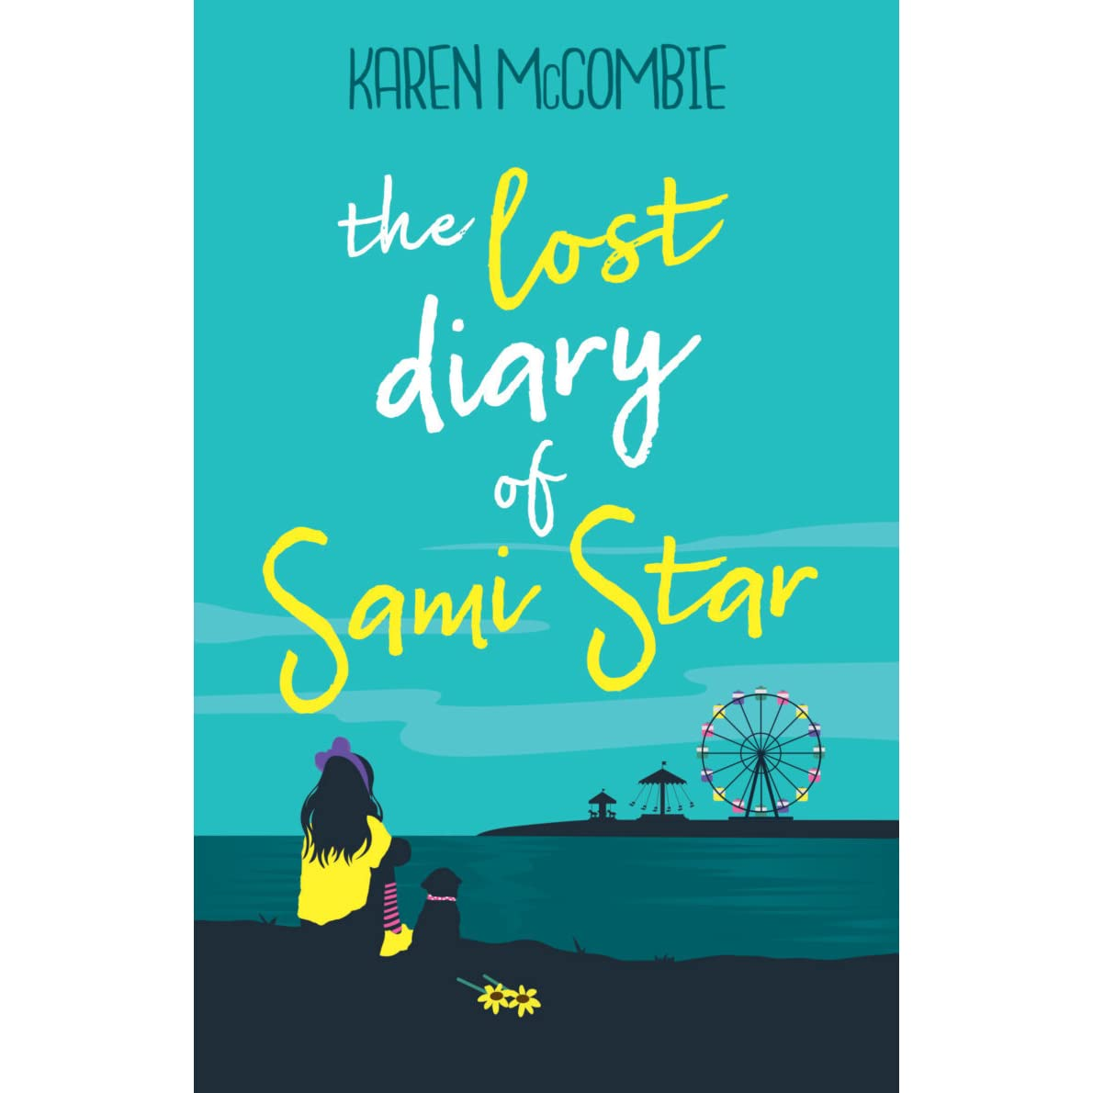
The Lost Diary of Sami Star

Slide 2
Page 1 & 2
Why does the author use the phrase ‘at it again’?
What do you think the relationship between Vix and her parents is like? What language suggests this?
How do you think Vix is feeling?
Why does the author describe the room as a war zone?
The phrase ‘at it again’ suggests that the family argue regularly.
I think that Vix and her parents disagree and argue about lots of things. The language nags, snaps, narks and growls suggests this.
I think Vix is feeling angry because she stormed out of the living room and whacked the door shut.
The author describes the room as a war zone because there are doors slamming and lots of arguments.

Slide 3
Page 3 & 4
What it Vix talking about when she says ‘They won’t let it go’?
Why do you think Mum and Dad want Vix to go to university?
Why did Vix shout?
Do you empathise with Vix?
Vix means that her mum and dad keep telling her that they would like her to go to university.
Mum and Dad want Vix to go to university because they think that she is very clever, they say that she is a total brainiac.
Vix shouted because she wanted her mum and dad to hear what she was saying to Hannah.

Slide 4
Page 5
Where do you think Vix could be going? Explain why she would be going there.
What does ‘stunned silence’ mean?
Why do you think that Mum and Dad are saying the same thing in the same frantic way?
Find 4 things in the text that tell us that Hannah is fed up.
Vix could have stormed out of the house to speak to her friends or another family member because she is frustrated with Mum and Dad.
Stunned silence means that someone is so shocked or surprised by something that they are unable to speak.
Mum and Dad keep saying the same things in the same frantic way because they really think that Vix should go to university.
Hannah is fed up because her parents don’t know that she got the lead part in the school play, Ms Barr is leaving to have a baby, she is finding Maths hard and that she has had a pain in her tummy.

Slide 5
Page 6
Why does the author describe the house as feeling ‘black and white’?
Do the arguments between Mum, Dad and Vix affect Hannah? How do they affect her?
Why does Hannah slip out of the door?
What do you think will happen in the rest of the story?
The author describes the house as feeling black and white because of the negative atmosphere caused by all of the arguments. The house is not a happy place.
The arguments do affect Hannah, she feels like there is a spotlight pointing at Vix and nobody notices her.
Hannah slips out of the door quietly because she doesn’t want her parents to hear her leave.

