Slide 1
Wednesday the 16th March 2022
Day 10
LO: To use noun phrases, synonyms and repetition.
Can you write down a sentence that uses repetition on your whiteboard.

Slide 2
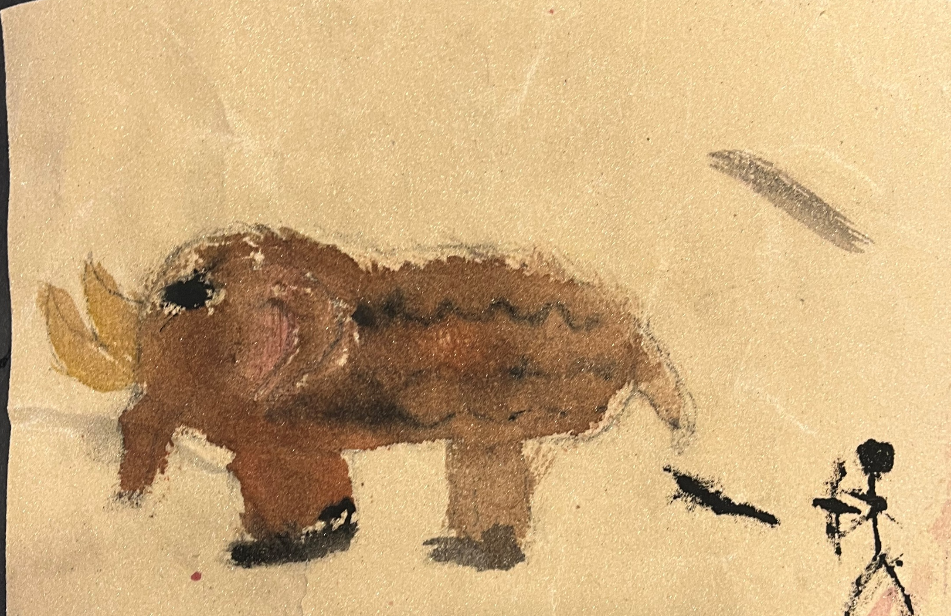
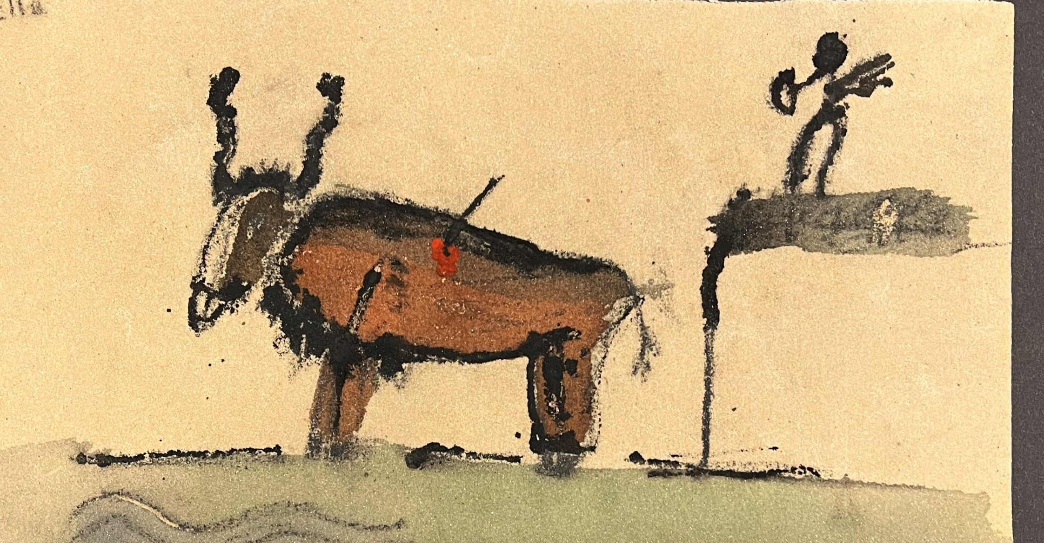
Noun phrase
Have a look back at the cave paintings that we made in Art.
What general phrases could we use to describe unknown groups of creatures?
Use the sentence below to help: One day, Om took me to a secret cave and taught me how to draw soaring sky birds, brutish beasts and lolloping land-walkers
Notes:
One day, Om took me to a secret cave and taught me how to draw soaring sky birds, brutish beasts and lolloping land-walkers.

Slide 3
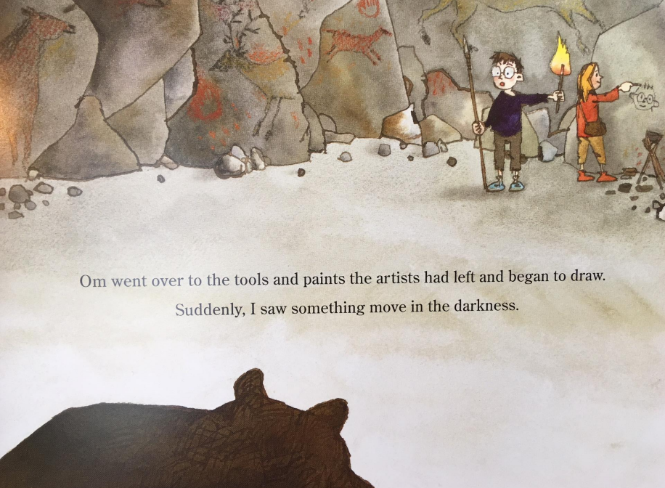
Synonyms
What words could we use to describe the shadow?
What words would make the shadow sound big and scary?
Use them in a sentence like this: While she was drawing, I glimpsed a shadow moving. A big shadow. A huge, dark shadow. A monstrous, ferocious shadow. A bear!
Notes:
While she was drawing, I glimpsed a shadow moving. A big shadow. A huge, dark shadow. A monstrous, ferocious shadow. A bear!

Slide 4
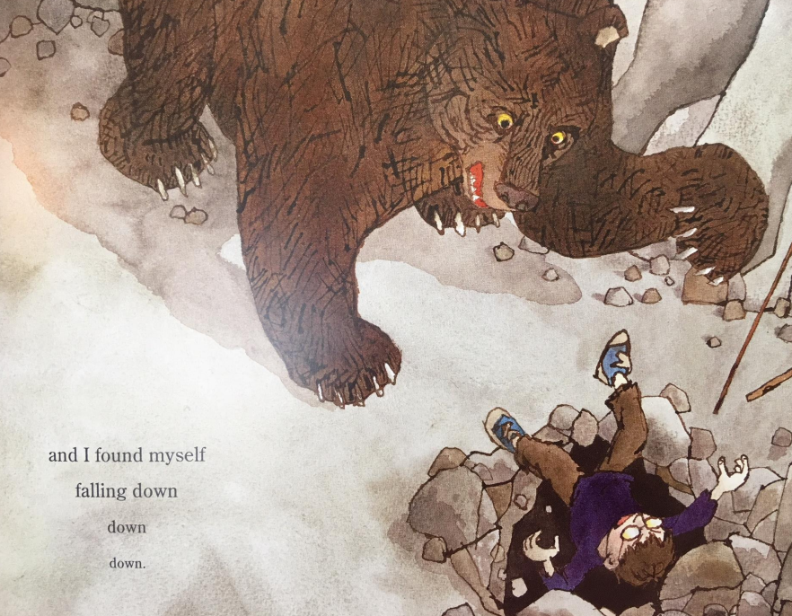
Repetition
Look at the page where the boy is falling.
We will be using repetition to show the boy falling like at the start of the story, the repetition will show the duration and depth of the fall.
Use the sentence below to help you:
I shouted at Om to run. Then, I tripped and found myself falling, down, down, down. When I awoke, I was back home. Fumbling in my pocket, my fingers clasped a smooth, cold stone. Flint!
Notes:
Provided sentence: I shouted at Om to run.
Teacher model: Then, I tripped and found myself falling, down, down, down.
Provided sentence: When I awoke, I was back home.
Teacher model: Fumbling in my pocket, my fingers clasped a smooth, cold stone. Flint!

