Slide 1
Friday the 11th March 2022
Day 9
LO: To use precise verbs, repetition and exclamation marks.
On your whiteboards write down a sentence that has onomatopoeic language.

Slide 2
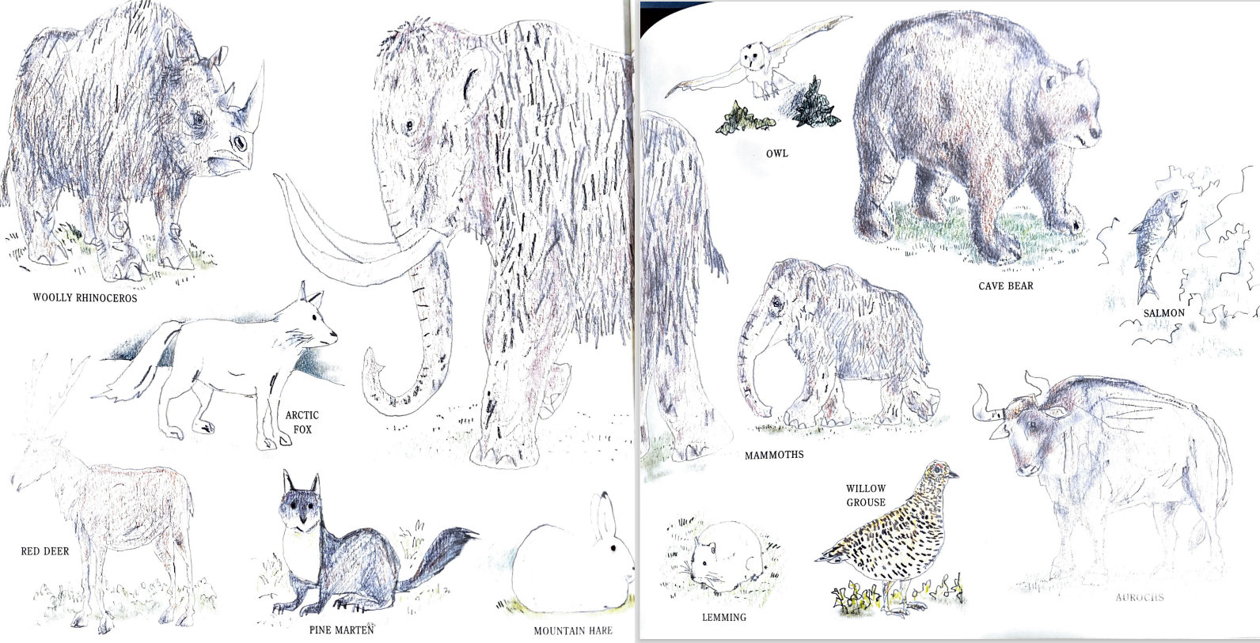
Precise Verbs
Look at the pictures of animals on the front and back pages.
What action words could we use to describe them?
Try to use a precise verb in your sentence like the following:
As the shadows began to lengthen, we spotted a reindeer grazing.
Notes:
As the shadows began to lengthen, we spotted a reindeer grazing.

Slide 3
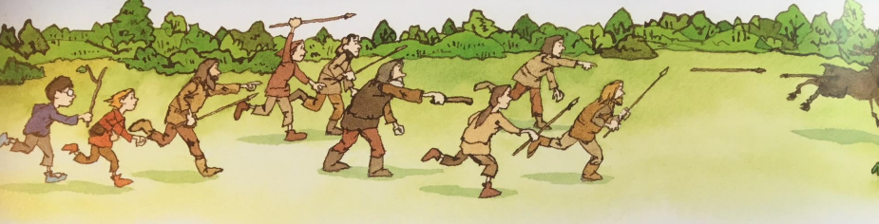
Repetition for effect
After you have some examples try to include them in your sentence like the following:
Spears flying, men shouting, ground shaking, we caught the reindeer.
What words could we use to describe the actions of the spears?
What other sounds would we hear as the men are hunting?
Notes:
Spears flying, men shouting, ground shaking, we caught the reindeer.

Slide 4
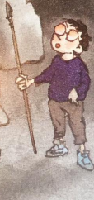
Exclamation mark
After hunting the reindeer what do you think the boy is thinking of the experience?
What would you be thinking if it was you?
Make sure you include an exclamation mark like this:
What an experience! I felt like a cowboy with his lasso, galloping across the plains!
Notes:
What an experience! I felt like a cowboy with his lasso, galloping across the plains!

