Slide 1
Thursday the 10th March 2022
Day 8
LO: To use time adverbials, similes and onomatopoeia.
On your whiteboards write down a sentence that has a simile.

Slide 2
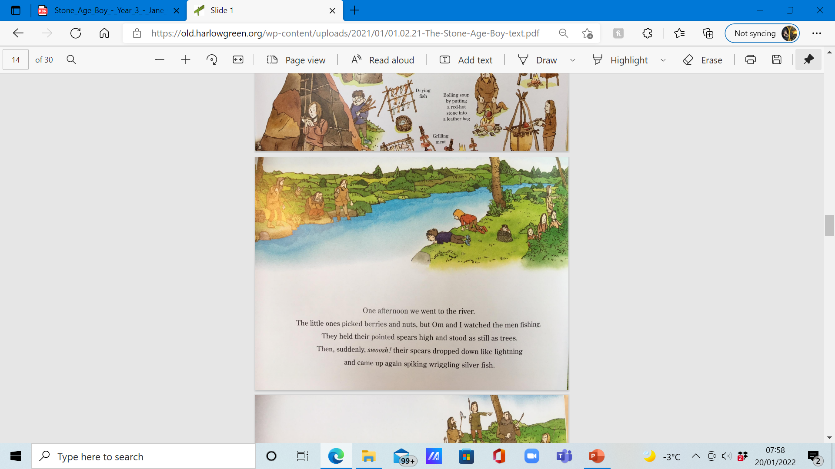
Time adverbial
Collect time adverbials that we can use at the start of our sentence.
Use the following sentence as an example:
One afternoon, we went to the river to watch the men fishing.
Notes:
One afternoon, we went to the river to watch the men fishing.

Slide 3
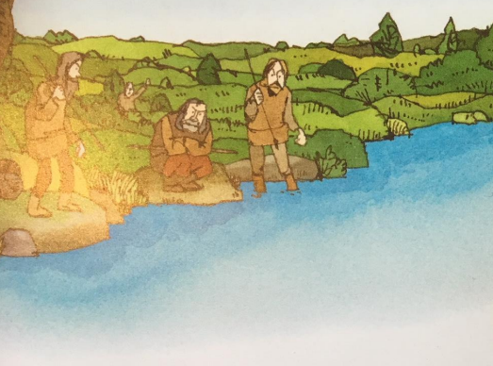
Simile
Gather similes to describe the stillness of the men trying to catch the fish in the river.
Include a simile in your sentence like the following:
They gripped their spears, perfectly still like soldiers waiting for battle.
Notes:
They gripped their spears, perfectly still like soldiers waiting for battle.

Slide 4
Role play
Imagine you are hunting fish in a river using a spear. Have a think about the actions you would make. How would you move?

Slide 5
Onomatopoeia
Gather action words to describe the motion of the spear
Collect onomatopoeic words to describe the sound
Collect words for the appearance and actions of the fish
Include these in your sentence, use the following example to help you:
Swoosh! Whoosh! Splash! Their spears pierced the water, plucking out the wriggling, wrestling, gleaming fish.
Notes:
Swoosh! Whoosh! Splash! Their spears pierced the water, plucking out the wriggling, wrestling, gleaming fish.

