Slide 1
Wednesday the 9th March 2022
Day 7
LO: To use time adverbials, verbs and similes.
On your whiteboards write down a sentence that uses alliteration.

Slide 2
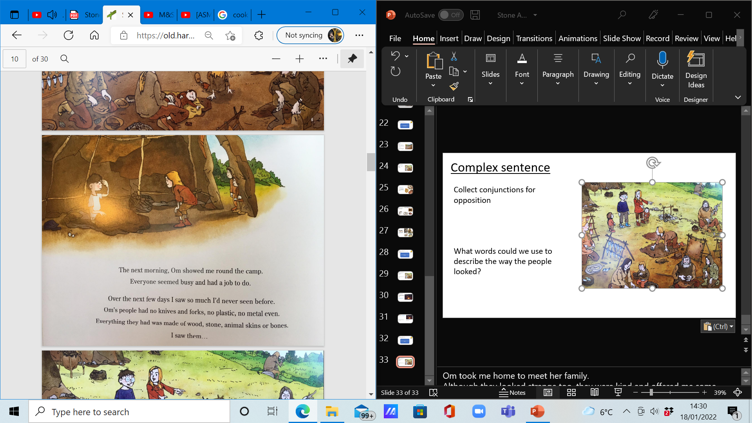
Time adverbial
What time adverbials can you think of?
Include a time adverbial in your sentence like the following:
Early the following morning. Om showed me around the camp.
Notes:
Early the following morning. Om showed me around the camp.

Slide 3
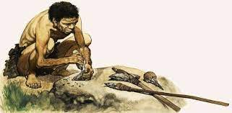
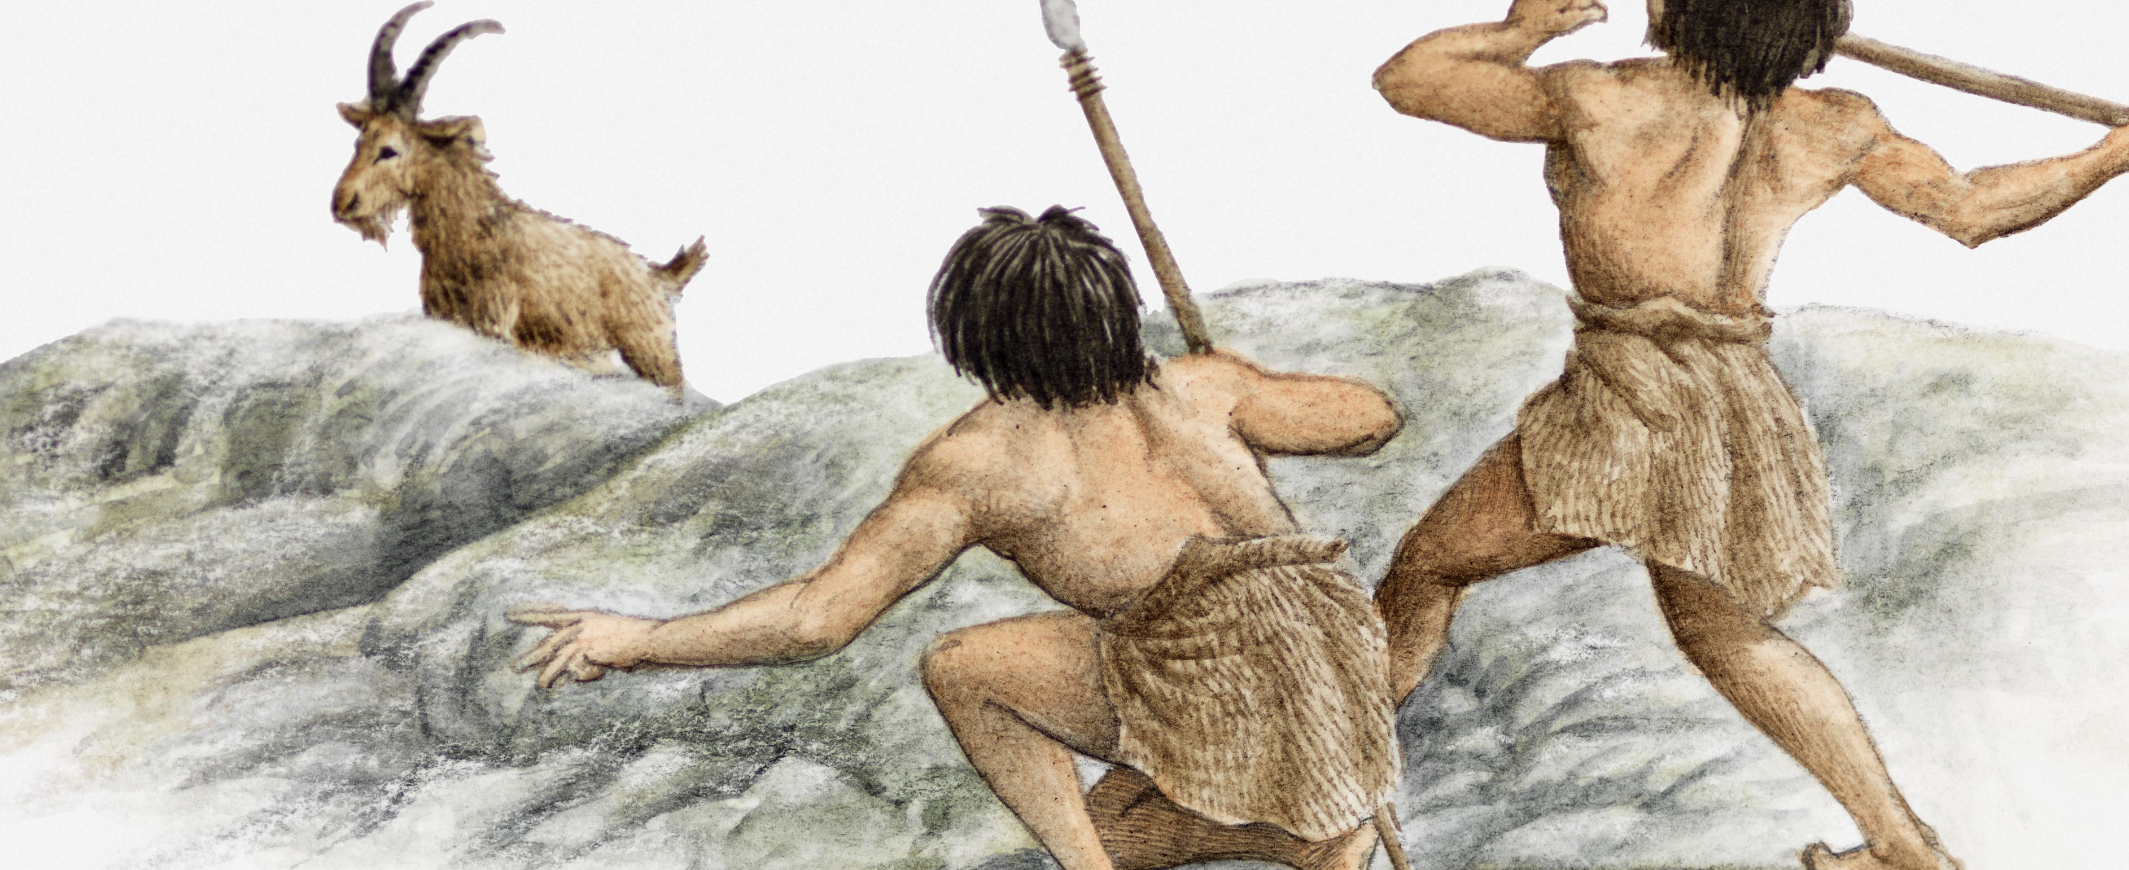
Three verbs
Have a look back at some of the tasks that people during the stone age had to do.
What were some of the different tasks?
Once you have a list of tasks try to include them in a sentence:
People busied themselves: striking flint to make flames: skinning deer to make caramel-coloured clothes and shaping bones to make exquisite jewellery.
Notes:
People busied themselves: striking flint to make flames: skinning deer to make caramel-coloured clothes and shaping bones to make exquisite jewellery.

Slide 4
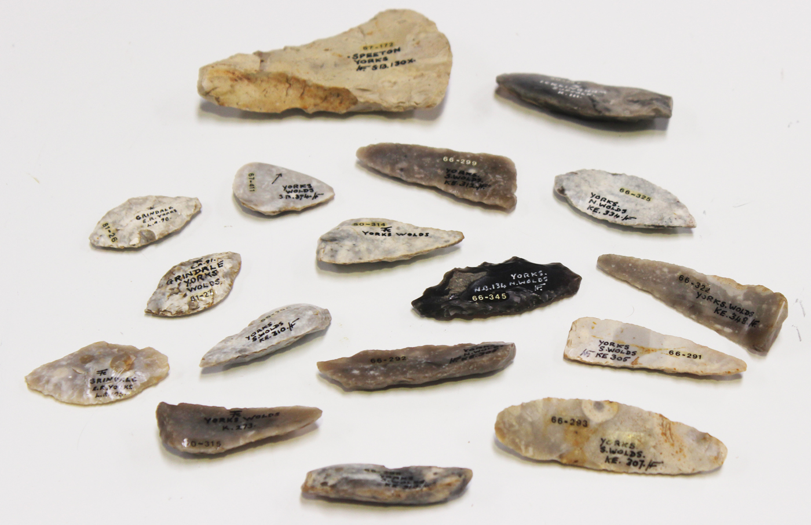
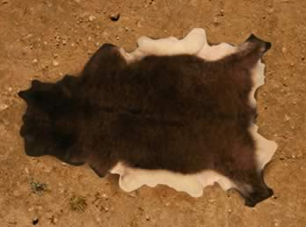
Simile
Have a look back at some of the materials that people during the stone age used.
What were some of the different materials?
How could you use a simile to make the sentence sound better?
When you have a list of different materials include them in your sentence (see if you can use some similes as well):
Om’s people had none of the materials we have today. Everything was made of wood, stone, animal skins or bone.
I wrapped myself in a thick mahogany auroch’s skin, feeling its soft warmth like a rug laid at the feet of the rising sun.
Notes:
Om’s people had none of the materials we have today. Everything was made of wood, stone, animal skins or bone.
I wrapped myself in a thick mahogany auroch’s skin, feeling its soft warmth like a rug laid at the feet of the rising sun.

