Slide 1
Tuesday the 8th March 2022
Day 6
LO: To use and understand a complex sentence, onomatopoeia and alliteration.
On your whiteboards write down a sentence using onomatopoeia.

Slide 2
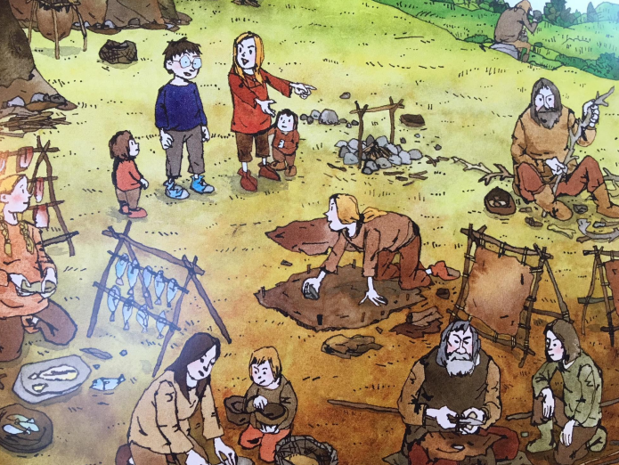
Complex sentence
Collect conjunctions for opposition.
What words could we use to describe the way the people looked?
Incorporate these words in a sentence like the following:
Om took me home to meet her family.
Although they looked strange too, they were kind and offered me some food.
Notes:
Om took me home to meet her family.
Although they looked strange too, they were kind and offered me some food.

Slide 3
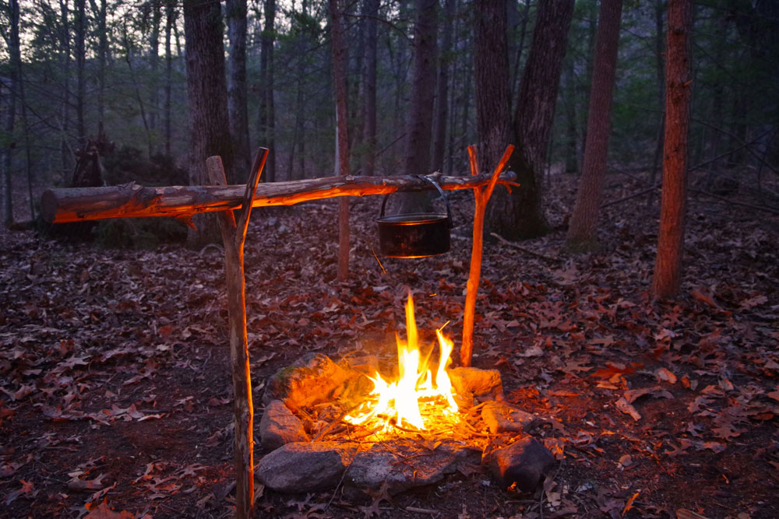
Onomatopoeia
After listening to the sound of food cooking on a campfire what onomatopoeic words can you think of?
Try to use the onomatopoeic words in a sentence like this:
We gathered around the campfire. Crackle! Hiss! Pop!
[ASMR] One Hour of Soothing Grill Sounds – Sizzling Meat - YouTube
Notes:
We gathered around the campfire. Crackle! Hiss! Pop!

Slide 4
Alliteration
M&S | Beef Traceability TV Advert 2018 - YouTube
What do we do when we are hungry?
What types of food were eaten during the Stone Age?
What adjectives could we use to describe the food?
Now you have examples of each try to put them all together like this:
I licked my lips at the thought of the succulent steaks, the crispy, chunky chops and the fresh, flavoursome fish.
Notes:
I licked my lips at the thought of the succulent steaks, the crispy, chunky chops and the fresh, flavoursome fish.

