Slide 1
Monday the 7th March 2022
Day 5
LO: To understand how people lived in the Stone Age.
On your whiteboards write down a sentence that includes a noun phrase.

Slide 2
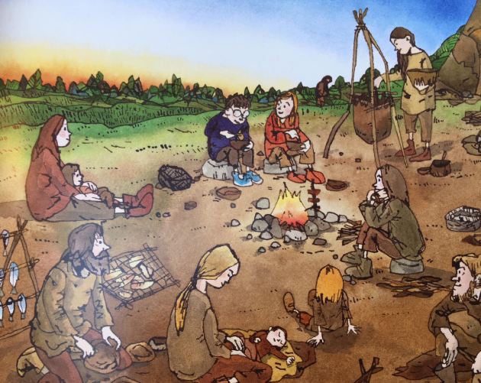
Campfire
Look at this picture from the book.
I want you to imagine you are around this campfire and freeze.
Think about:
What would they have eaten? How would they have cooked? What utensils would they have used?
Freeze frame being around a campfire.

Slide 3
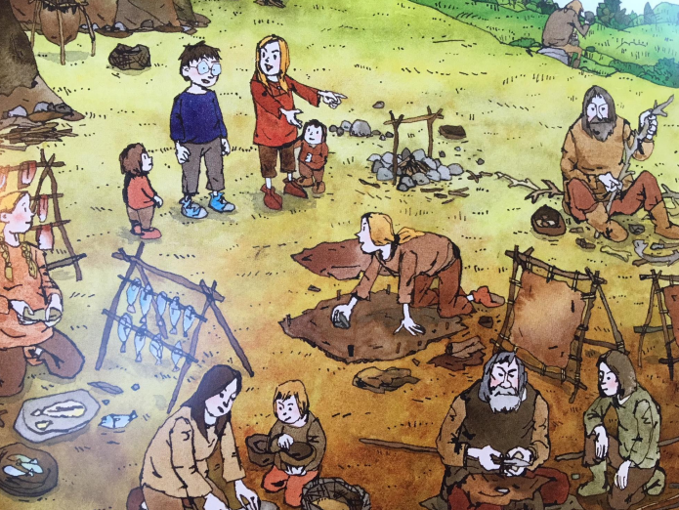
Cave Drawings
Look at this picture from the book.
What do you think these people are doing?

Slide 4
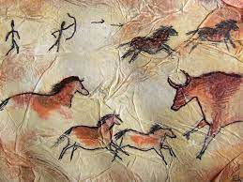
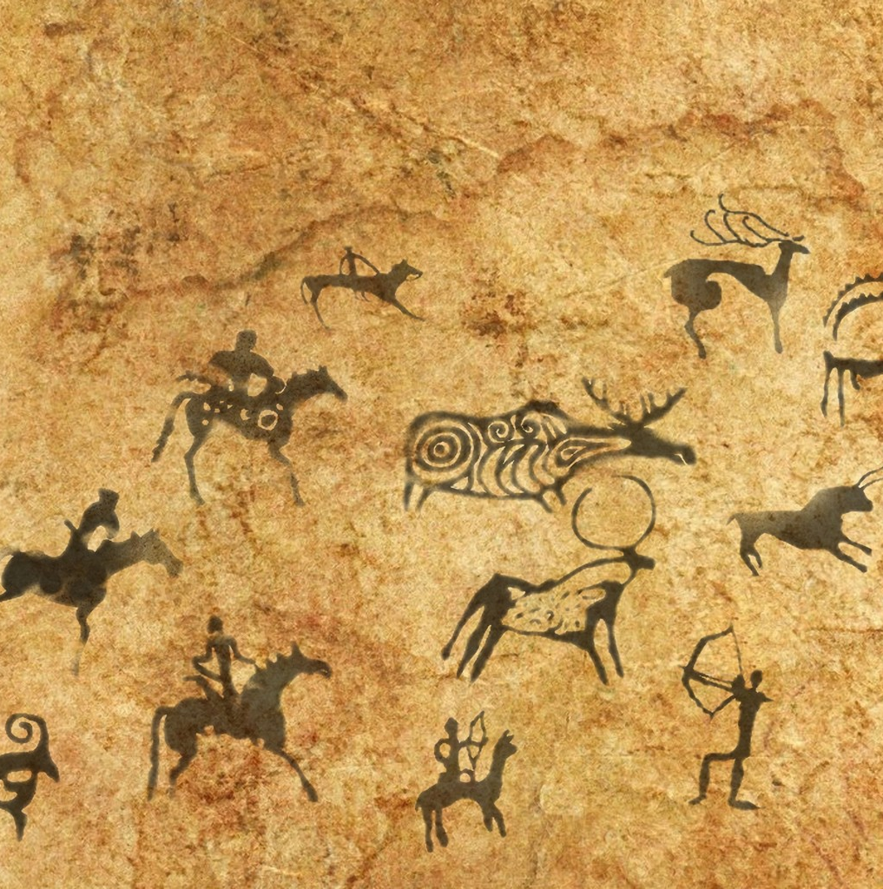
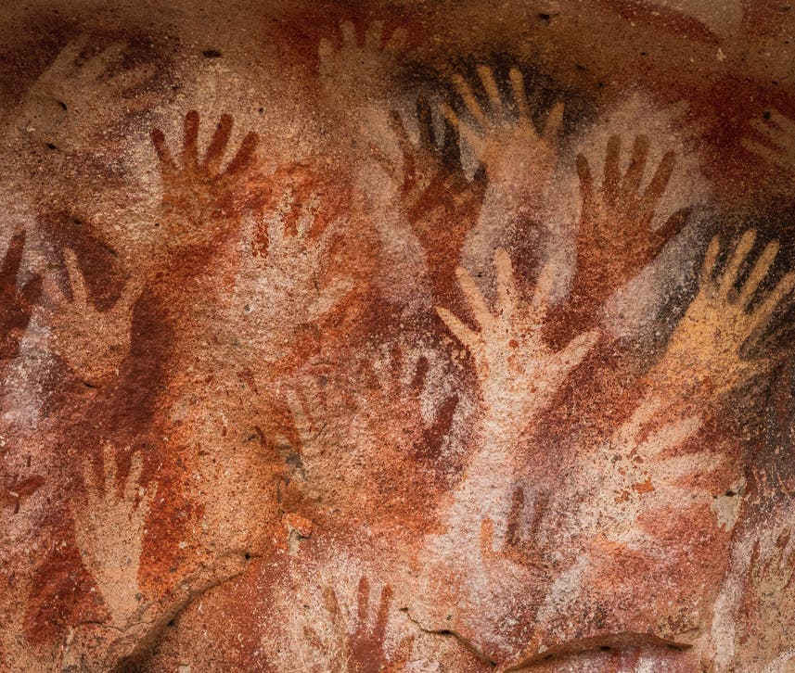
Cave Drawings
Look at these pictures of cave drawings that have been uncovered in various places.

Slide 5
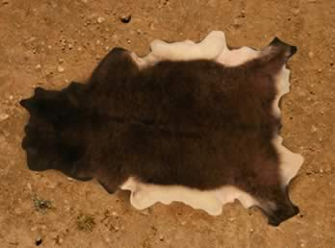
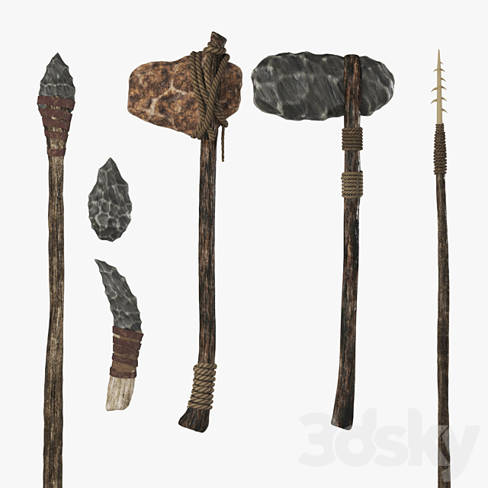
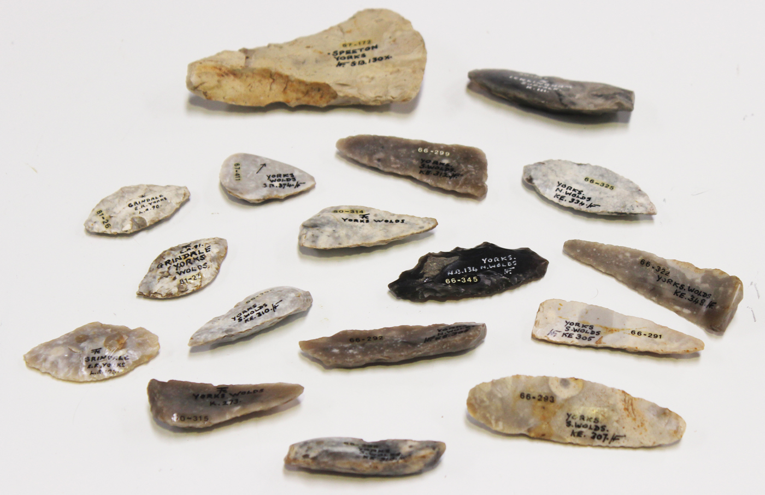
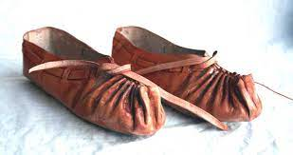
Exploring materials
Look at the different materials that were used by people that lived in the Stone Age.
What words could we use to describe these materials?
(Make a word bank of adjectives to use for next lesson)

Slide 6
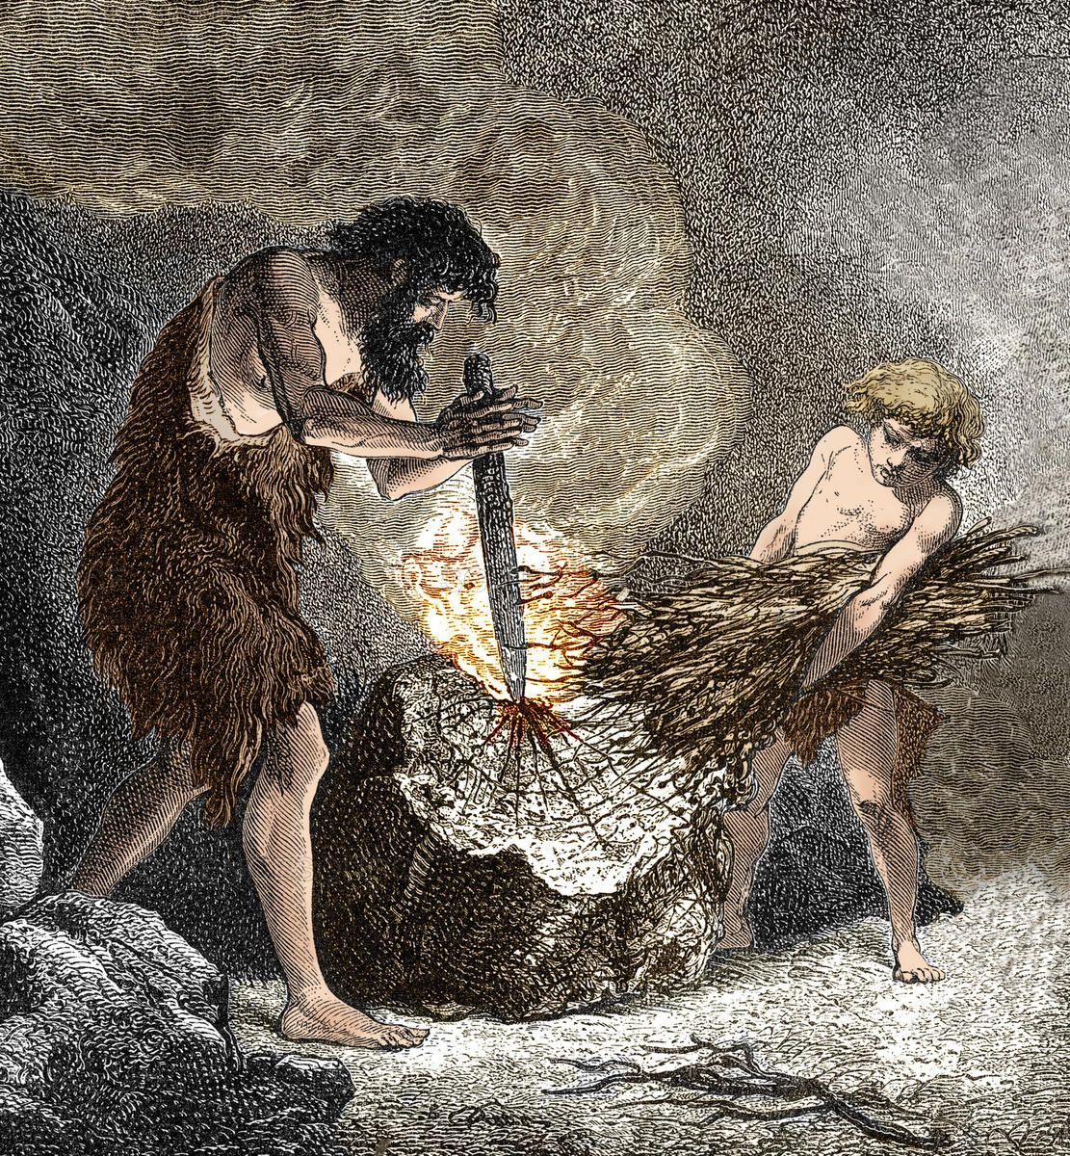
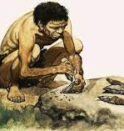
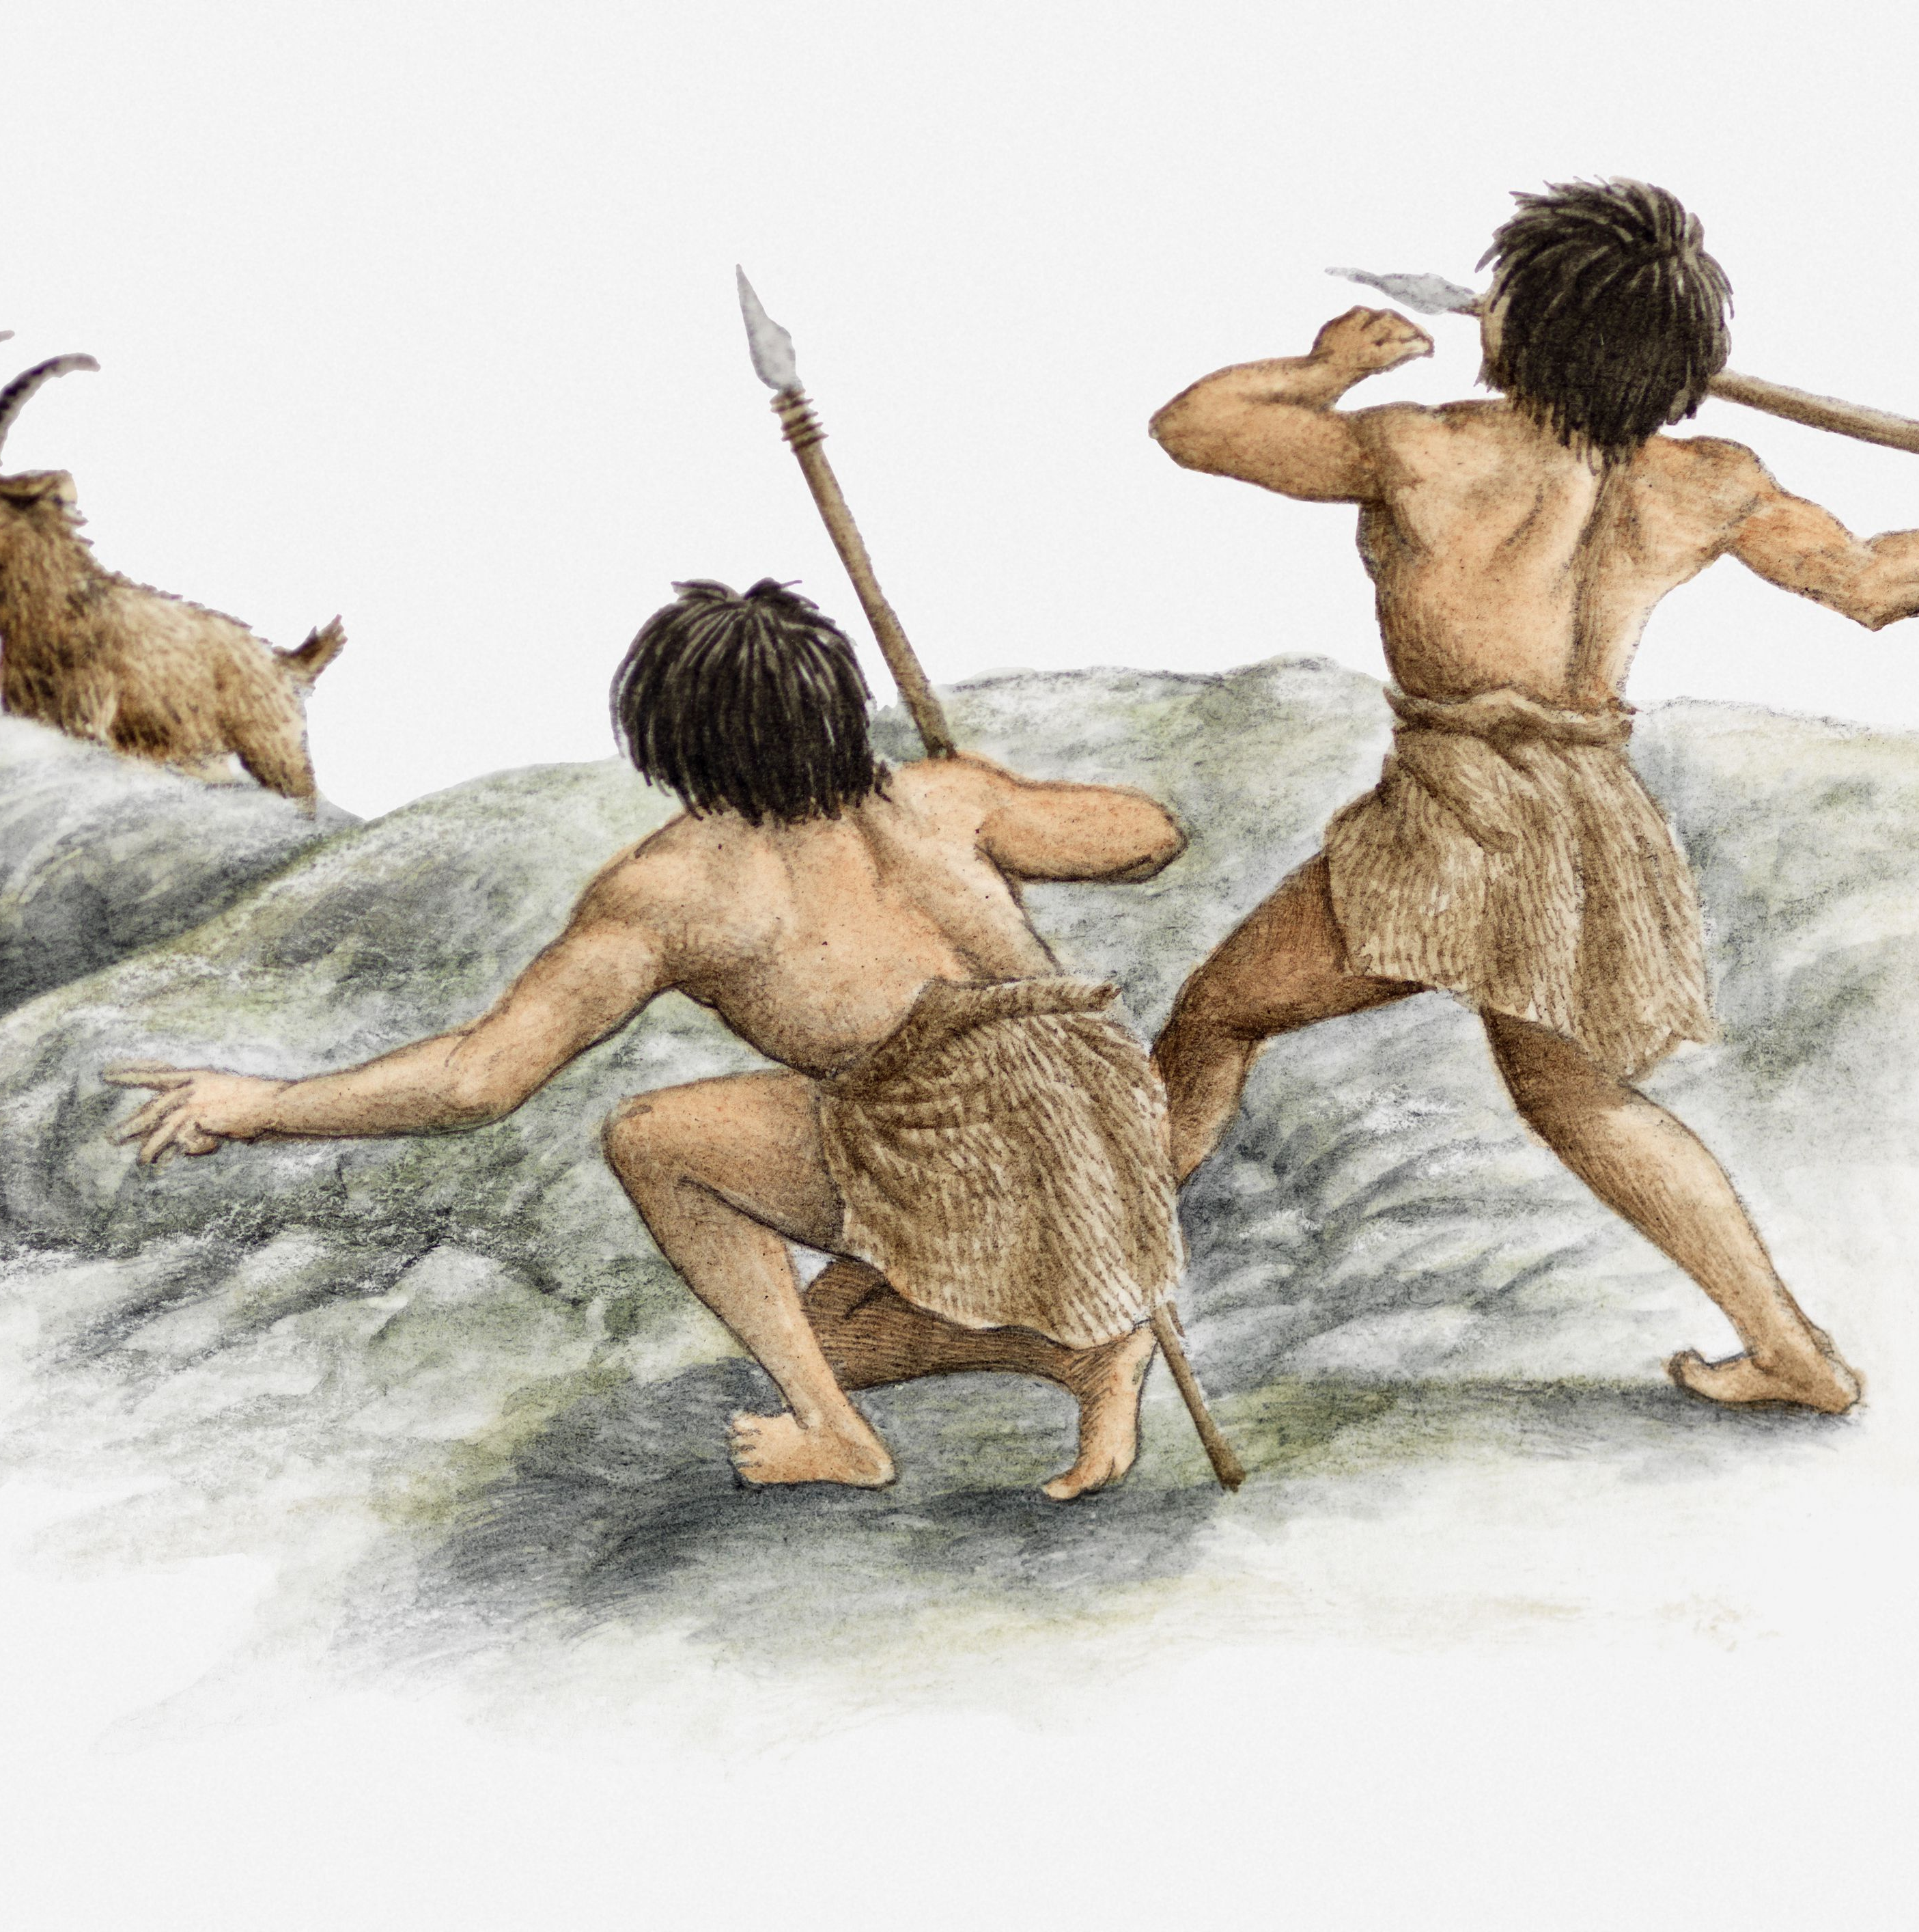
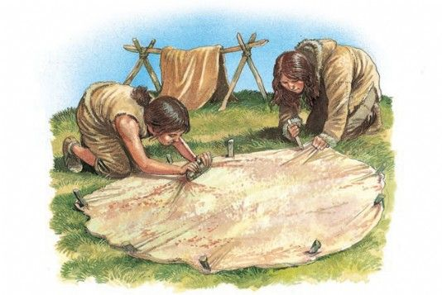
Daily Tasks
During the Stone Age people had to do a bunch of different jobs. Do you recognise some of these?

