Slide 1
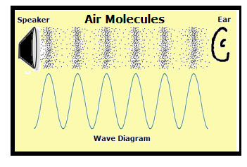
Year 4: Sound Knowledge Mat
Subject Specific Vocabulary |  |  | Sticky Knowledge about Sound
vibrating | Sound is caused by the vibration of a medium (usually air) and it travels in waves.
 |  |  | Sound travels with a speed of 767 miles per hour but it cannot travel through a vacuum.
pitch | A high sound has a high pitch and a low sound has a low pitch. A tight drum skin gives a higher pitched sound than a loose drum skin.
 |  |  | Sound comes from vibrations. These vibrations create sound waves which move through mediums such as air and water before reaching our ears.
volume | Volume is the perception of loudness from the intensity of a sound wave. The higher the intensity of a sound, the louder it is perceived in our ears, and the higher volume it has.
 |  |  | Dogs can hear sounds at a higher frequency than humans.
insulation | Protecting something by surrounding it with material that reduces or prevents the transmission of sound.
 |  |  | Our ear drums vibrate in a similar way to the original source of the vibration, allowing us to hear many different sounds.
outer, middle and inner ear | The ear is made up of three different sections: the outer ear, the middle ear, and the inner ear. These parts all work together so you can hear and process sounds. | Important facts to know by the end of the sound topic:
 |  | Know how sound is made. Know how sound travels from the source to the ears. Know to associate sound with vibration. Know the correlation between pitch and the object producing a sound. Know the correlation between the volume of a sound and the strength of the vibrations that produced it. Know what happens to a sound as it travels away from its source. | When traveling through water, sound moves four times faster than when it travels through air.
cochlea | The cochlea looks like a spiral-shaped snail shell deep in your ear. It plays an important part in helping you hear.
auditory | Auditory is close in meaning to acoustic, but auditory usually refers more to hearing than to sound. |  | Sound is used by many animals to detect danger, warning them of possible attacks before they happen.
frequency | Frequency is measured as the number of wave cycles that occur in one second.
sound wave | Another word for the vibrations which cause sound |  | The loud noise you create by cracking a whip occurs because the tip is moving so fast it breaks the speed of sound!
vacuum | A space where there is nothing. There are no particles in a vacuum.

