Slide 1
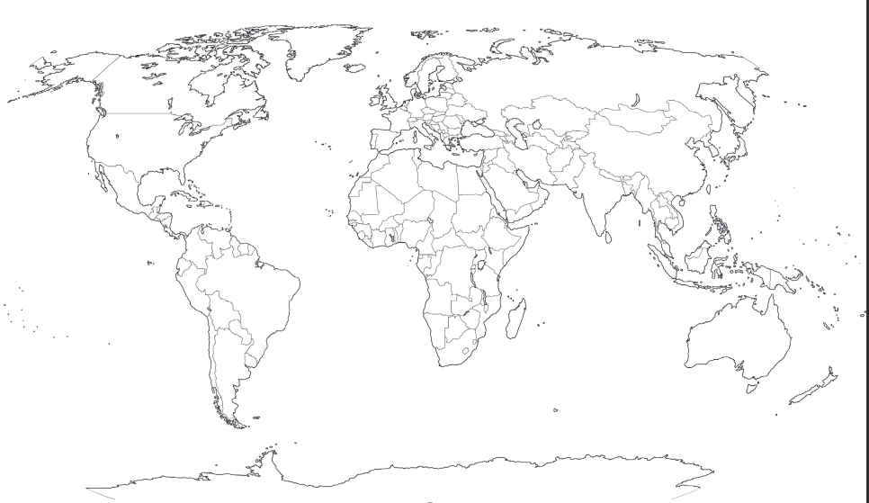
Date
L.O. To use an Atlas to find the countries that Paddington has visited.
Country | Colour
England
Peru
Australia
China
Egypt

