Slide 1
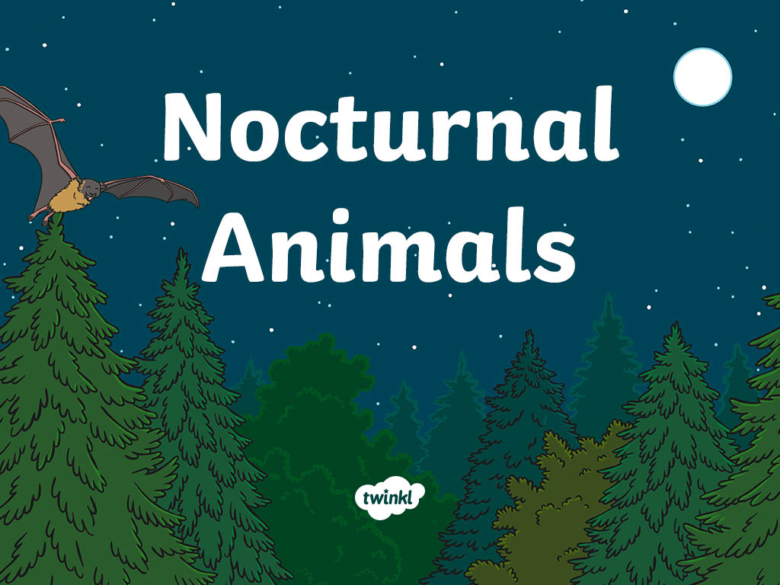

Slide 2

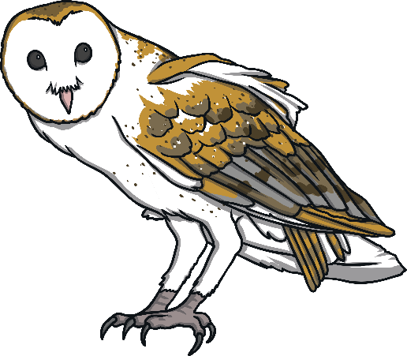
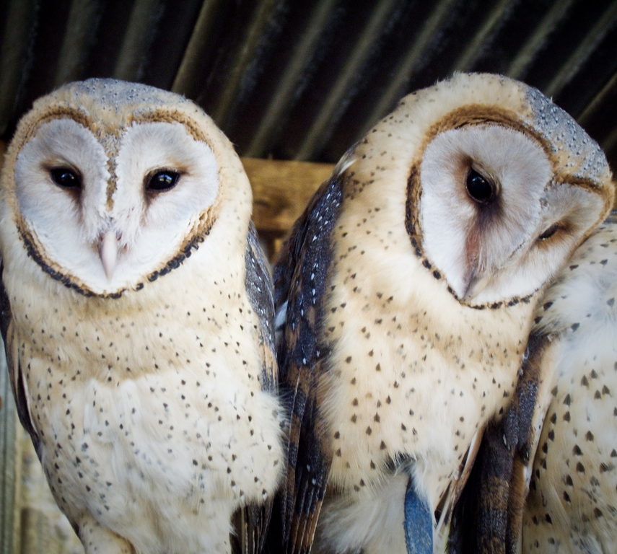
Owl
This bird waits, listens and watches for prey then swoops down. Their large facial disk and the position of their ears, helps them focus sounds and locate their prey.

Slide 3
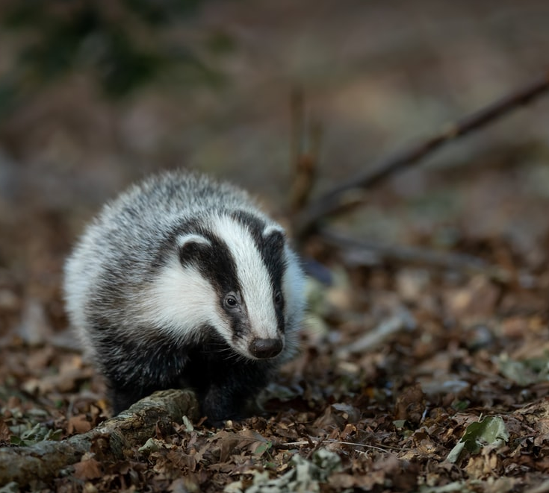

Badger
Badgers live in setts under the ground and come out at night. They have very poor eyesight and a very good sense of smell and hearing.

Slide 4
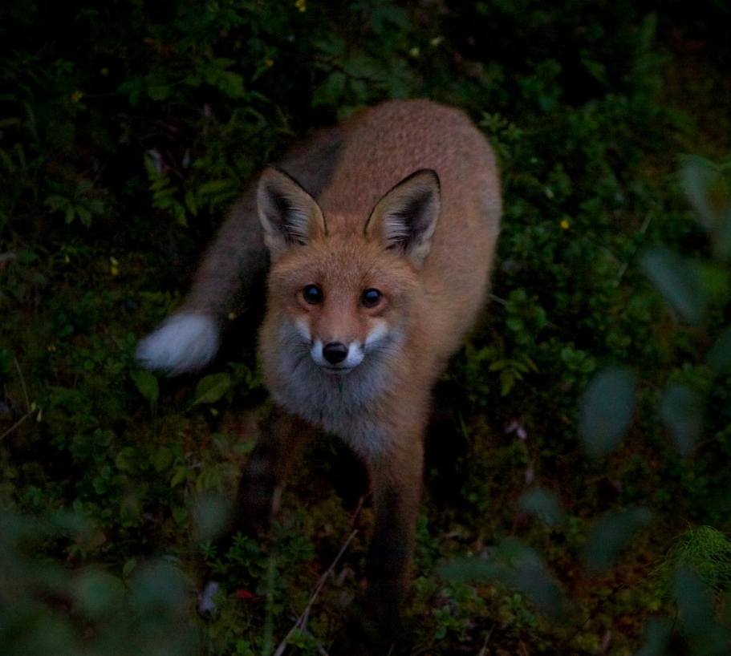
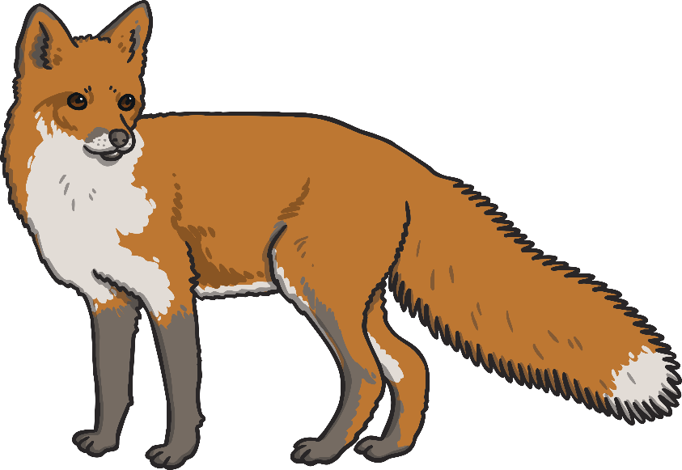
Fox
The red fox has tendencies to become nocturnal in areas of human interference, for example, cities.
Foxes are more active at night and twilight and hunt alone.

Slide 5
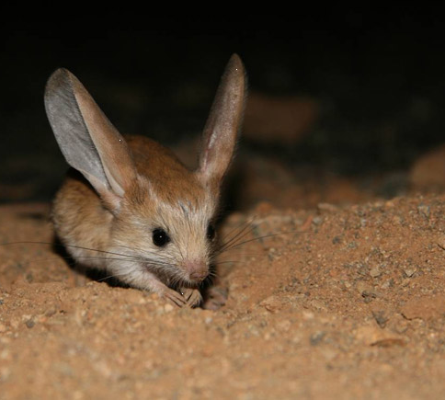

Long-eared Jerboa
The long-eared jerboa is a nocturnal, jumping rodent that feeds mainly on insects, and lives in the Gobi desert in temperatures ranging from
-40 to +40.

Slide 6

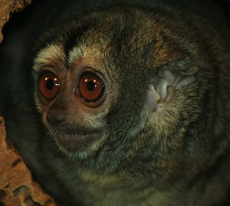
Night Monkey
This night monkey has big brown eyes, helping his ability to be active at night.
They are called night monkeys because they are the only truly nocturnal monkey.
“Is There Anybody Out There....” by GollyGforce is licensed under CC BY 2.0

Slide 7
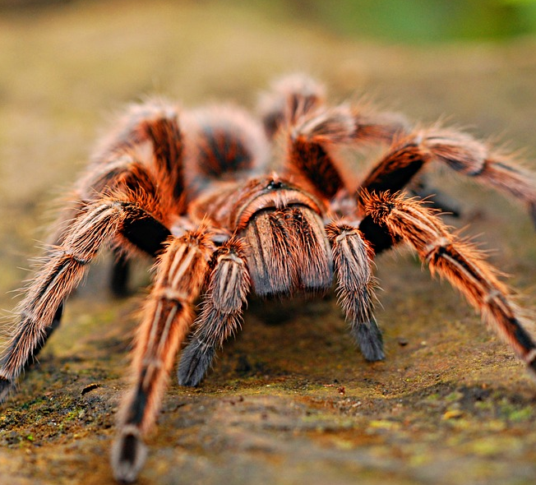
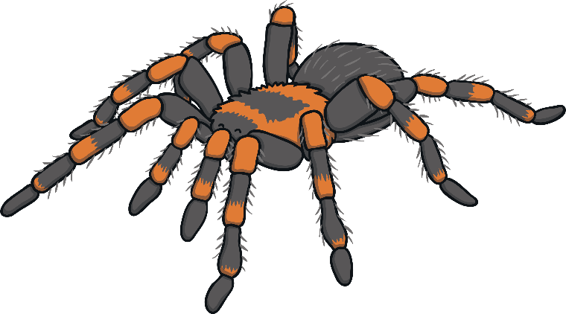
Tarantula
Tarantulas are nocturnal,
avoiding bright light and direct sunlight.
They live in a small, dark holes in the ground and are mostly active at night.

Slide 8
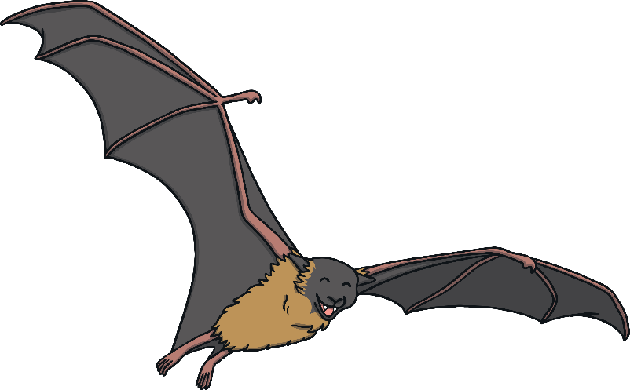
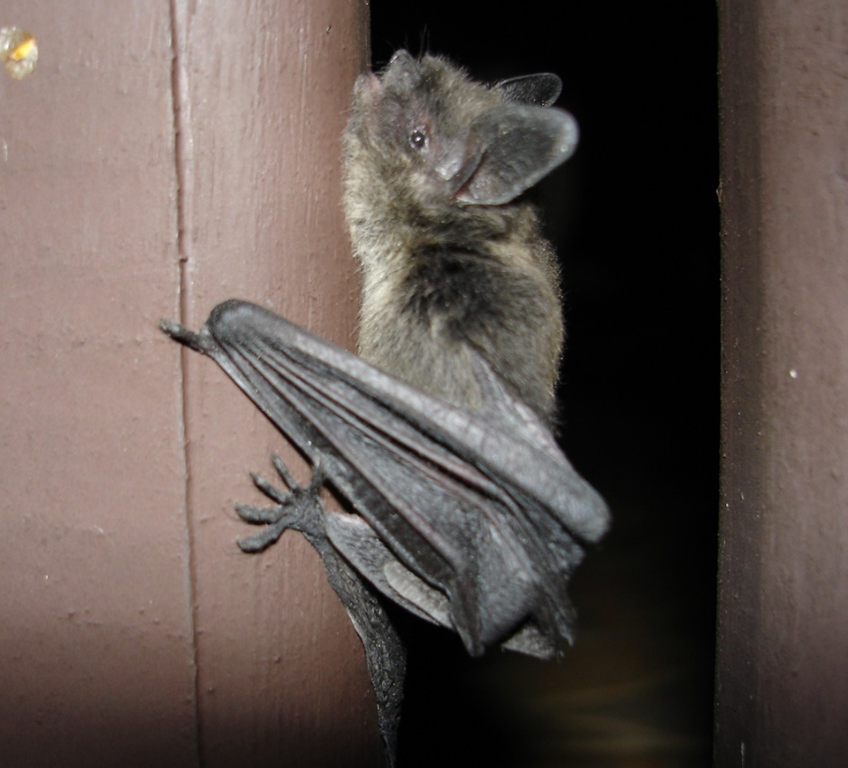
Bat
Most bats are active at twilight or at night. Bats locate their prey using sonar, so they do not need daylight to hunt.
It is common for bats to retreat to caves during the winter and hibernate for six months.

Slide 9


