Slide 1
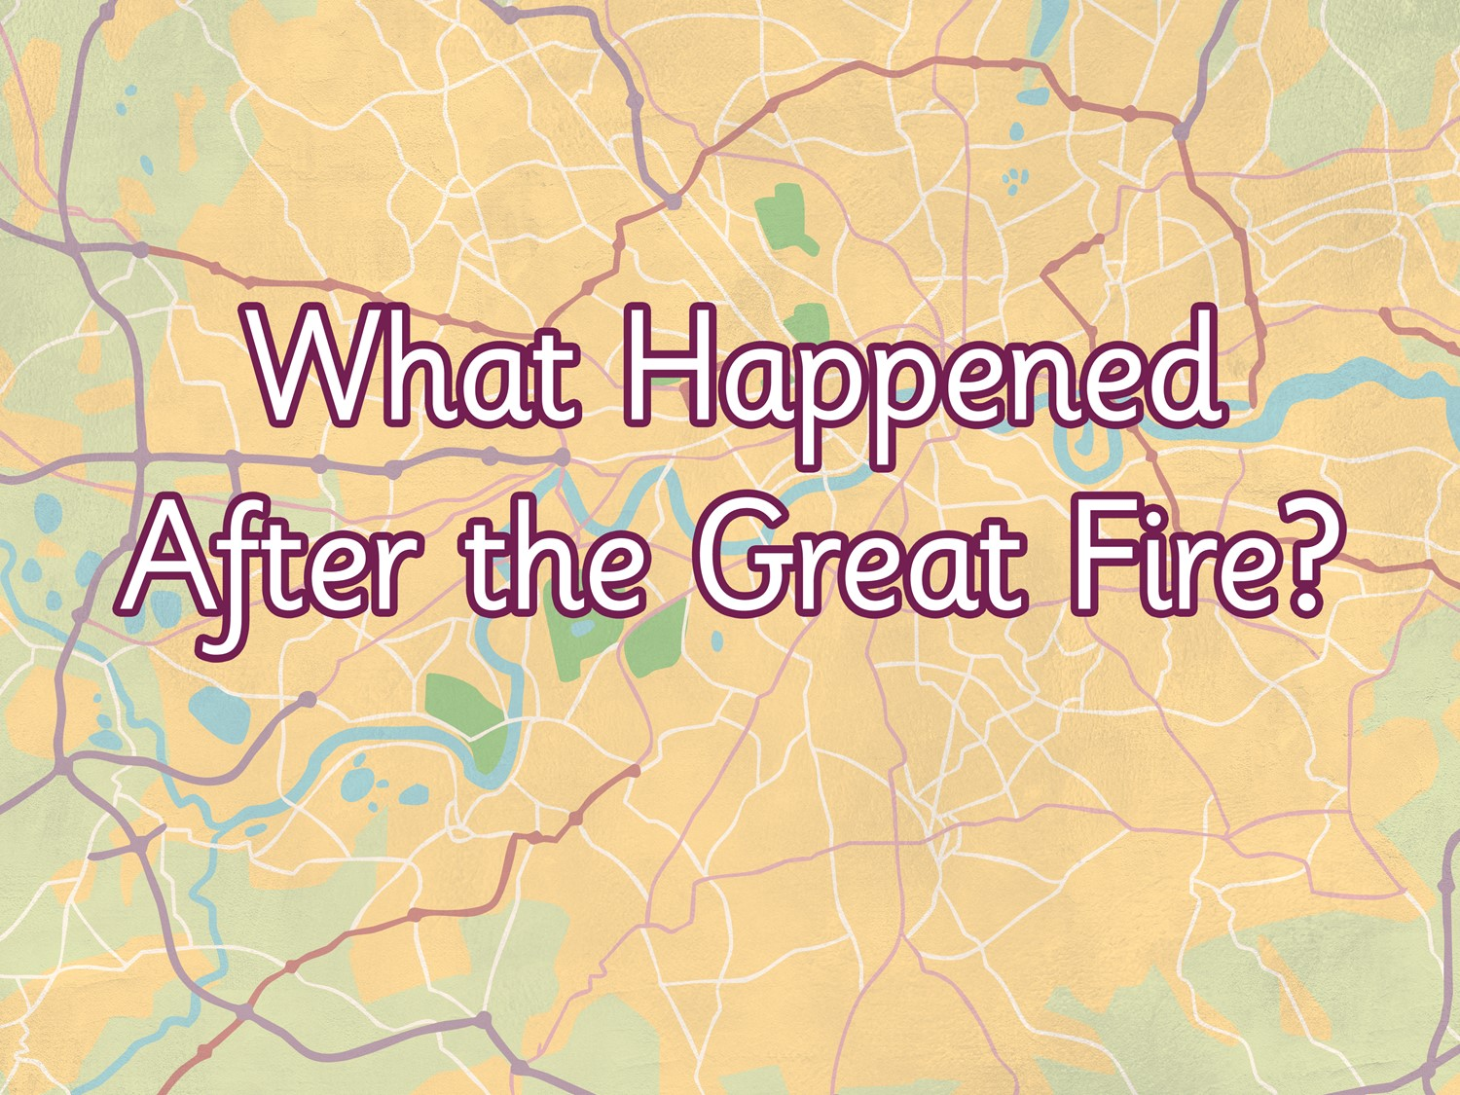


Slide 2
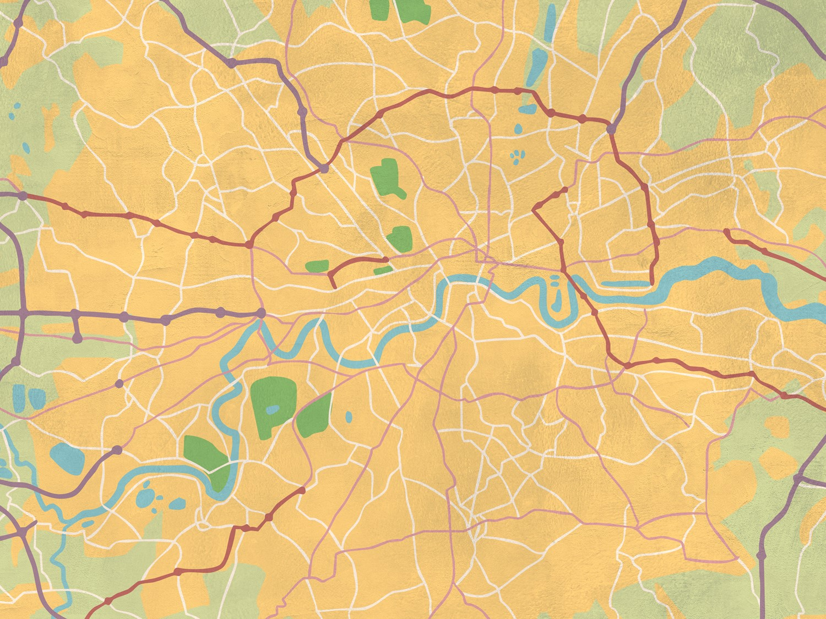
Aim
I can find out how London was rebuilt after the Great Fire
Success Criteria
I can create a poster showing my ideas about how London could have been rebuilt after the Great fire
I can describe the ways in which London was rebuilt

Slide 3

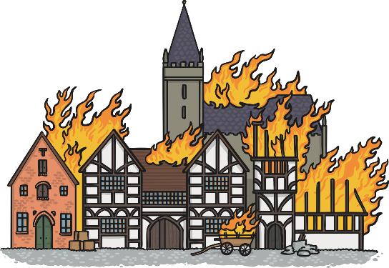
Why did the Great Fire eventually stop?
Houses in London’s streets were built very close together and made from wood. Many of these houses had been pulled down to stop the fire spreading between them.
The wind had stopped so it wasn’t spreading the fire anymore.
In some areas, the ground was so hot it took several days before people could walk there again!
At least 65,000 people were left homeless and without their belongings. London needed to be rebuilt.

Slide 4

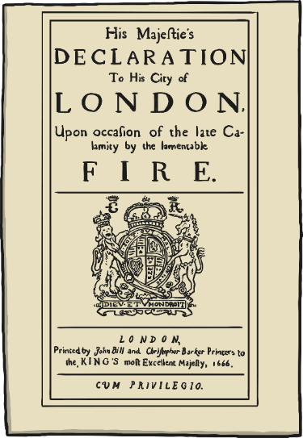
What Happened Next?
Who made the decisions about what happened next to London?
Who do you think decided what happened
to London in 1666?
King Charles II?
The Lord Mayor?
Architects?
King Charles II made a speech to the people of London; the details are this declaration from 1666. he praised the courage of the people who tried to put out the fire. He also said that he wanted to rebuild the city and make plans to ensure another disaster like this could not happen again.

Slide 5
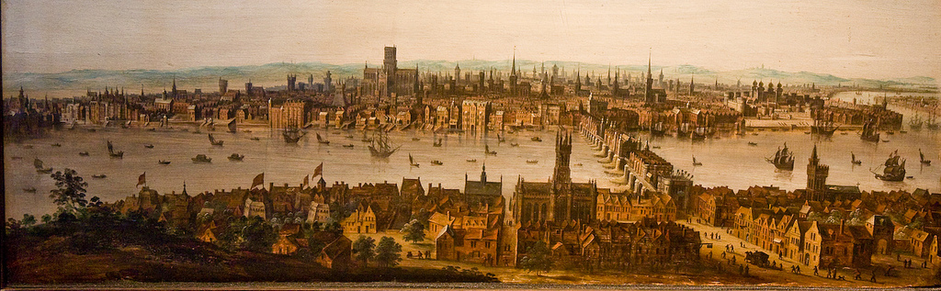
How would you rebuild London?
This is a painting of London before the fire. The houses are made from wood, often leaning into the streets and tightly packed together.
Photo courtesy of Fred Dawson (@flickr.com) - - granted under creative commons licence – attribution
What was dangerous?
What could make the new houses safer?
What could be done to make the streets cleaner?
What could be done to make the streets safer?

Slide 6
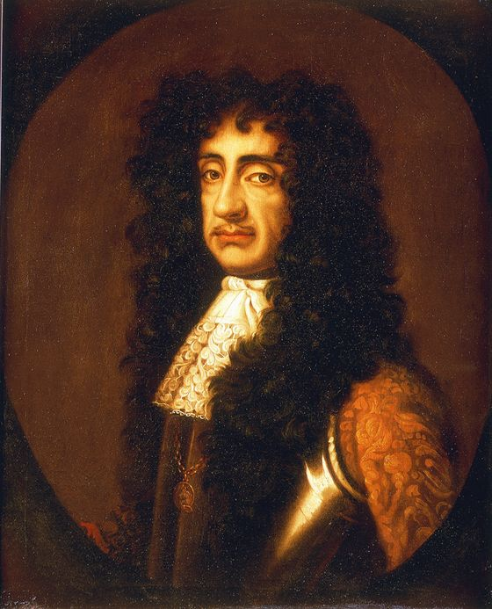
Activity
This is a portrait of King Charles II, he made decisions about what happened after the Great Fire.
Imagine you have lived through the Great Fire of 1666. You have lost your home and many of your belongings. You are living in a tent outside of London. What questions do you have for the King?
Now is your chance to ask him! What do you want to happen to London now?
Photo courtesy of lisby1(@flickr.com) - - granted under creative commons licence – attribution

Slide 7

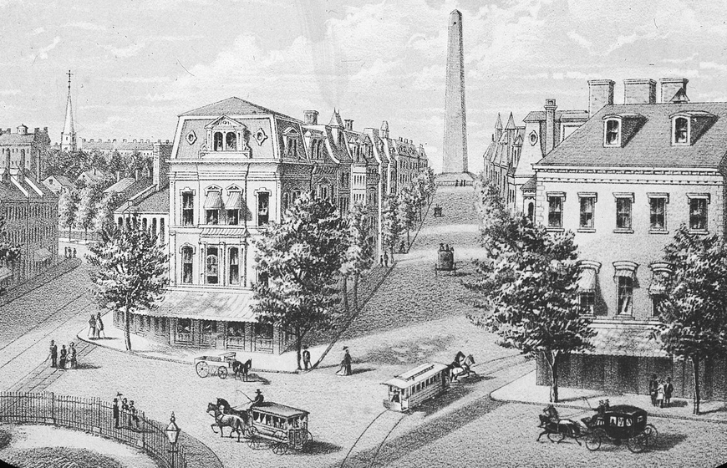
How would you rebuild London?
Here is an architect’s idea of how he or she might design a city. Can you create a poster of how you want to rebuild London?
How will the houses be safer?
What will the houses be made from?
What will the streets look like?
How much space will there be?
Photo courtesy of Boston Public Library(@flickr.com) - - granted under creative commons licence – attribution

Slide 8
What actually happened after the Great Fire?
In October 1666, King Charles appointed architects including Sir Christopher Wren, to start rebuilding London.
Some streets were widened or straightened.
All houses had to be constructed of brick, though some use of wood was allowed in practice. The grander houses sometimes had doorways and windows in stone. Some are still present in London today (see picture).
It was made easier to get water from the River Thames to the houses close by.
Did you think of any of these ideas too?
Can you share your designs with the class?

Slide 9
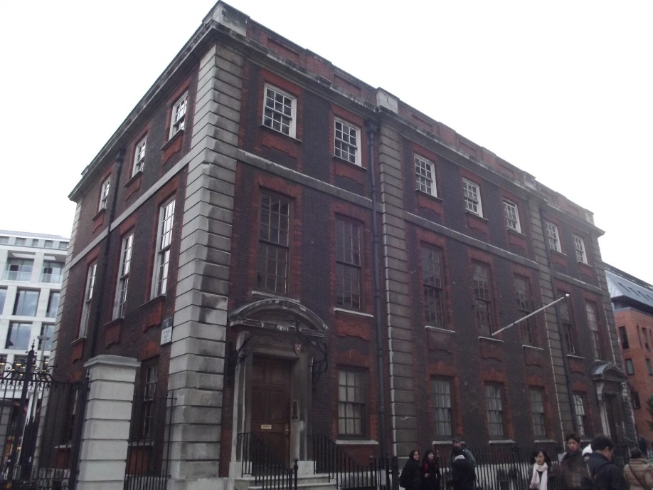
Christopher Wren’s House
This is Christopher Wren’s House, designed after the Great Fire. What materials have been used to build the house?
Photo courtesy of Elliott Brown(@flickr.com) - - granted under creative commons licence – attribution

Slide 10
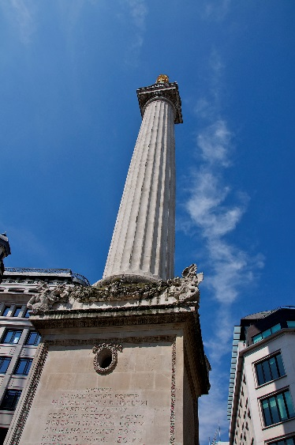
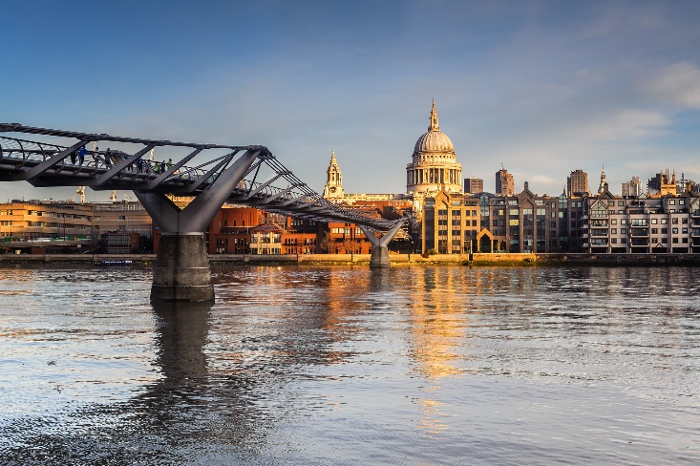
Christopher Wren’s Designs
St. Paul’s Cathedral was rebuilt by Sir Christopher Wren, and it still survives today!
Sir Christopher Wren also designed this Monument to remember the Great Fire. Can you guess where it is in London?
Photos courtesy of Martin Pettitt, Philip Hartland (@flickr.com) - - granted under creative commons licence – attribution

