Slide 1

A Journal of the Plague Year
By Daniel Defoe

Slide 2
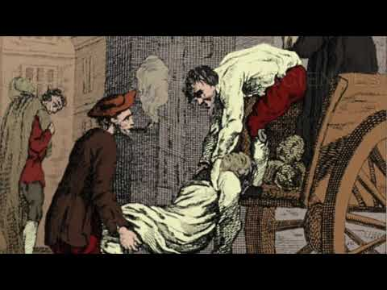
The eve of the Great Plague
Notes:
Teaching Note: Students could do this quiz at this point or wait until after the following slides if they need further guidance

Slide 3
News from Holland
It was about the beginning of September, in the year 1664, when the news first reached us.
The plague had returned to Holland....
Notes:
Note
In Defoe's novel the narrator hears of news from Holland. This chimes with what his contemporaries believed about the origin of the virus – that it came to London via a cotton bale imported from Amsterdam. For modern historians the problem with this theory is that England was at war with Holland in 1665 and the shipping lanes between the two countries were closed
The current consensus is that the plague originated in London – in other words it was a flare up of an epidemic that had never been fully eradicated.

Slide 4
News from Holland
Some said it came from Italy, others from Cyprus or Canada.
Notes:
Script: read from slide
The narrator speculates on where the plague came from
Some say it came from Italy, others from the Levant, among some goods which were brought home by their Turkey fleet. Others said it was brought from Canada; others from Cyprus.

Slide 5
News from Holland
All that mattered was that the sickness was all over Amsterdam and Rotterdam.
Notes:
Script: read from slide
Interesting echo of dispute over origin of Covid-19. Chinese government argues that the source of the origin unimportant – the US accuses China of a 'cover-up'.
From London's point of view it 'mattered' that there was sickness in Holland because this was highly likely to eventually arrive in England

Slide 6
December 1664
Outbreak?
'Two frenchmen' die with what appear to be plague symptoms 'at the far end of Dury Lane.'
Notes:
Script
According to H.F. the 'two frenchmen' were effectively the joint patient zero in London. What could the authorities have done at this point?
They could have immediately 'contact traced' and isolated anyone they had been in contact with. They might also have closed the ports to travellers from infected areas – or ensured quarantine for new arrivals.
But at this time the importance of doing taking rapid preventative measures was not understood. Even if they had been, the epidemic spread so rapidly that the authorities were overwhelmed – see interactive here chart here

Slide 7
January 1665
After a month … life started to return to normal.
Notes:
Script
This is typical of what happens in pandemics. When there are few cases, neither the public nor the authorities pay close attention. Preventative measure are often only introduced when the infection begins spreading rapidly

Slide 8
Feb 1665
{we} paid close attention to the parish burial records At first they were …. at more or less their typical level for the time of year.
Notes:
Script
This is typical of what happens in pandemics. When there are few cases, neither the public nor the authorities pay close attention. Preventative measure are often only introduced when the infection begins spreading rapidly.
Parish burial records are a useful indicator of the number of deaths in an epidemic/pandemic. 'Excess deaths' - the number compared to the year average is still perhaps the best guide when countries use different methods to record.

Slide 9
St Giles
Then we learned that there had been a large increase in burials in the parish of St Giles.
Notes:
Script
St Giles was the poorest, most crowded parish in the city of London. The 'bells of St Giles' are in the nursery rhyme 'Oranges and Lemons'
Key modern medical/statistical concept: 'excess deaths' - when there are significantly more deaths than the previous average. This is important when we cannot be sure of the cause of death.

Slide 10
St Giles
Average number of burials in previous years: 250
Date | Number of burials | Increase
December 20th - 27th, 1664 | 291 | 41
Dec 27- 3rd January, 1665 | 349 | 58
3rd Jan - 10th January | 394 | 45
10 - 17 January | 415 | 21
17 - 24 January | 474 | 59
Notes:
Script
St Giles was the poorest, most crowded parish in the city of London. The 'bells of St Giles' are in the nursery rhyme 'Oranges and Lemons'

Slide 11
Weather
Plagues generally occurred in warmer weather
Then the weather got colder. Hope briefly returned.
Notes:
Script
St Giles was the poorest, most crowded parish in the city of London. The 'bells of St Giles' are in the nursery rhyme 'Oranges and Lemons'.

Slide 12
Spread
...warm weather came in April. Suddenly the number of burials increased dramatically not only in St Giles but in neighbouring parishes.
Notes:
Script
Tragically, the summer of 1665 was one of the hottest on record

Slide 13
Epidemic
...The infection was spreading across the city.
Notes:
Script – read the slide
Notes
This may not have been obvious at the time. In an epidemic/pandemic early reporting of cases often underestimates numbers. With Covid-19 we now see that the epidemic started in December 2019, possibly earlier. Even when data was published in late January, none of the major medical journals predicted the scale of the pandemic (the WHO did not declare one until March 11).

Slide 14
What will happen next?
Notes:
More free resources about the Great Plague of London, the history of pandemics & the lessons for Covid-19 here:

