Slide 1
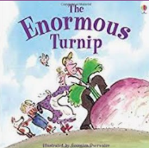

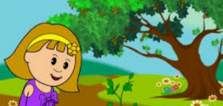
Year 1: Plants Knowledge Organiser
Subject Specific Vocabulary |  | Interesting Books | Sticky Knowledge about plants
buds | A small lump on a stem or twig that will grow into a leaf, flower or shoot.
 |  |  | Some trees can live for thousands of years.
bulbs | The resting stage of a plant that is usually formed underground. |  | Some trees can live for thousands of years.
deciduous | Deciduous is the name given to trees that lose their leaves in autumn and are bare in the winter.
 |  |  | Around 2000 different types of plants are used by humans to make food.
 |  |  | Some plants are carnivores. A well known example of a carnivorous plant is the Venus Flytrap.
evergreen | Evergreen is the name of trees that have leaves all year round.
trunk | A tree's trunk holds up its crown, protects its inner parts and works like a pipeline, transporting essential materials to the different parts of the tree. | Important facts to know by the end of the plants topic: | Bamboo can be a fast growing plant. Some types can grow almost a metre in just one day!
 |  |  | Touching poison ivy will cause an allergic reaction, usually in the form of an itchy rash on the skin.
vegetable | A vegetable is a plant or part of a plant which is used as food, for example cabbage or potato.
 |  | Know the names of a variety of common wild and garden plants Know the names of a variety of common trees Know the difference between deciduous and evergreen trees Know which plants grow in the local environment | As well as looking beautiful, trees help purify the air and provide food and shelter for all sorts of creatures.
wild plants | These are plants that don’t grow in our gardens and are self-seeded. |  | As well as looking beautiful, trees help purify the air and provide food and shelter for all sorts of creatures.
 |  |  | Water and nutrients travel up the tree trunk, through the branches and all the way out to the leaves.
environment | The area where a plant or tree lives is its environment. |  | Water and nutrients travel up the tree trunk, through the branches and all the way out to the leaves.
blossom | Blossom is the flower that comes before the fruit. For example, apple blossom comes before the apple starts to grow.
petals | A petal is a part of the flower and is usually coloured. The colour attracts insects.
branches | Branches come from the tree trunk and grow outwards.

