Slide 1
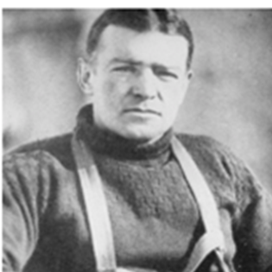

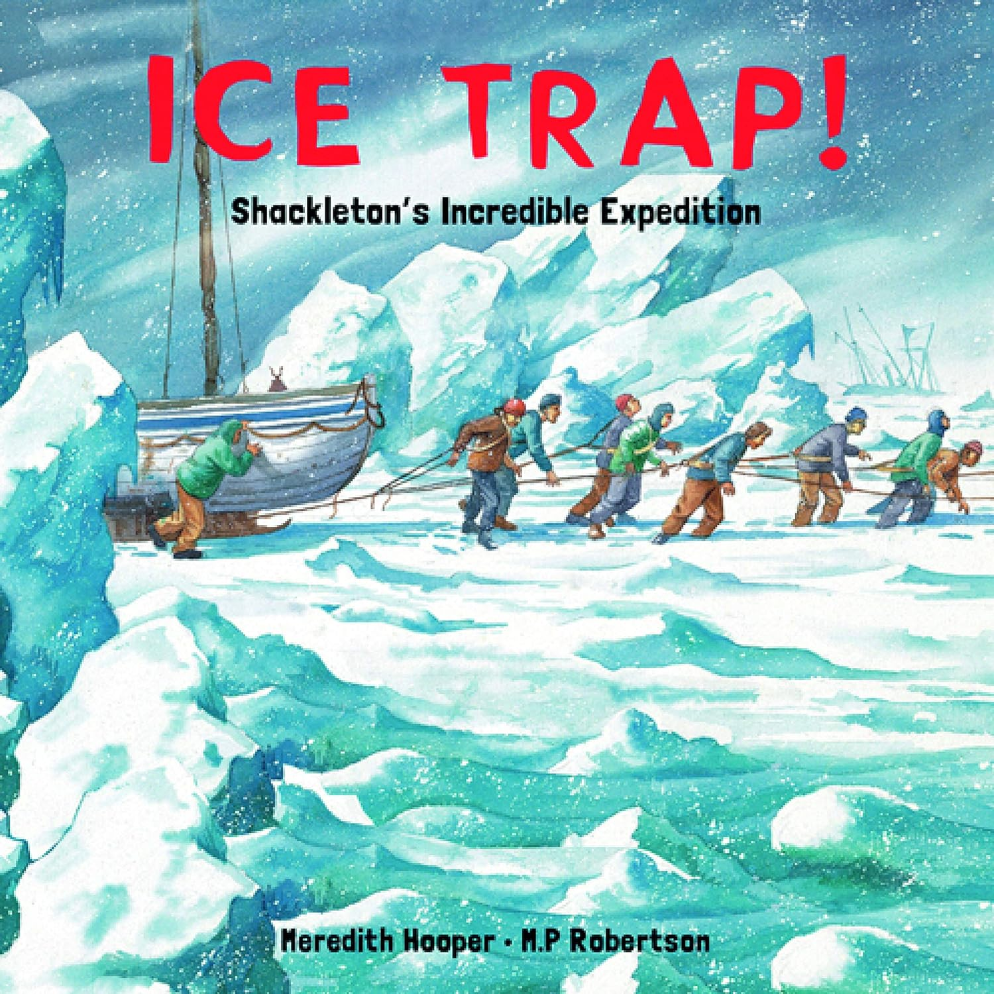
Shackleton: KS2 Knowledge Mat
Subject Specific Vocabulary |  | Each symbol represents a letter or sound | Exciting Books
Depot | A place where large amounts of raw materials or other supplies are kept until they are needed.
Rations | Having a limited amount of food or supplies for each person.
Compass | An instrument that you use for finding directions | Sticky Knowledge about Ernest Shackleton
Frostbite | Frostbite occurs when parts of your body become damaged due to being very cold. | In August 1914, Shackleton set out to be the first man to cross the South Polar Continent known as Antarctica.
Capsize | A boat capsizes when it turns upside down in the water. | Shackleton’s crew was made of 26 men and 69 dogs. His ship was called Endurance.
Dehydration | Dehydration occurs when the amount of water in the body is dangerously low. | Endurance became stuck in the pack ice in the Weddell sea and the men had to evacuate.
Blizzard | A very heavy snowstorm with strong winds. | The ice began to crush the ship, which sank on 21st November 1915. After living on Elephant Island for 16 months, Shackleton took a single boat and 2 crew members to South Georgia to seek help.
Gale | A very strong wind | The government of Chile sent a ship to rescue the remaining crew.
Glacier | Extremely large ice blocks that move very slowly, often down a mountain valley. | No member of the crew died during the expedition and Shackleton became known for his bravery and perseverance.

