Slide 1
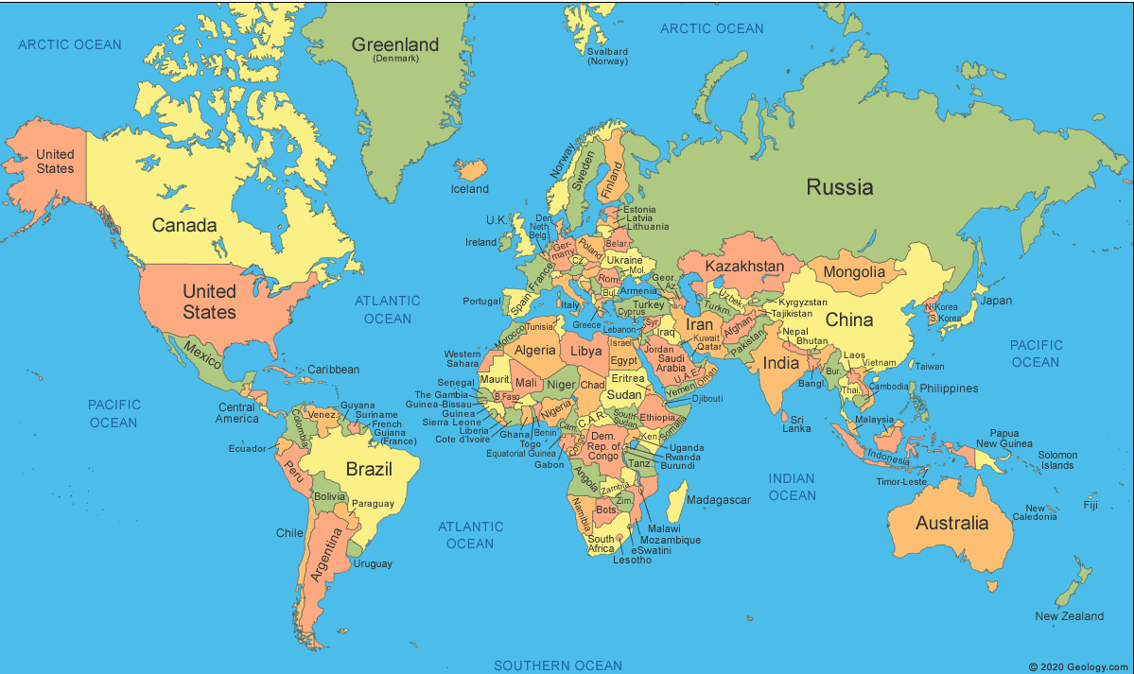
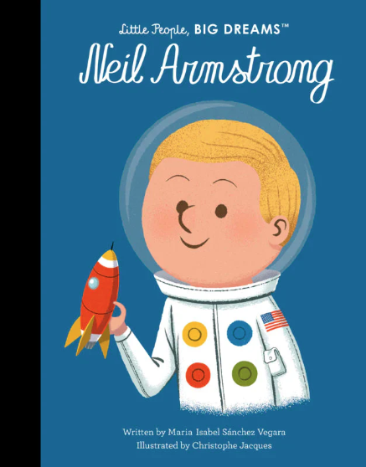

Explorers: KS1 Knowledge Mat
Subject Specific Vocabulary |  |  | Exciting Books
change | To make or become different
adventure | An exciting or unusual experience
impact | The effect or influence of one thing on another
explore | To travel in or through an unfamiliar area | Sticky Knowledge about Explorers
discover | To find something unexpectedly or in the course of a search | Neil Armstrong and Buzz Aldrin first landed on the moon in a rocket called Apollo 11 in 1969.
voyage | A long journey involving travel by sea or in space | Neil Armstrong was the first person to walk on the moon in 1969.
past | The time before the present | In 2005, Ellen MacArthur became the fastest solo sailor to sail around the world.
present | Existing or occurring now | Ibn Battuta started his travels in 1325 when he set off on hajj to Mecca.
Explorer Pacific Ocean Indian Ocean | A person who travels to unfamiliar places in order to learn about them The Pacific Ocean is the world’s largest ocean. The Indian ocean is the third largest in the world. | Helen Sharman is the first British astronaut, she flew to space in 1991.
 |  | Felicity Aston became the first woman to ski alone across Antarctica in 2012.
 |  | Matthew Henson was the co-discoverer of the North Pole with Robert E. Peary in 1909. The Arctic Ocean is the world’s smallest and shallowest ocean.

