Slide 1
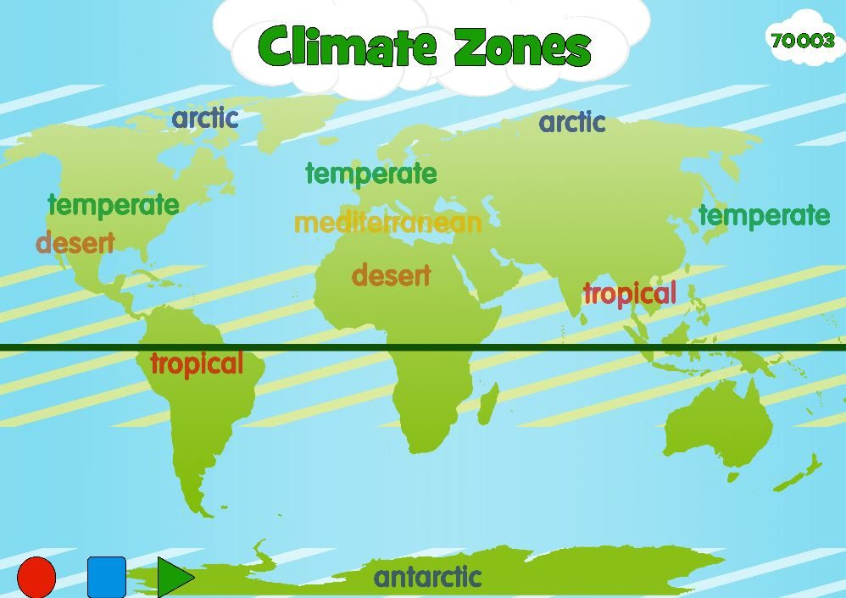


Climate Detectives: KS1 Knowledge Mat
Subject Specific Vocabulary |  |  | Exciting Books
Climate zone | Climate zones are areas with distinct climates.
Temperate | relating to or denoting a region or climate characterized by mild temperatures.
Mediterranean | of or characteristic of the Mediterranean Sea, the countries bordering it, or their inhabitants.
Equatorial | of, at, or near the equator. | Sticky Knowledge about Climate Detectives
Microclimate | the climate of a very small or restricted area
Arid | having little or no rain; too dry or barren to support vegetation.
Ocean | a very large expanse of sea, in particular each of the main areas into which the sea is divided geographically. | There are 6 major climate zones in the world. These are polar, temperate, Mediterranean, tropical, arid and mountain regions.
Polar | relating to the North or South Pole.
Living conditions | the circumstances or factors affecting the way in which people live | Mediterranean climates have warm summers and short, mild, rainy winters.
Impact | the action of one object coming forcibly into contact with another. | The UK is a temperate climate zone.
 |  | A microclimate is the climate of a small or restricted area and differs from the climate of the surrounding area.
Cold | of or at a low or relatively low temperature
Hot | having a high degree of heat or a high temperature.
 |  | There are 7 continents in the world. These are Asia, Africa, North America, South America, Antarctica, Europe and Oceania.
Tropical | of, typical of, or peculiar to the tropics.

