Slide 1
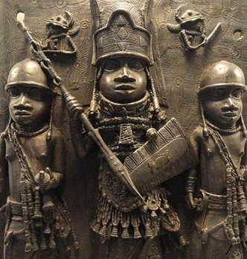
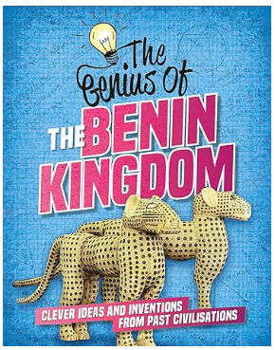
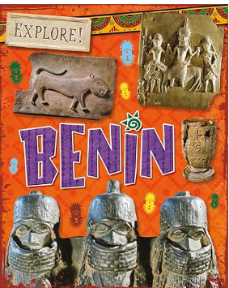
Kingdom of Benin: KS2 Knowledge Mat
Subject Specific Vocabulary |  | Each symbol represents a letter or sound | Exciting Books
Oba | The ruler or king.
Empire | Empire is a term used to describe a group of territories ruled by one single ruler or state.
Animism | Animism is the belief that all objects, places, and creatures are alive. | Sticky Knowledge about the Kingdom of Benin
Invasion | An invasion is the movement of an army into a region, usually in a hostile attack, which is part of a war or conflict. | The people of Benin traded with merchants from Europe and with other African kingdoms. Instead of using money they exchanged goods.
Ivory | Ivory is a hard, white material from the tusks (traditionally from elephants) and teeth of animals, | Around 1440, Ewuare became the new Oba of Benin. He was the first of five great warrior kings. Ewuare built up an army. He also rebuilt Benin City and the royal palace.
Manillas | Horseshoe-shaped brass rings that were used as currency by Europeans to trade with West Africans. | Benin was a large and varied kingdom. Some people lived in villages and small towns, but most people lived and worked in Benin City.
Guild | A guild is an association of artisans and merchants who oversee the practice of their craft/trade. | The most important person in the kingdom was the king, known as the Oba. Hundreds of men and women lived at the royal court, and looked after the Oba and his family.
Bronze | Bronze is an alloy or mixture of tin and copper. It could be used to make a greater range of tools and weapons than had previously been possible. | The Benin people were animists. This meant that they believed that animals and objects had souls and spirits. They worshipped many gods and held ceremonies in their honour.

