Slide 1


LIFE/work balance
We have started a #LIFEworkbalance campaign and we need your help to complete our LIFE/work balance survey.
We hope to publish the results soon, so please give 15 minutes of your time to help us get a true picture of school life.
Want to be a part of this campaign? Take the survey on our website and share it with your colleagues!
© Classroom Secrets Limited 2019

Slide 2
Year 6 – Autumn Block 4 – Subjunctive Form – Recognising Subjunctive Form
About This Resource:
This PowerPoint has been designed to support your teaching of this small step. It includes a starter activity and an example of each question from the Varied Fluency and Application and Reasoning resources also provided in this pack. You can choose to work through all examples provided or a selection of them depending on the needs of your class.
National Curriculum Objectives:
  English Year 2: (6G4.3) Recognising subjunctive forms
More resources from our Grammar, Punctuation and Spelling scheme of work.
Did you like this resource? Don’t forget to review it on our website.
© Classroom Secrets Limited 2018

Slide 3
Year 6 – Autumn Block 4 – Subjunctive Form – Recognising Subjunctive Form
Notes and Guidance
From the previous step, children will be familiar with the difference between using was and were. They should be able to recognise when ‘were’ is used in the subjunctive form, or for plural statements of fact.
The main focus of this step is to recognise the subjunctive form of action verbs where the verb is in the basic form (without the -s). For example: They insisted that he play the piano.
Children should be able to identify action verbs in a sentence and recognise that the subjunctive uses these in sentences when the action is yet to happen
Focused Questions
Is were used as a subjunctive in this sentence? Explain why or why not? [for example: ‘They were going shopping’ is not an example of a sentence in the subjunctive form].
In this sentence, which verb is written in the subjunctive form?
Is this sentence in the subjunctive form? How do you know?
© Classroom Secrets Limited 2018

Slide 4
Year 6 – Autumn Block 4 – Subjunctive Form
Step 2: Recognising Subjunctive Form
© Classroom Secrets Limited 2018

Slide 5
Introduction
Highlight the sentences below that are hypothetical.
If I were the Queen, I would enjoy being really rich.
We were going to the park but it began to rain.
They were reading their books in silence.
If I were taller, I would be able to wear my sister’s clothes.
I would accept his offer if I were you.
© Classroom Secrets Limited 2018

Slide 6
Introduction
Highlight the sentences below that are hypothetical.
If I were the Queen, I would enjoy being really rich.
We were going to the park but it began to rain.
They were reading their books in silence.
If I were taller, I would be able to wear my sister’s clothes.
I would accept his offer if I were you.
© Classroom Secrets Limited 2018

Slide 7
Varied Fluency 1
Circle the subjunctive verb in each sentence.
A) It is important that he be allowed the space to explore his talent.
B) If you were in my class, we could work together.
C) He recommends that Jacinta play guitar in the band.
© Classroom Secrets Limited 2018

Slide 8
Varied Fluency 1
Circle the subjunctive verb in each sentence.
A) It is important that he be allowed the space to explore his talent.
B) If you were in my class, we could work together.
C) He recommends that Jacinta play guitar in the band.
© Classroom Secrets Limited 2018

Slide 9
Varied Fluency 2
Highlight the word(s) in the sentence below that would change if it were written in the subjunctive form.
If I am smarter, I will get all the answers on my next test correct.
© Classroom Secrets Limited 2018

Slide 10
Varied Fluency 2
Highlight the word(s) in the sentence below that would change if it were written in the subjunctive form.
If I (were) smarter, I (would) get all the answers on my next test correct.
© Classroom Secrets Limited 2018

Slide 11
Varied Fluency 3
Tick the sentences written in the subjunctive form and underline the subjunctive verbs.
A) I suggested that he write a poem about the seasons.
B) I wish I was going to the cinema with you and Sunita.
C) I would be very patient if I were you.
© Classroom Secrets Limited 2018

Slide 12
Varied Fluency 3
Tick the sentences written in the subjunctive form and underline the subjunctive verbs.
A) I suggested that he write a poem about the seasons. | ✓
B) I wish I was going to the cinema with you and Sunita.
C) I would be very patient if I were you. | ✓
© Classroom Secrets Limited 2018

Slide 13
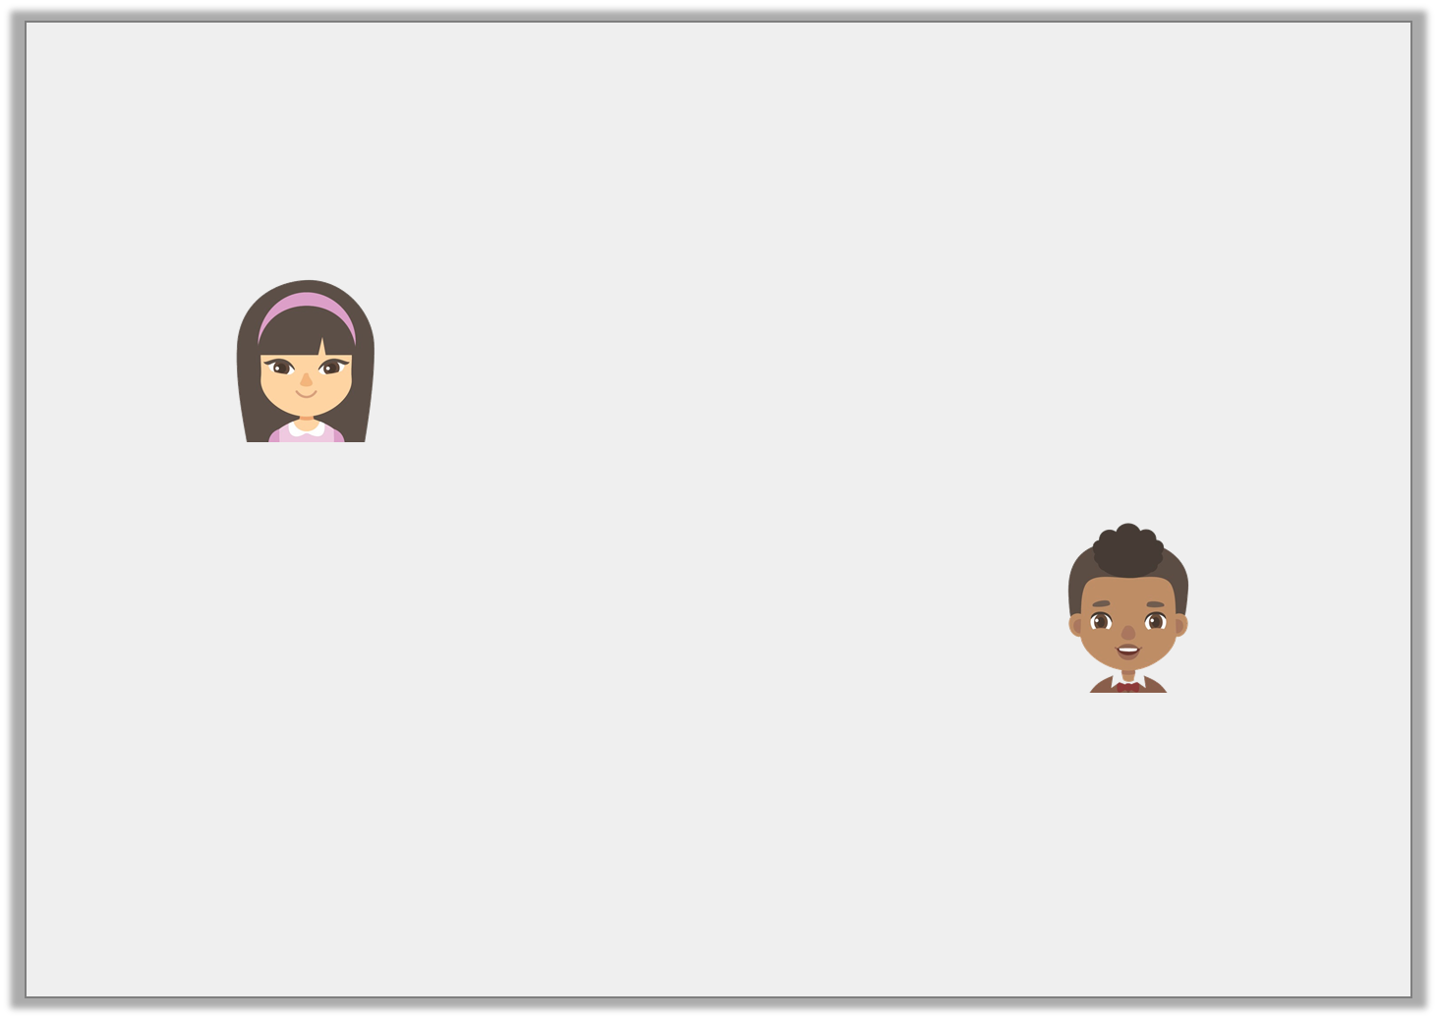
Reasoning 1
Which child is using the subjunctive form? How do you know?
I request that the dog sit quietly in the waiting room.
Lucy
I request that the dog sits quietly in the waiting room.
Hassan
© Classroom Secrets Limited 2018

Slide 14
Reasoning 1
Which child is using the subjunctive form? How do you know?
Lucy is using the subjunctive form because…
I request that the dog sit quietly in the waiting room.
Lucy
I request that the dog sits quietly in the waiting room.
Hassan
© Classroom Secrets Limited 2018

Slide 15
Reasoning 1
Which child is using the subjunctive form? How do you know?
Lucy is using the subjunctive form because she has used the basic form of the verb ‘sit’.
I request that the dog sit quietly in the waiting room.
Lucy
I request that the dog sits quietly in the waiting room.
Hassan
© Classroom Secrets Limited 2018

Slide 16
Reasoning 2
Joanna has tried to write the sentence below using the subjunctive form.
It was important that Tommy watched his brother when was playing.
Explain her mistake.
© Classroom Secrets Limited 2018

Slide 17
Reasoning 2
Joanna has tried to write the sentence below using the subjunctive form.
It was important that Tommy watched his brother when was playing.
Explain her mistake.
Joanna has not used the subjunctive form of the verb…
Her sentence should be…
© Classroom Secrets Limited 2018

Slide 18
Reasoning 2
Joanna has tried to write the sentence below using the subjunctive form.
It was important that Tommy watched his brother when was playing.
Explain her mistake.
Joanna has not used the subjunctive form of the verb ‘watch’.
Her sentence should be: It was important that Tommy watch his brother when he was playing.
© Classroom Secrets Limited 2018

Slide 19
Application 1
Rewrite the passage below so that it is written in the subjunctive form.
I wish I could be a celebrity, so that I could buy a huge house and a new, red sports car. I’d request that my mum drives the car to all my favourite shops.
© Classroom Secrets Limited 2018

Slide 20
Application 1
Rewrite the passage below so that it is written in the subjunctive form.
I wish I could be a celebrity, so that I could buy a huge house and a new, red sports car. I’d request that my mum drives the car to all my favourite shops.
I wish I were a celebrity, so that I could buy a huge house and a new, red sports car. I’d request that my mum drive the car to all my favourite shops.
© Classroom Secrets Limited 2018

