Slide 1
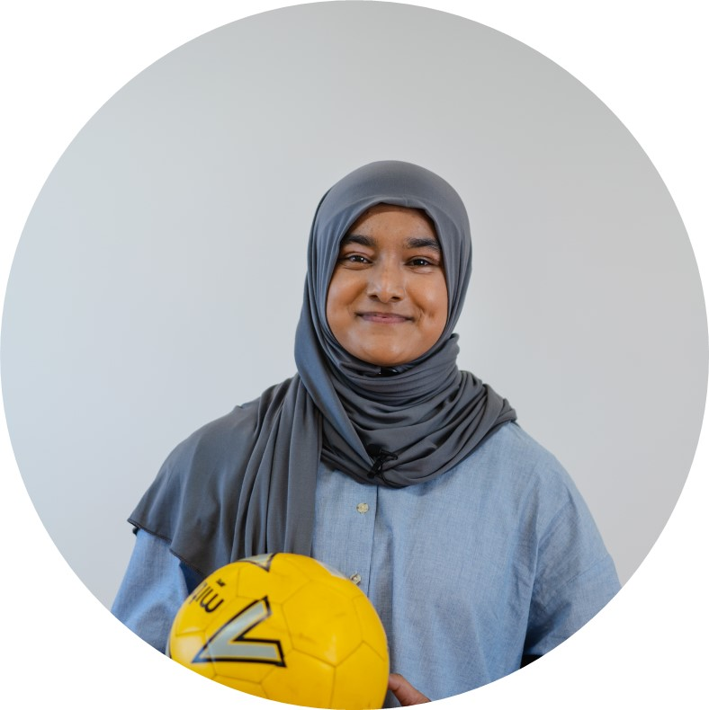

Lipa’s Story
Stage 2: Building Empathy
8 - 11 years

Slide 2

Choose your lesson:
Empathy with Myself
Empathy with Others

Slide 3

Empathy with Myself

Slide 4

Applying Empathy
Aims & Objectives
To enable students to take empathic action to maintain their own wellbeing.

Slide 5
Student Objectives & Aims
All students will learn actionable responses to uncomfortable feelings and how to ask for help if they are struggling with their mental health.
Most students will learn to use empathy to celebrate and share positive experiences.
Some students will learn to identify positive and negative influences on their wellbeing.

Slide 6

Focusing Activity
Look at the Feelings Wheel and think of 3 different feelings you experience when you are having a good time with your friends.
Then think about 3 feelings you may experience when you have had an argument.

Slide 7
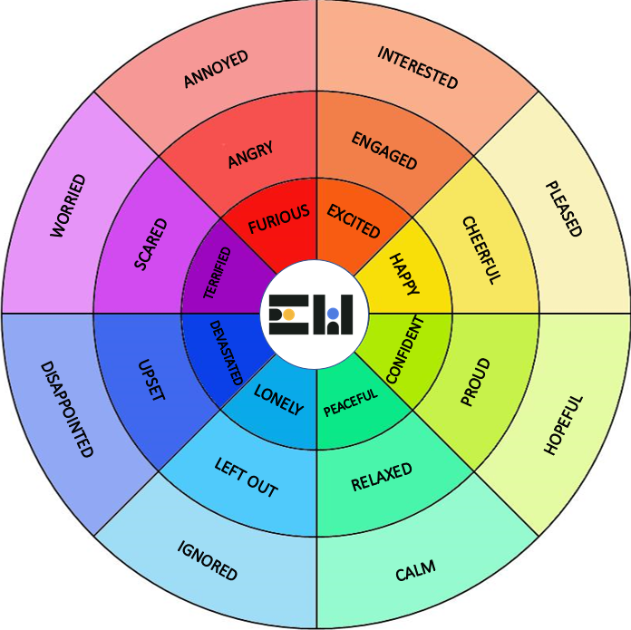
Feelings
Wheel

Slide 8
Focusing Activity
Which feelings did you select?
How are these feelings different to each other?

Slide 9
Main Activity
What does “purpose” mean?
What is Lipa’s purpose?
How does it make her feel?
Notes:
Self-Empathy

Slide 10
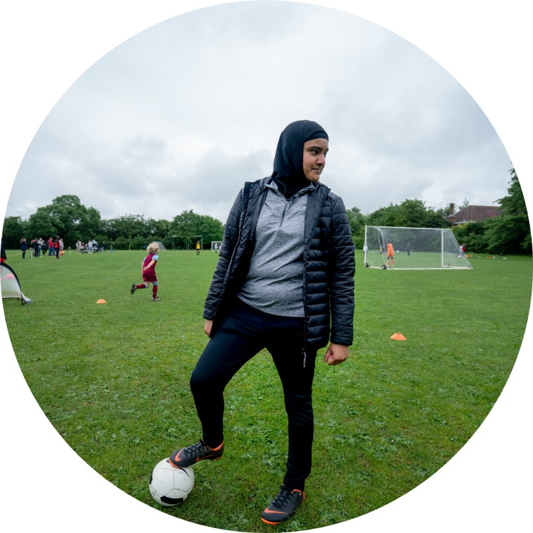
Main Activity
“Before I found my purpose I thought I was a caterpillar. A caterpillar can only wriggle.
When I found my purpose, I came out of the cocoon and turned into a butterfly and now I’m free.
The wings are who I am – my purpose.”

Slide 11

Main Activity
Lipa’s purpose and passion is football. Discovering football makes her feel free like a butterfly.
She says her wings represent who she is and what she loves.
However, when Lipa started to wear a headscarf, her love and enjoyment of football was put in jeopardy.

Slide 12
Main Activity
Talk to your partner to recall what happened when Lipa started wearing her headscarf.
How did some people start to treat Lipa?
How did this make Lipa feel?
How did her experience of playing football change?
Notes:
Self-Empathy

Slide 13

Main Activity
If other people treat us horribly, we may feel tempted to change ourselves or the things we do in order to fit in.
But we should never feel under pressure to change who we are. If anyone is putting pressure on you to change or do something that makes you uncomfortable, it is important to take steps to address this.
In groups, compare these 2 scenarios.

Slide 14
Scenario 1
Someone in your class keeps mispronouncing your name. You’ve politely told them how it should be said, but now they make fun of it and put on an accent every time they say it.
The first time you laughed because you didn’t know how to respond. But it makes you very sad and uncomfortable.
You don’t know whether to carry on pretending to find it funny to avoid an argument.
What should you do?

Slide 15
Scenario 2
You go to watch a football match with your friends. The team you support start the game really well but then the other team score two goals.
Your friends start to boo the other team and call out unkind things every time the other team get the ball.
You know it is wrong but you don’t want your friends to be angry with you.
What should you do?

Slide 16
Plenary
Share your thoughts with the class.
What different options are there?
What is the best decision for your wellbeing?

Slide 17
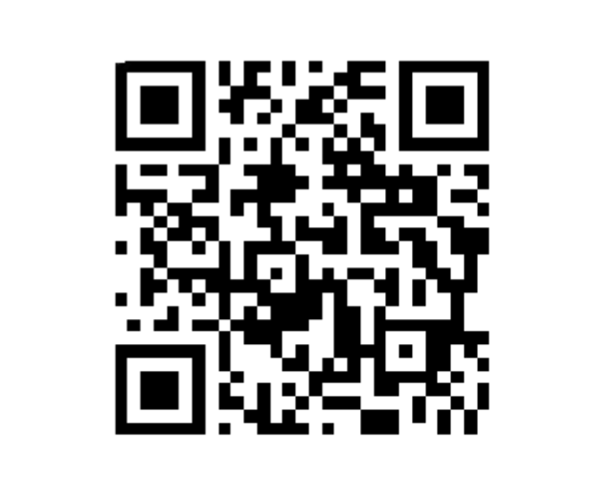
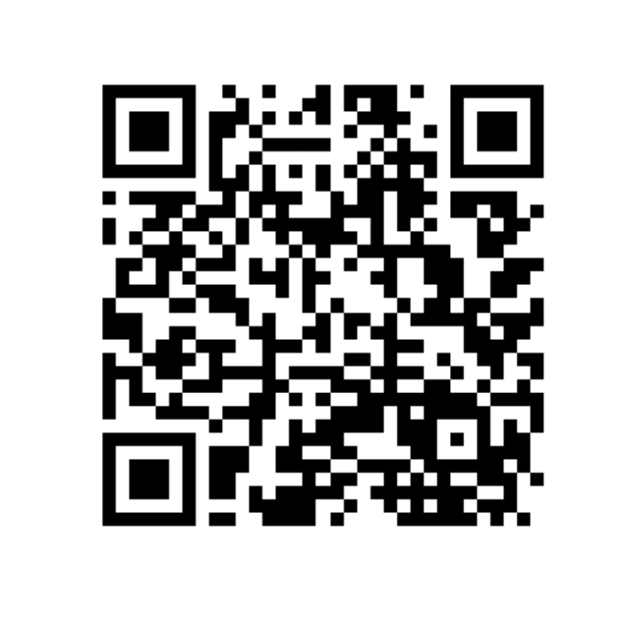
The Empathy Wall
Help & Support
Showcase your week and work with us on our Empathy Wall
For further resources, support and guidance about the issues covered today, visit our Help and Support page

Slide 18
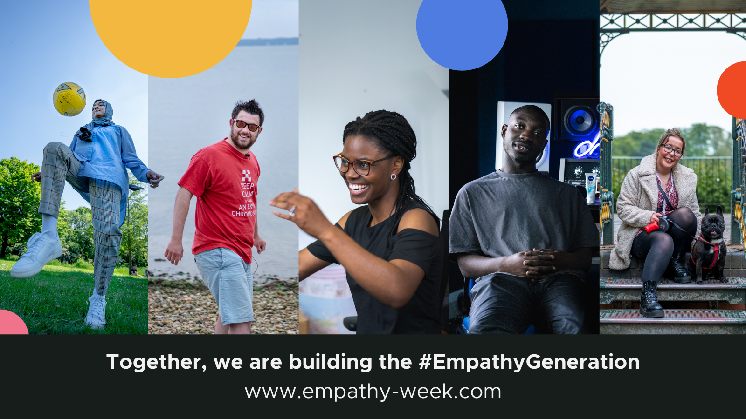

Slide 19
Empathy with Others

Slide 20
Valuing Perspectives
Aims & Objectives
To equip students with the skills to engage empathically and respectfully with people who have a different opinion to them.

Slide 21
Student Objectives & Aims
All students will learn how to react respectfully when disagreeing with someone else.
Most students learn to evaluate, investigate and appreciate differing opinions.
Some students will learn to embrace differences in opinion as learning opportunities.

Slide 22
Focusing Activity
What do you remember about Lipa?
Think of one difference between you and Lipa.
Think of two similarities between you and Lipa.

Slide 23
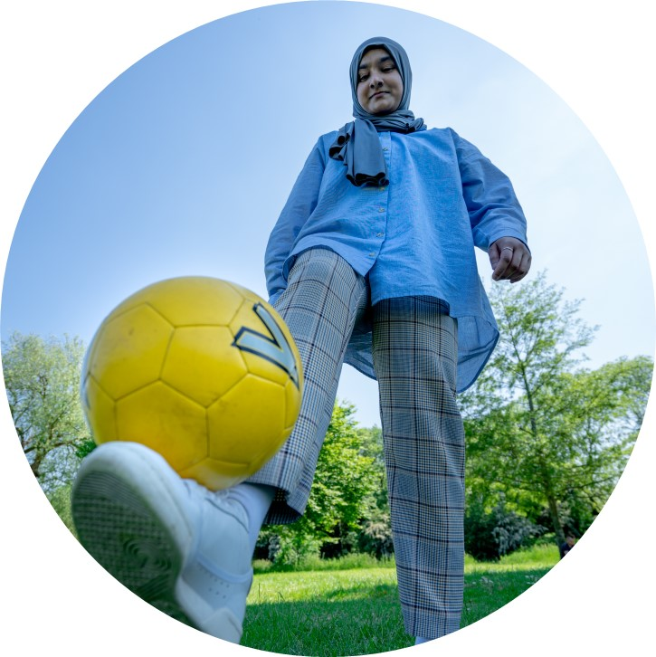
Click to watch Lipa’s Story
Video | 8 mins

Slide 24
Main Activity
Talk to your partner about this question. You have 1 minute to think of as many examples as possible!
What makes you “super”?

Slide 25
“So if you know there’s something different about you. Some people might not like it and maybe pick on you for it, or you might not like yourself for it, but that could actually be a superpower.”
Has this ever happened to you?
What did it make you feel?

Slide 26
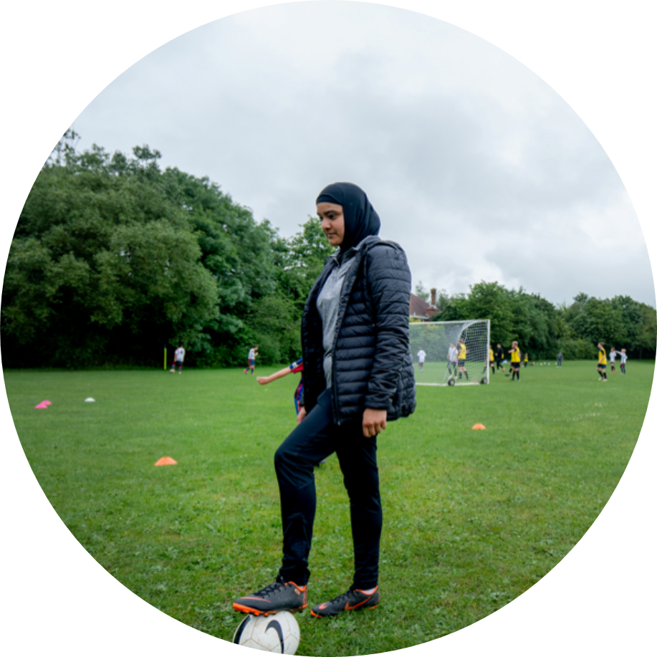
Main Activity
Lipa talks about Spiderman. When he was first bitten by the spider and realised he was different to everyone else, he didn’t like it and felt unsure of himself.
However, in time he came to realise how incredible this difference made him!
Our differences are our superpowers!

Slide 27
Main Activity
Lipa talks about Spiderman. When he was first bitten by the spider and realised he was different to everyone else, he didn’t like it and felt unsure of himself. However, in time he came to realise how incredible this difference made him!
Our differences are our superpowers! Use the outline to draw your partner as a superhero!
What are your superpowers?
What are your partner’s superpowers?

Slide 28
Plenary
Show your partner the drawing you have done of them as a superhero.
How does it make you feel to see the drawing?
What did you learn about yourselves from your partner’s drawing?
Notes:
Self-Empathy

Slide 29
The Empathy Wall
Help & Support
Showcase your week and work with us on our Empathy Wall
For further resources, support and guidance about the issues covered today, visit our Help and Support page

