Slide 1
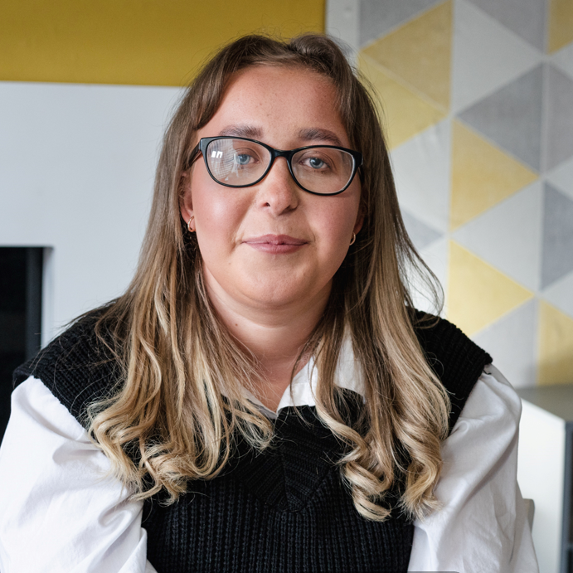

Courtney's Story
Stage 2: Building Empathy
8 - 11 years

Slide 2

Choose your lesson:
Empathy with Myself
Empathy with Others

Slide 3
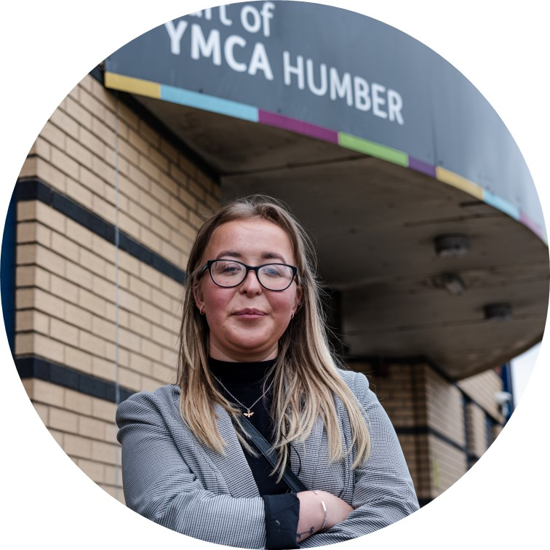
Empathy with Myself

Slide 4

Preparing to Connect
Aims & Objectives
To use empathy to fully and productively engage with other people.

Slide 5
Student Objectives & Aims
All students will be given the opportunity to value and celebrate diversity.
Most students will acknowledge the existence of stereotypes and prejudice and the harm they cause.
Some students will explore the impact biases can have when forming and maintaining relationships.

Slide 6
Focusing Activity
Close your eyes and think…
“How are you feeling today?”
Which colour matches your feeling?

Slide 7
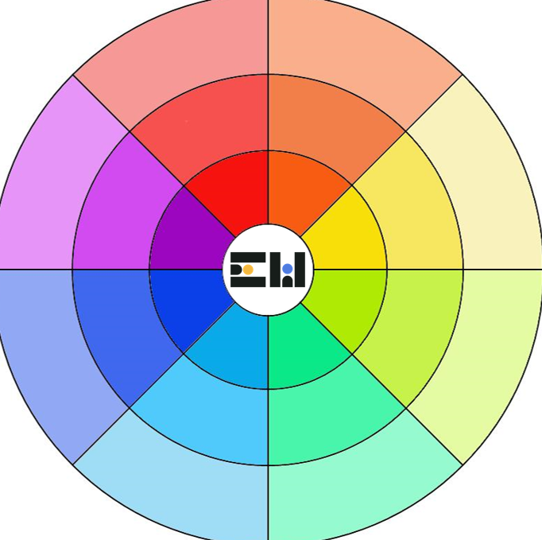
Feelings
Wheel

Slide 8
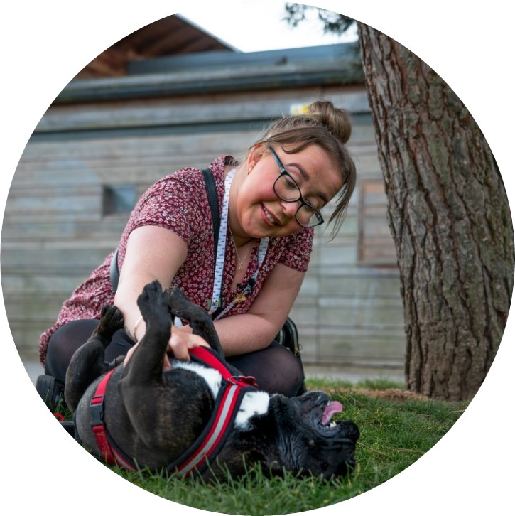
Main Activity
Talk to your partner about what you remember about Courtney.
Courtney told us about how she was bullied at school and people were unkind about the way she looks.
Use the Feelings Wheel on the next slide to think about what that might have been like for her.

Slide 9
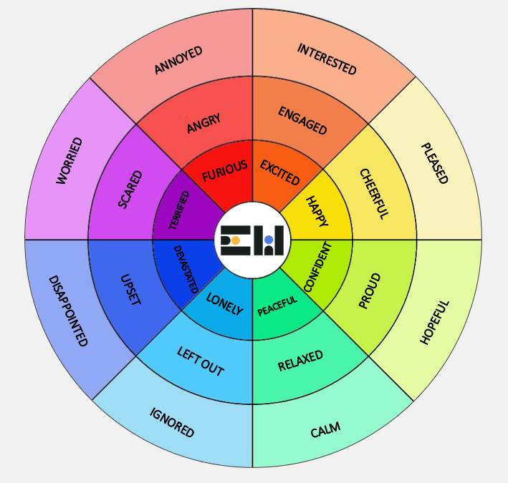
Feelings
Wheel

Slide 10
Main Activity
Talk to your partner about this question.
What is
“body image”?

Slide 11
We all look different and we are all deserving of the same amount of respect. We all deserve to feel special.
The term “body image” is used to refer to how we feel about how our bodies look and what we think other people think about our appearance.
Some people worry about what they look like or want to change the way they look. This can happen for many different reasons.
It is important that we remember not to compare ourselves to images we see online: they are often filtered and don’t represent real life. Also, you are beautiful just as you are!

Slide 12
Body Facts
Did you know….
Our faces have 43 muscles which we use to show about 10,000 different emotions!
On average we have 200 eyelashes on our top eyelids and 100 below!
Your heart beats 100,000 times a day, sending 2,000 gallons of blood around your body!
One inch of our skin has over 19,000,000 cells!
Our bodies are amazing! Instead of worrying about what they look like, we should celebrate all the amazing things they can do!
Notes:
Self-Empathy

Slide 13
Love your Body
A really important way of maintaining a positive body image is to celebrate the ways in which we are different and learn to be kind to ourselves.
Take a few minutes to think about your own body and complete these sentences. Some examples are shown in red.
I love my body because…it can dance which makes me happy.
I love my arms because…I can use them to give good hugs.
I will thank my body by…feeding it healthy food and getting enough sleep.
My body is unique and it is special because….it’s always there for me.

Slide 14
Love Your Body
Take a few minutes to think about your own body and complete these sentences. You can think of as many examples as you like!
I love my body because…
I love my _____ because…
I will thank my body by…
My body is unique and it is special because….

Slide 15
Love Your Body
If you feel comfortable doing so, share your sentences with your partner or your class.
What is special about you?
What is special about your partner?

Slide 16
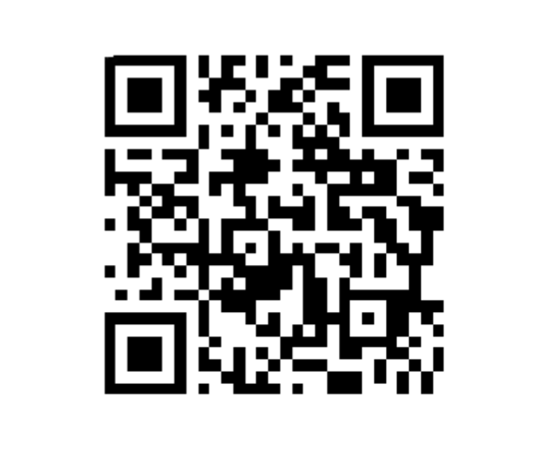
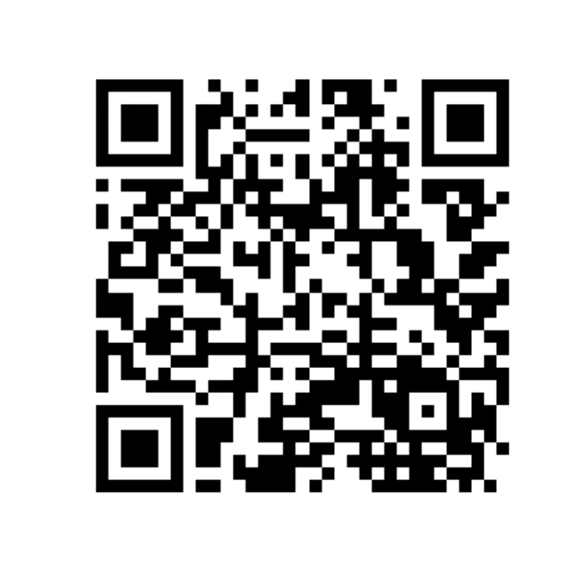
The Empathy Wall
Help & Support
Showcase your week and work with us on our Empathy Wall
For further resources, support and guidance about the issues covered today, visit our Help and Support page

Slide 17
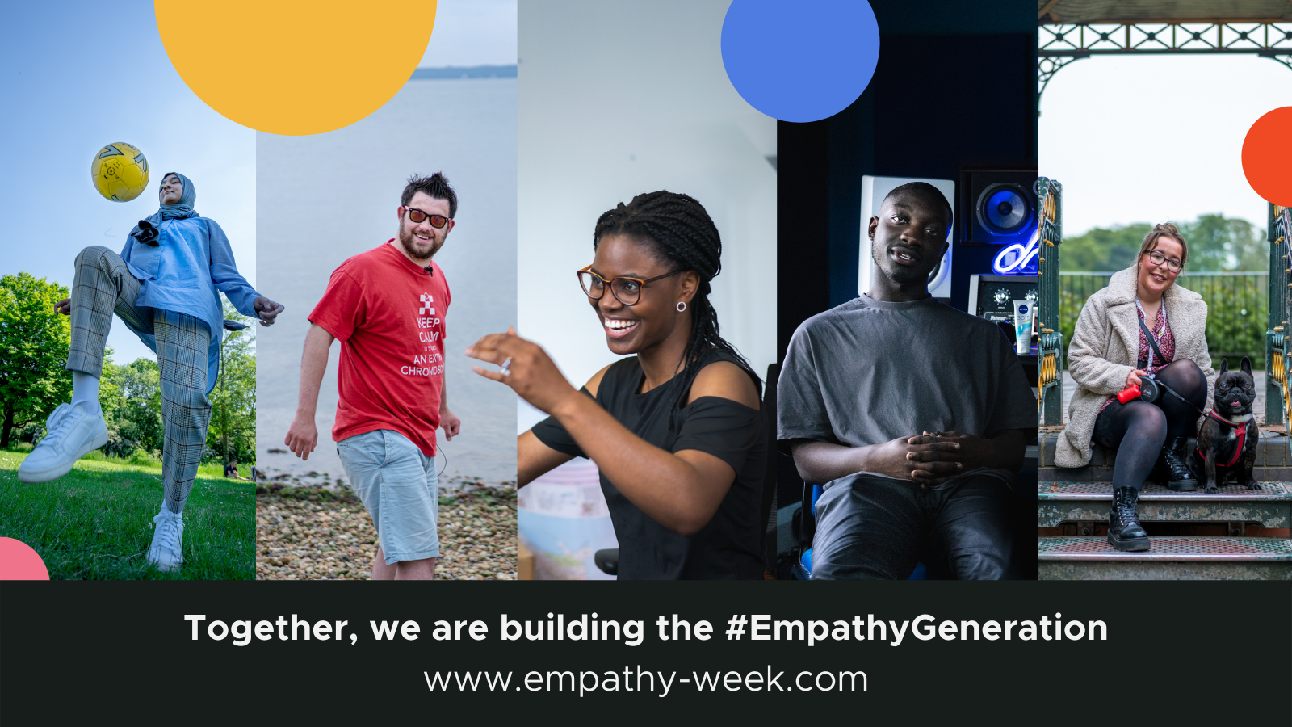

Slide 18

Empathy with Others

Slide 19
Valuing Perspectives
Aims & Objectives
To equip students with the skills to engage empathically and respectfully with people who have a different opinion to them.

Slide 20
Student Objectives & Aims
All students will learn how to react respectfully when disagreeing with someone else.
Most students learn to evaluate, investigate and appreciate differing opinions.
Some students will learn to embrace differences in opinion as learning opportunities.

Slide 21
Focusing Activity
What do you remember about Courtney?
Think of two similarities between you and Courtney.
Think of one difference between you and Courtney.

Slide 22
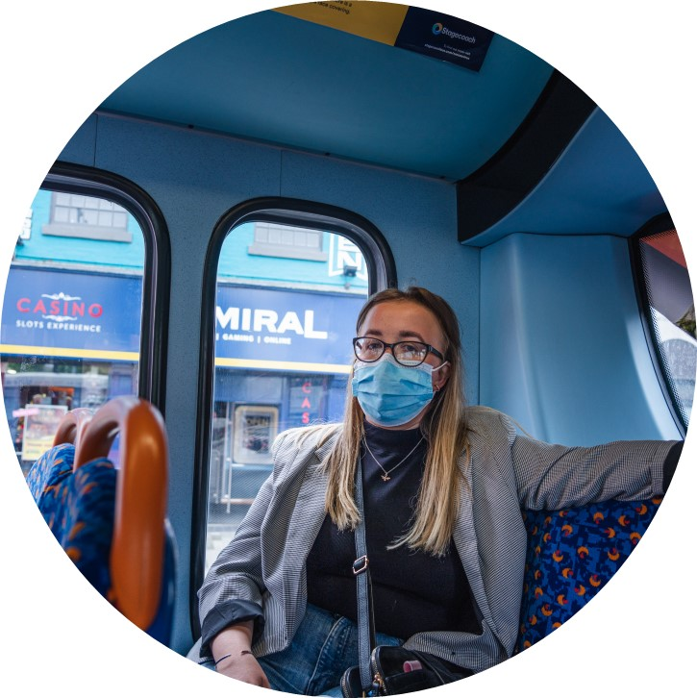
Click to watch Courtney's Story
Video | 8 mins

Slide 23
Main Activity
Courtney says
“People are always going to disagree. People are allowed opinions, but for me is how you voice your opinions. You can be polite, and you respect the other person and show empathy, but still disagree.”
What does this mean?

Slide 24
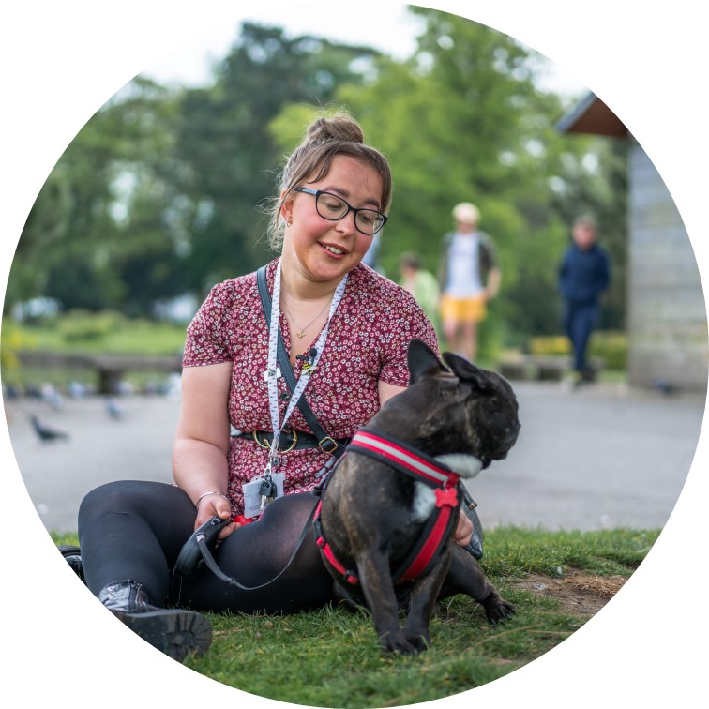
Main Activity
We will not always have the same opinion as other people, and that is ok!
However, it is important that we are always kind and respectful to others, even if we have a different opinion to them. A disagreement does not need to become an argument.
We can also try to understand the other person’s point of view.

Slide 25
Scenario 1
You and your group of friends always get together to play the same game. During the holiday, you learn about a new game which you think they would like too. However, when you tell them about it, they don’t want to try it. They tease you about liking the other game.
What would you do?

Slide 26
Scenario 2
You are playing in the park. Your friend sees someone else’s bag by the football pitch. Inside there is a bag of sweets. Your friend says you should take them and eat them together. You don’t think you should.
What would you do?

Slide 27
Scenario 3
You and your friend support different football teams and they are playing against each other in the final. Your team win and you want to celebrate. Your friend is really upset.
What would you do?

Slide 28

Main Activity
Well done for thinking of ways to respond to these situations.
It is important to remember to stay calm and polite and try to avoid arguments. Even if someone has a different opinion to you, it isn’t right to hurt their feelings.
If someone says hurtful things to you, remember to tell a trusted adult.

Slide 29
Can my friend…?
Can my friend support a different team to me?
Can my friend follow a different religion to me?
Can my friend have a different favourite hobby to me?
Can my friend have other friends?
…of course they can!
Remember, you can still be friends even if you have different opinions about things!
Notes:
Self-Empathy

Slide 30
The Empathy Wall
Help & Support
Showcase your week and work with us on our Empathy Wall
For further resources, support and guidance about the issues covered today, visit our Help and Support page

