Slide 1
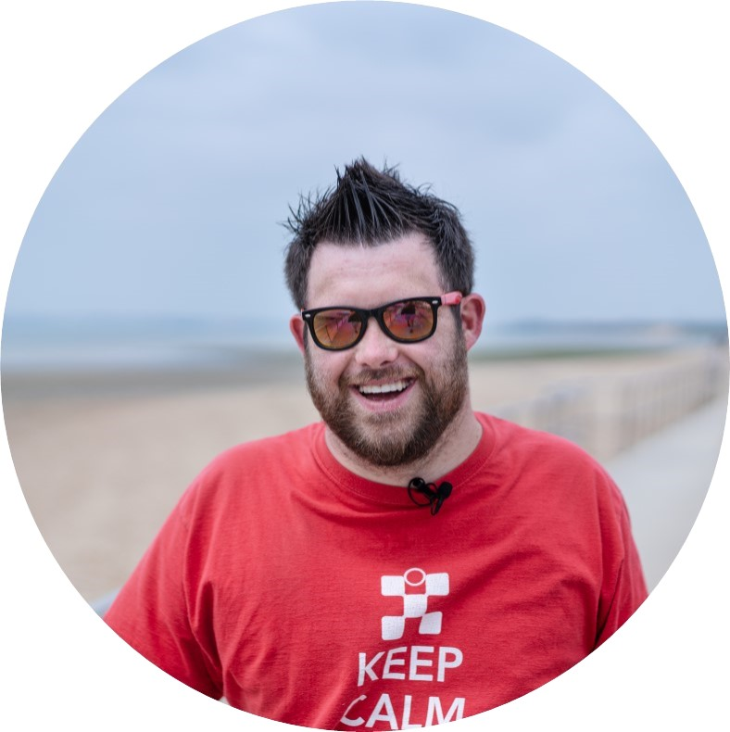

James' Story
Stage 2: Building Empathy
8 - 11 years

Slide 2

Choose your lesson:
Empathy with Myself
Empathy with Others

Slide 3
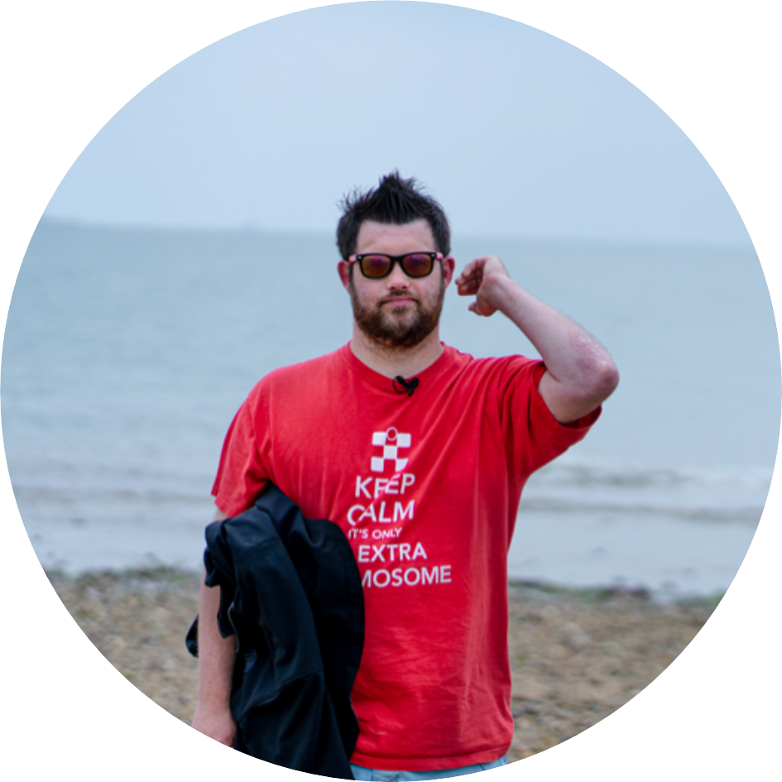
Empathy with Myself

Slide 4

Preparing to Connect
Aims & Objectives
To use empathy to fully and productively engage with other people.

Slide 5
Student Objectives & Aims
All students will be given the opportunity to value and celebrate diversity.
Most students will acknowledge the existence of stereotypes and prejudice and the harm they cause.
Some students will explore the impact biases can have when forming and maintaining relationships.

Slide 6
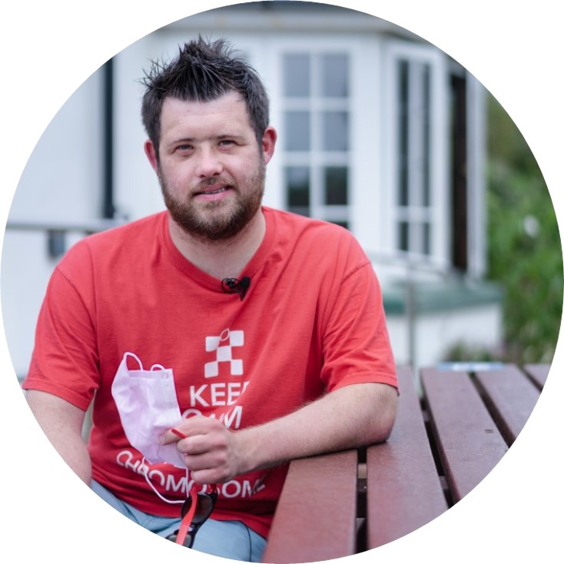
Focusing Activity
Think of a time when you have been supported by others.
Examples:
Being cheered on by your friends
Being helped by your teacher
Being cared for by a doctor.

Slide 7
Focusing Activity
What did people say to support you?
What did people do to support you?
How did this make you feel?

Slide 8
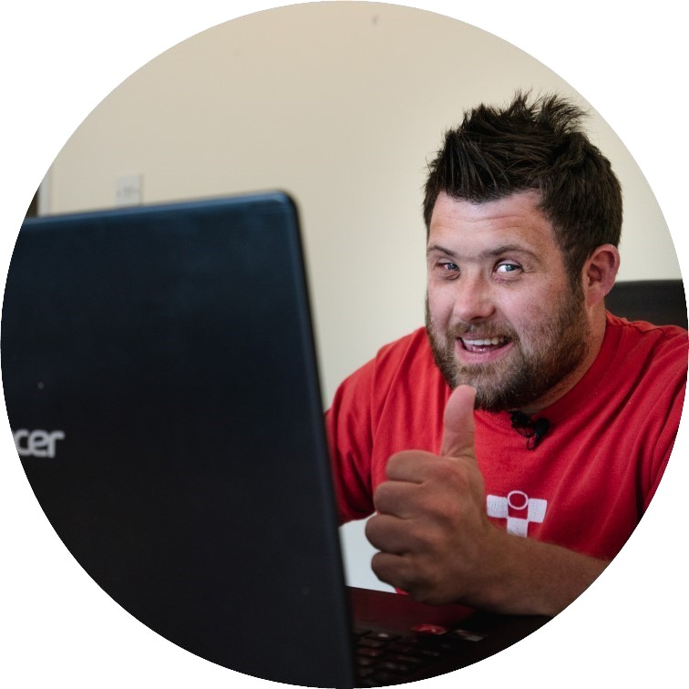
Main Activity
When we met James in his film we learnt that he loves football!
He talked about his favourite team, his dreams and how he approaches life. We met his mum too!
We also learnt that James has a condition called Down syndrome.

Slide 9
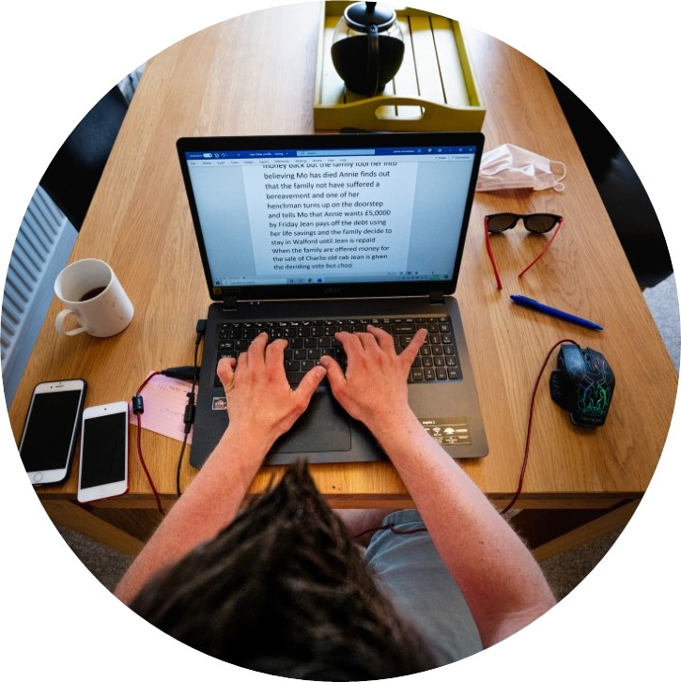
Main Activity
Down syndrome is a condition that affects the way some people look, learn and grow.
Down syndrome occurs when someone is born with an extra chromosome in their all or some of their cells.
A person who has Down syndrome may have to work harder to learn how to do some things which come more easily to others.

Slide 10
Main Activity
When James was born, his parents were told he would never be able to do certain things.
What do you think it felt like to be told this?
Have you ever been told you won’t be able to do something?
How did it make you feel?

Slide 11
Main Activity
James has achieved many things already, including lots of things he was told he would never be able to do.
He is still young and still achieving – as he says, he is “smashing life!”
How does this make James and his mum feel?

Slide 12
Main Activity
Sometimes people make assumptions about what people can achieve.
For example, some people think that
girls aren’t as strong as boys
people who use wheelchairs can’t play sport
people with Down syndrome can’t live on their own.
These are called stereotypes.
Have you heard that word before?

Slide 13
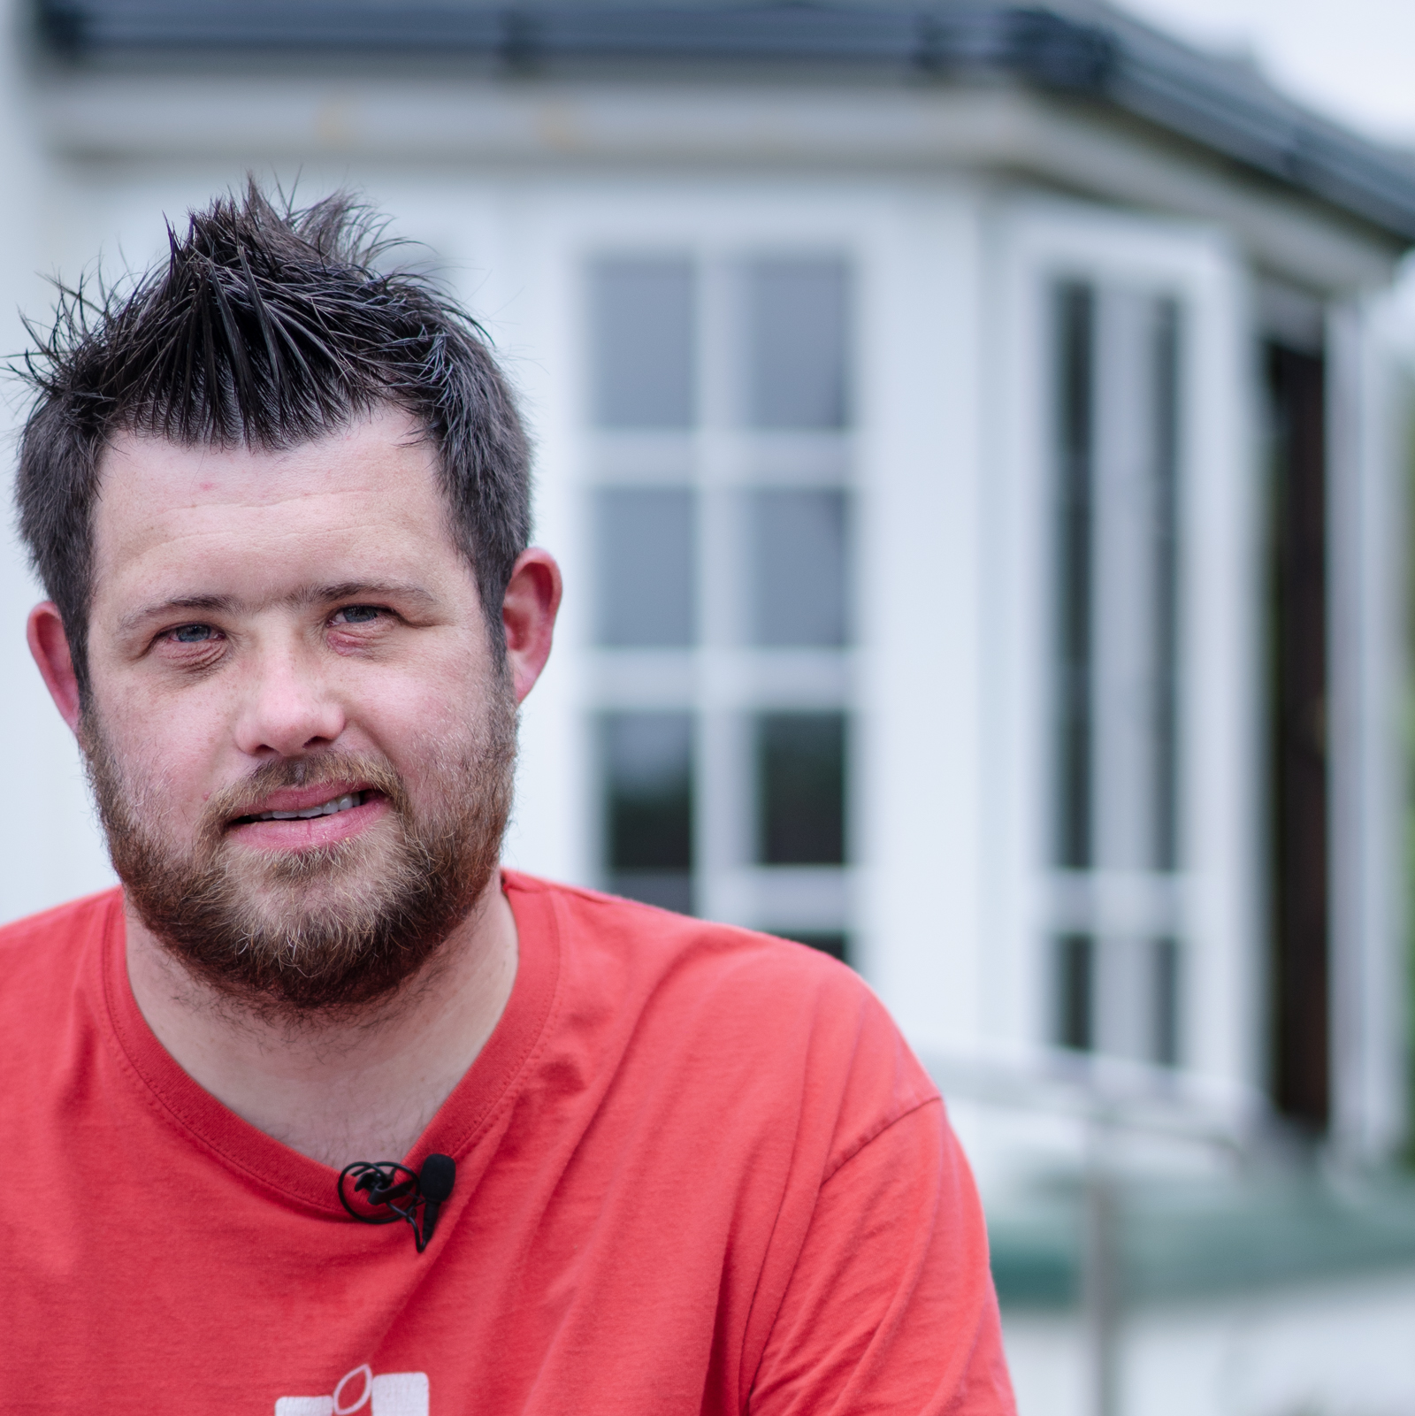
Main Activity
Stereotypes are ideas that people have about a group or type of person. They are usually false and can cause people to make unfair or inaccurate assumptions. Unfortunately, some people make stereotypes about people with conditions like Down syndrome.
It is important that we remember not to judge people based on stereotypes. Instead, we should get to know each person as an individual!

Slide 14

Main Activity
We have already discussed the many ways in which we are different and how this makes us special.
We all speak in different ways, but that doesn’t mean we can’t be understood.
We all learn in different ways but that doesn’t mean we can’t achieve.

Slide 15
Main Activity
Things I find difficult
Things I can do easily
Things I can do with help
Things I choose not to do

Slide 16
Main Activity
Every single one of us has a range of abilities and preferences. We are all capable of learning to do different things but we will not learn in exactly the same way as each other.
There are also some things that we might decide are not for us, and that is ok!
Remember, we cannot make assumptions about what other people can or can’t do.

Slide 17
Plenary
One of the ways we can make sure we don’t make stereotypes is by reserving judgement and getting to know each person as an individual.
Why does getting to know people stop us from stereotyping?
What questions can you ask someone to get to know them better?

Slide 18
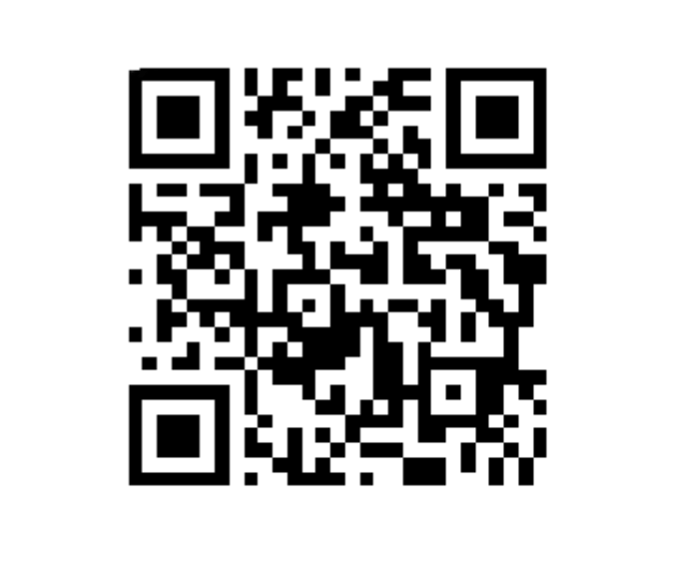
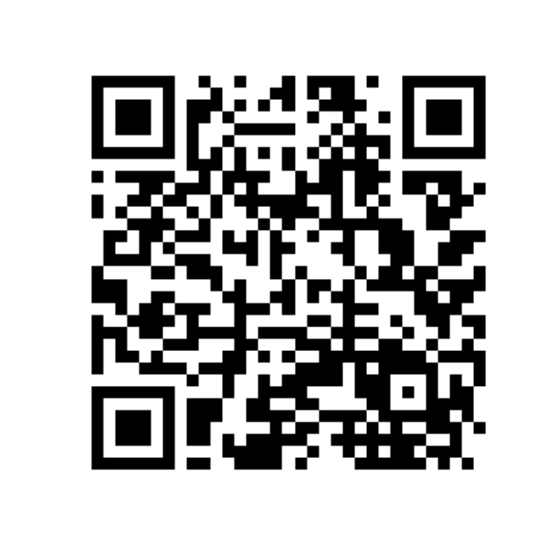
The Empathy Wall
Help & Support
Showcase your week and work with us on our Empathy Wall
For further resources, support and guidance about the issues covered today, visit our Help and Support page

Slide 19
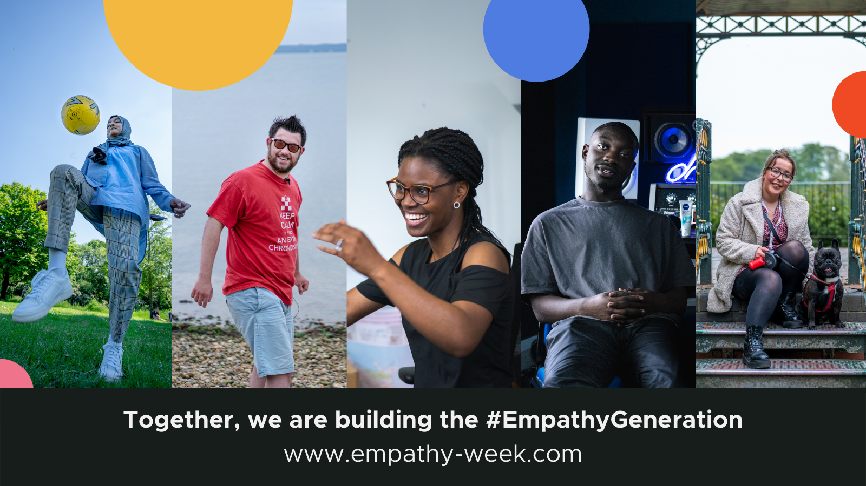

Slide 20

Empathy with Others

Slide 21
Listening with Empathy
Aims & Objectives
To understand and practise empathic listening.

Slide 22
Student Objectives & Aims
All students will be given the opportunity to practise meaningful communication strategies.
Most students will learn to appreciate the role of listening when connecting with others.
Some students will learn to listen effectively whilst reserving judgement.

Slide 23
Focusing Activity
What do you remember about James?
Think of one difference between you and James.
Think of two similaritities between you and James.

Slide 24

Click to watch James' Story
Video | 8 mins

Slide 25
Discussion Page
Think back to the top tips for listening we thought of in our lesson about Kwasi.
What do we need to listen properly?
What does it feel like to be listened to?
What can we gain from listening to other people?
Notes:
Self-Empathy

Slide 26

Main Activity
James’ speech is affected by his condition.
People’s voices can be different in many different ways for example language, vocabulary, speed, tone and accent.
It is unkind to make fun of someone’s voice for any reason. Remember, whatever someone’s voice is like, everyone deserves to be listened to.

Slide 27
Main Activity
Sometimes we might have to change the way we listen in order to be able to communicate with someone. Talk with your partner about how you can communicate with…
…someone speaks very quietly?
…someone who speaks a different language to you?
….someone who is shy?
Notes:
Self-Empathy

Slide 28
Main Activity
There are many reasons why someone may find communicating more difficult.
When communicating with anyone, it is really important that we give them our full attention.
Talk to your partner about how you can show someone you are listening to them.
Think about your facial expressions, body posture and the things you can say back to them.
How can you show somebody you are listening to them?

Slide 29

Main Activity
If James were in our classroom, we could show him we were listening using all the suggestions you just made!
As James is not with us, we are each going to write him a short note to thank him for making the film for us.
In your note, include sentences that show James we really listened to what he had to say.

Slide 30
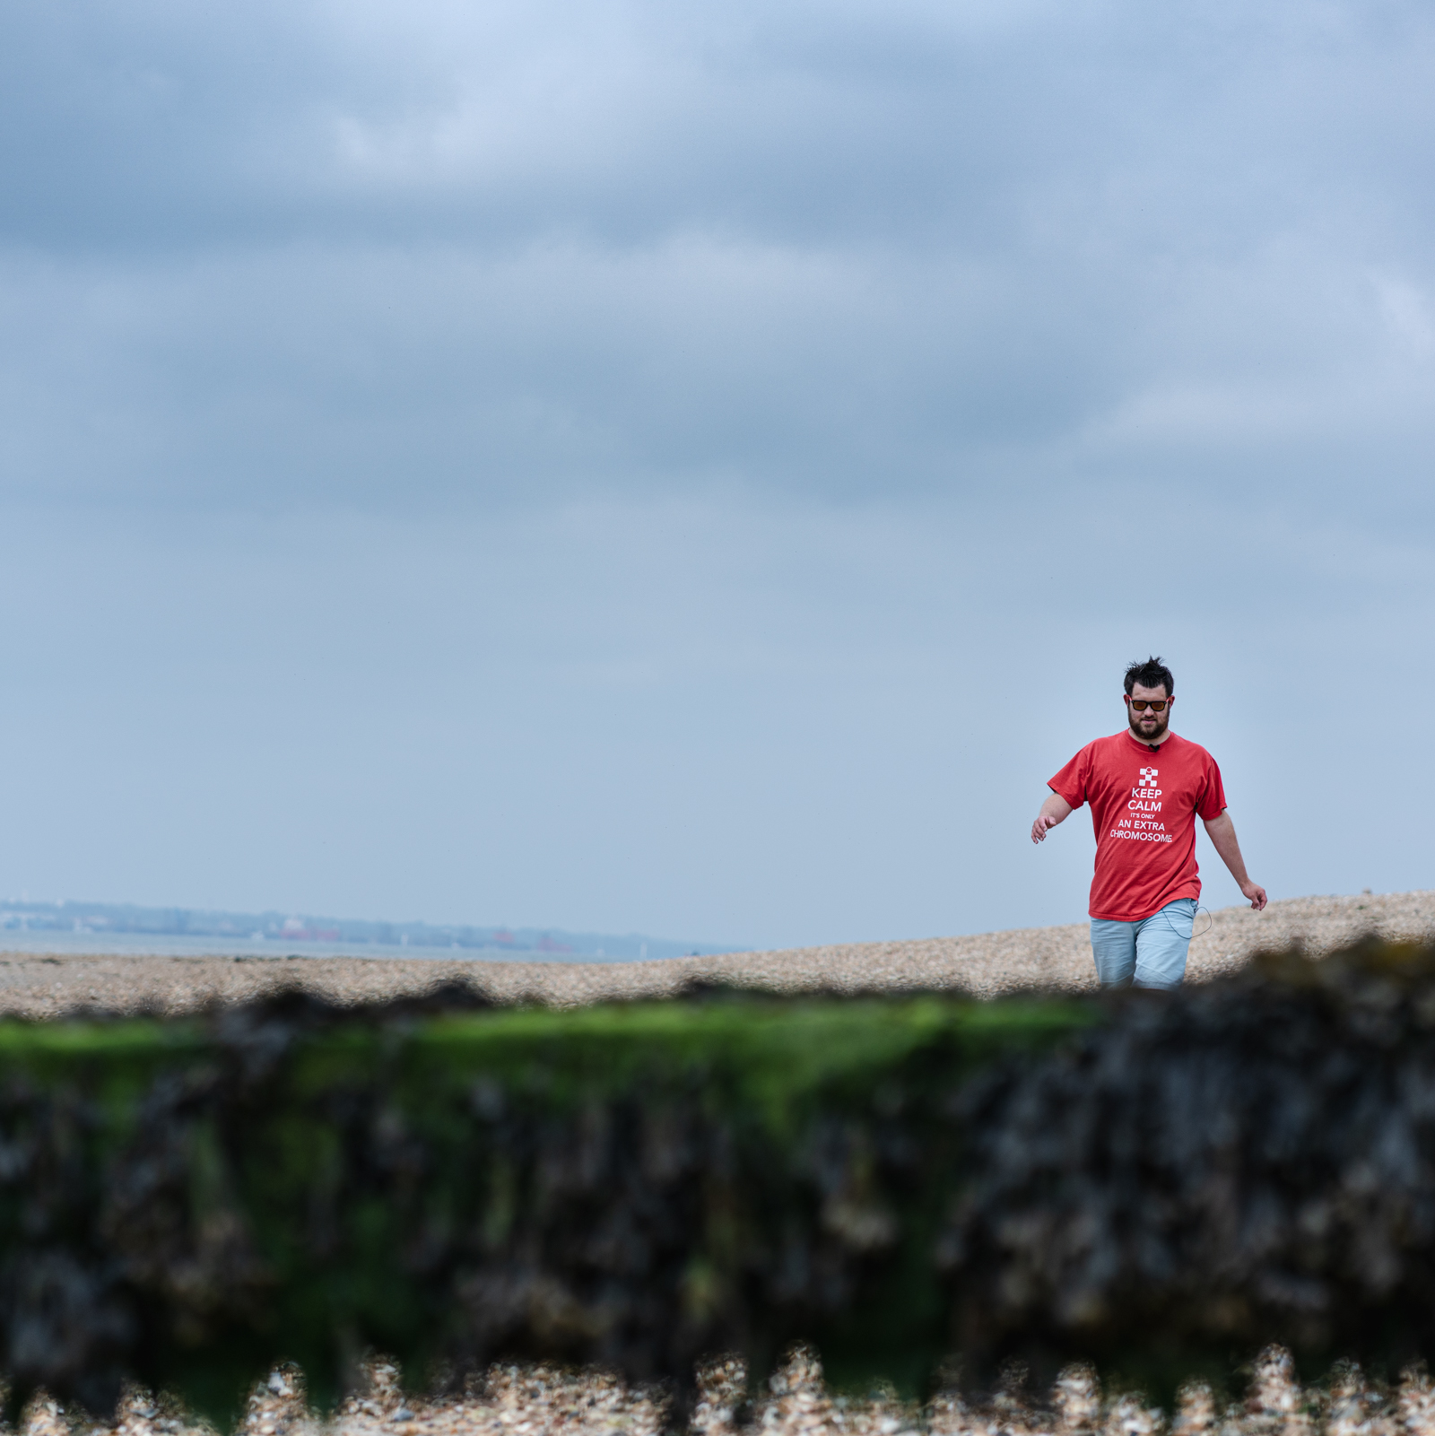
Main Activity
Think of a few sentences to communicate the following things:
thank James and his mum for making the film;
what you found interesting;
what you learned from listening to his words;
how you will try to follow James’ advice about life.

Slide 31
Listening Goals
I will try harder not to get distracted when someone else is talking.
I will try harder not to interrupt.
When someone has finished talking, I will ask questions if I do not understand.
I will try to look at someone when they are speaking to me.
Which target have you chosen?

Slide 32
The Empathy Wall
Help & Support
Showcase your week and work with us on our Empathy Wall
For further resources, support and guidance about the issues covered today, visit our Help and Support page

