Slide 1
Britain As the First Industrial Nation
Child Labour in Factories

Slide 2

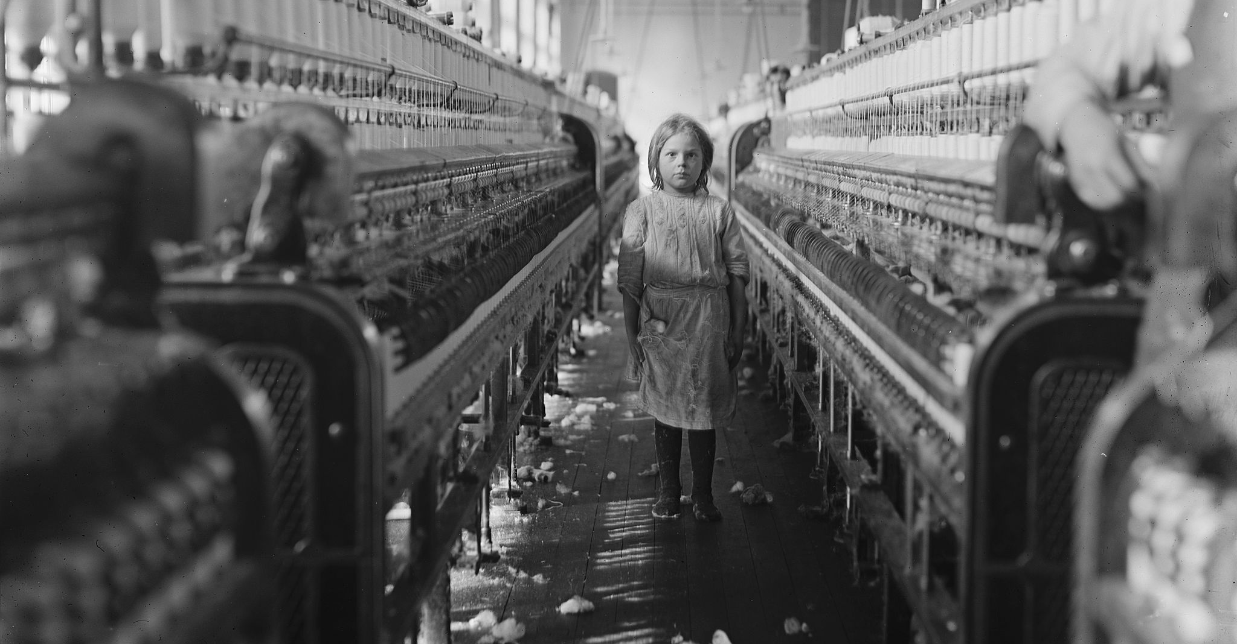
I See, I Hear, I Feel
Imagine you are the person taking this photograph. What can you see, hear and what do you feel about this scene?
A small girl in an American cotton mill, 1908. This is a scene that could have been witnessed in many factories in Britain in the 19th century.

Slide 3
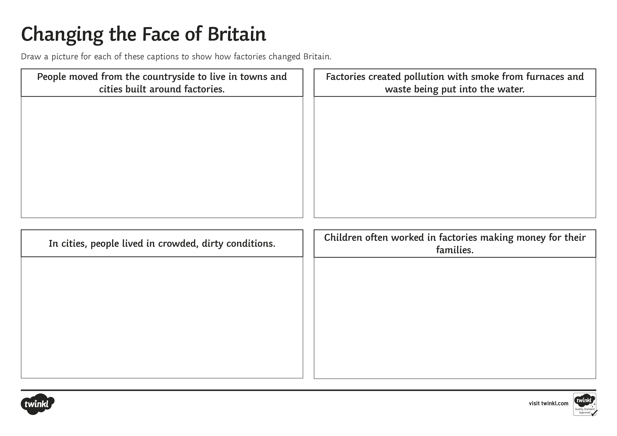
Changing the Face of Britain
Factories changed the shape of Britain in many ways. From mills that produced textiles, to metal works that produced wrought-iron goods, they changed where people lived, the way people lived and the way people worked.
For each of the headings on your Activity Sheet, draw an image to show what these changes were.

Slide 4

It’s a Hard-Knock Life
Study these two sources, both taken from a Parliamentary Report from 1831-2.
What can these accounts tell us about what life was like for children working in mills at this time?
Source A
‘My boy, Edwin, was well known for being lively and straight before he went to the mill, but after three years he was weak in his knees and it was so bad that he could hardly walk. Many people told me to take him away but I was a poor man with a large family and needed his wages.’
A father from Keighley, Yorkshire
Source B
‘I saw her shoulders and asked what the matter was. She said “the overlooker has strapped me, but do not complain for we will be sacked.” The overlooker had strapped her because she hadn’t done as she was told immediately. Her back was beat nearly to a jelly…’
Samuel Coulson talking about his daughter, who worked 18 hours a day in a mill in Leeds.

Slide 5

The Factory Act of 1833
After many terrible years of poor conditions for children in factories, the government decided something must be done to make things better.
Shown here are the main points of the Factory Act, 1833; a new law that came into place to protect children:
1) No child workers under nine years of age.
2) Employers must have an age certificate for their child workers.
3) Children of 9-13 years to work no more than nine hours a day.
4) Children of 13-18 years to work no more than 12 hours a day.
5) Children are not to work at night.
6) Two hours schooling each day for children.
7) Four factory inspectors appointed to enforce the law. (in the whole of Britain!)
With a partner, select two things that were improvements and two things that were still not satisfactory, in your opinion.

