Slide 1
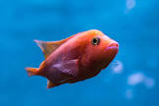


Short-term memory
How many stages are there in the life cycle of a frog?
Can you remember things from a while ago?
Give an example of a mammal.
Question from the last topic – good long term memory
Which scientist discovered gravity?

Slide 2
Sticky knowledge!!
Irreversible changes, like burning, cannot be undone. Reversible changes, like melting and dissolving, can be changed back again.

Slide 3
L.O: To compare everyday materials on the basis of their properties.

Slide 4


Slide 5

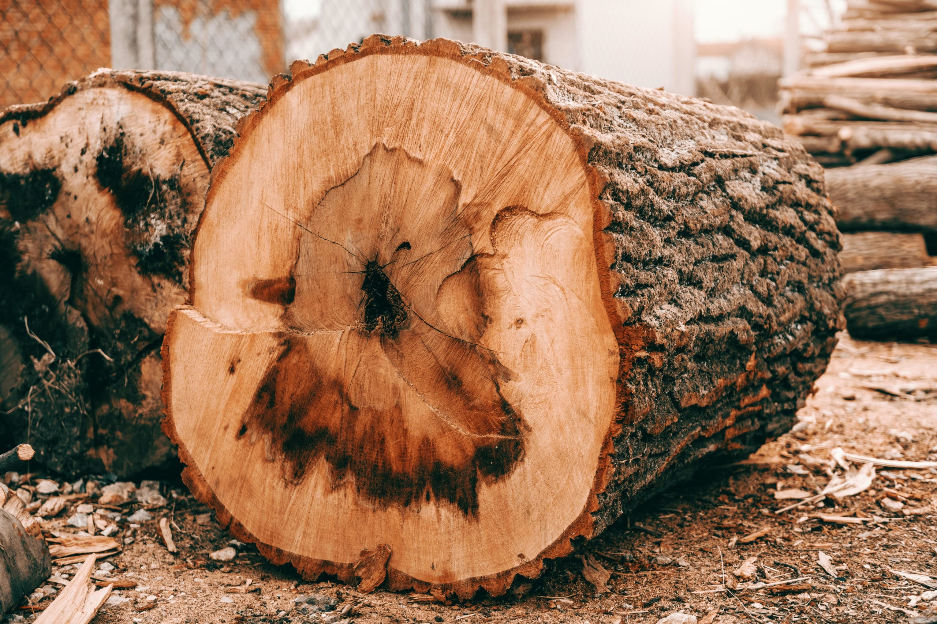
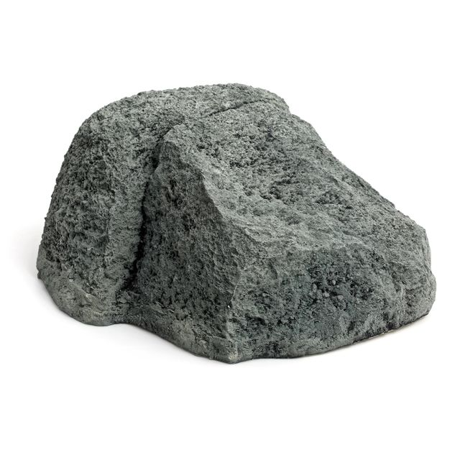


What is the difference between natural materials and human-made materials?
Can you think of any examples?
Natural
Human-made

Slide 6


