Slide 1
The Storm Keeper’s Island
By Catherine Doyle

Slide 2
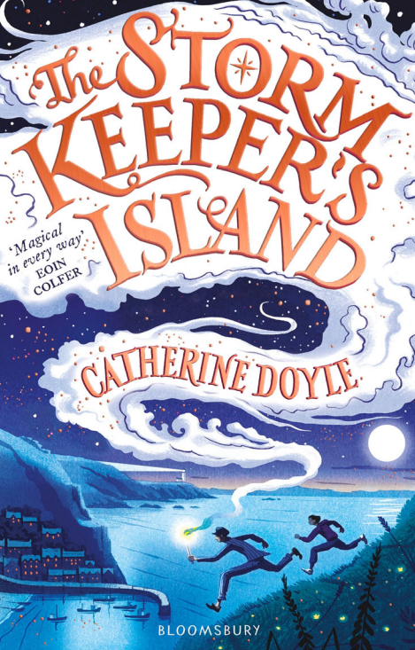
Day 1
Predict
What do you think this book is going to be about?
Do you think it is fiction or non-fiction and why?

Slide 3
Day 1 – Vocabulary check (Pages 11 and 12)
Find and copy a word that means:
Knobbly, rough, and twisted, especially with age.
Tremble or shake with a slight rapid motion.
Eating food or prey hungrily or quickly.
Burnt and blackened.
To cover or surround something.
6) Make or become spread out from a rolled or folded state.
Challenge: Choose 3 words from the text and create a dictionary.

Slide 4
Day 2 - Page 11 - 13
Find and copy a simile that has been used to describe the weather.
2) Why has the author used a hyphen in this sentence?
‘Betty?’ said the boy uncertainly. ‘Should we –’
3) Why did the girl grow restless?
4) Define ‘unfurled’
5) How was Betty feeling after the boy woke up? Use evidence from the text to support your answer.
6) Predict what you think is going to happen next using evidence from the text.

Slide 5
Day 3 – Chapter 1 – Page 1-3
Find two pieces of evidence in the text that suggest that the ferry is old.
Define nattering.
Do you think Fionn is enjoying his time on the ferry? Use evidence to support your answer.
Look at the line ‘Don’t be such a baby!’ Tara taunted. What impression does this give you of Tara?
Look at the line I’m mature now, Fionny. My interests have changed. Why has the author used italics?
6) Fionn went back to staring at the blurry horizon to help his headache. True or false? Prove it.

