Slide 1
We hope you find the information on our website and resources useful. This resource contains links to external video websites. These websites often have autoplay features meaning that other videos will play after the video you are watching finishes. You should disable this feature before using the video in any classroom or similar setting. Twinkl assumes no responsibility for the contents of linked websites. The inclusion of any link in this resource should not be taken as an endorsement of any kind by Twinkl of the linked website or any association with its operators. We have no control over the availability of the linked pages. If the link is not working, please let us know by contacting TwinklCares and we will try to fix it, although we can assume no responsibility if this is the case.

Slide 3
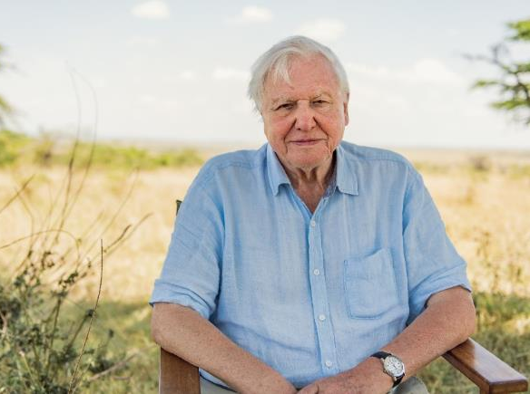
Sir David Attenborough
Sir David Attenborough is a very well-known English broadcaster and natural historian. He was born on the 8th of May 1926, in London. He studied natural sciences at Cambridge University and joined the BBC in 1952.
Sir David Attenborough has produced, written and narrated over 100 groundbreaking natural history documentaries.
Conor McDonnell / WWF-UK
Have you seen any of these?
Life On Earth (1979)
The Private Life of Plants (1995)
Blue Planet (2001)
Planet Earth (2006)
Blues Planet II (2017)

Slide 4
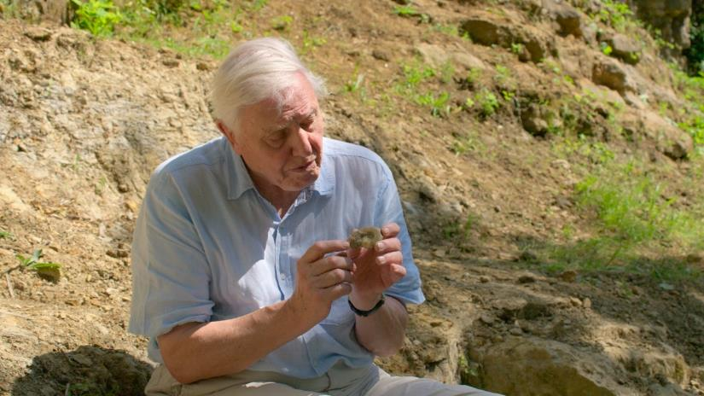
Sir David Attenborough
Did You Know…?
Sir David has visited every continent on earth. He is thought to be the most-travelled human in history!
‘David Attenborough: A Life on Our Planet’ is a culmination of his extraordinary experiences and a reflection on the changes he has witnessed during more than 90 years on earth.
WWF-UK / David Attenborough: A Life On Our Planet

Slide 5
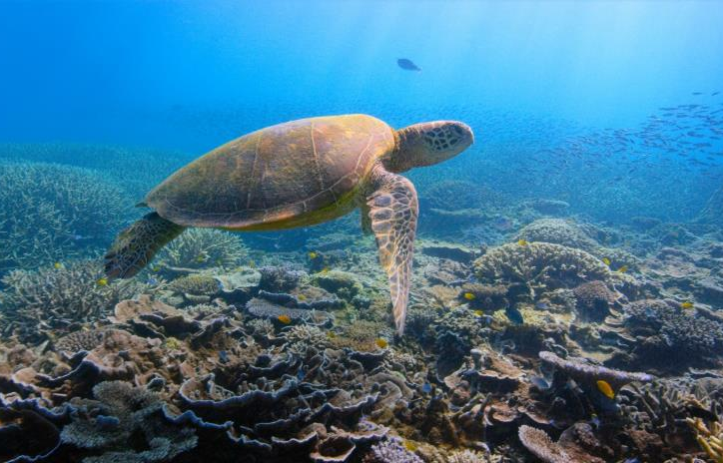
A life on Our Planet
‘David Attenborough: A Life on Our Planet’ is a powerful, first-hand account of the impact humanity has had on nature and a message of hope for future generations.
Over his lifetime, Sir David has witnessed a serious decline in the living world.
Netflix / David Attenborough: A Life On Our Planet
Did You Know…?
In 2014, the WWF calculated that populations of wild animals had reduced by more than half since 1970.

Slide 6
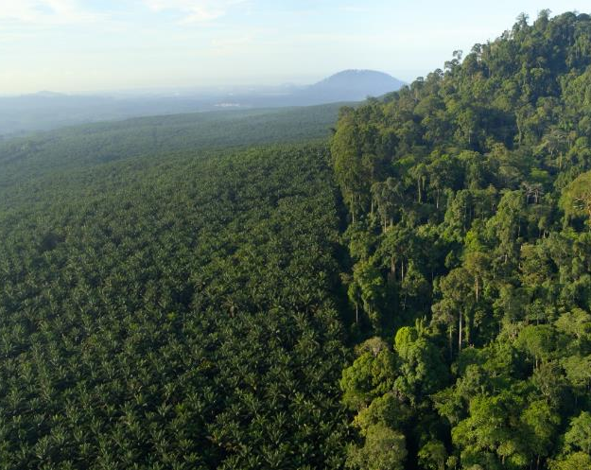
A life on Our Planet
Sir David is dedicated to trying to stop this human-made devastation and believes, if we can change to live in a more sustainable way, we can reverse the damage.
Every single one of us has a responsibility to look after the earth — for ourselves and future generations.
We can all play a part, however small, in repairing the destruction.
What Do We Need to Do?
In ‘A Life on Our Planet’, Sir David Attenborough tells us how to build a new kind of life on earth.

Slide 7
The Four Imperatives
In ‘A Life on Our Planet’, four imperatives will be covered. They are:
Use Less Space
Eliminate Waste
What can we do to
reduce deforestation?
How can we reduce,
reuse and recycle waste?
Go Carbon Net Zero
Revive Our Oceans
How can we generate
and use renewable energy?
How can we look
after our oceans?
In this presentation, we will be looking at 'Go Carbon Net Zero'.
Imperatives are important issues that need urgent attention or action.

Slide 8

Go Carbon Net Zero
What Does This Mean?
‘Go Carbon Net Zero’ is to do with reducing our carbon footprint by using renewable sources for our energy, instead of relying on fossil fuels.
To learn more about this, we are going to explore the following questions:
Where does our energy come from?
How does our energy use affect the planet?
What is renewable energy?
What types of renewable energy could we use?
How does renewable energy work?
Why is renewable energy better for our planet?
Where is the best place for each renewable energy source?

Slide 9
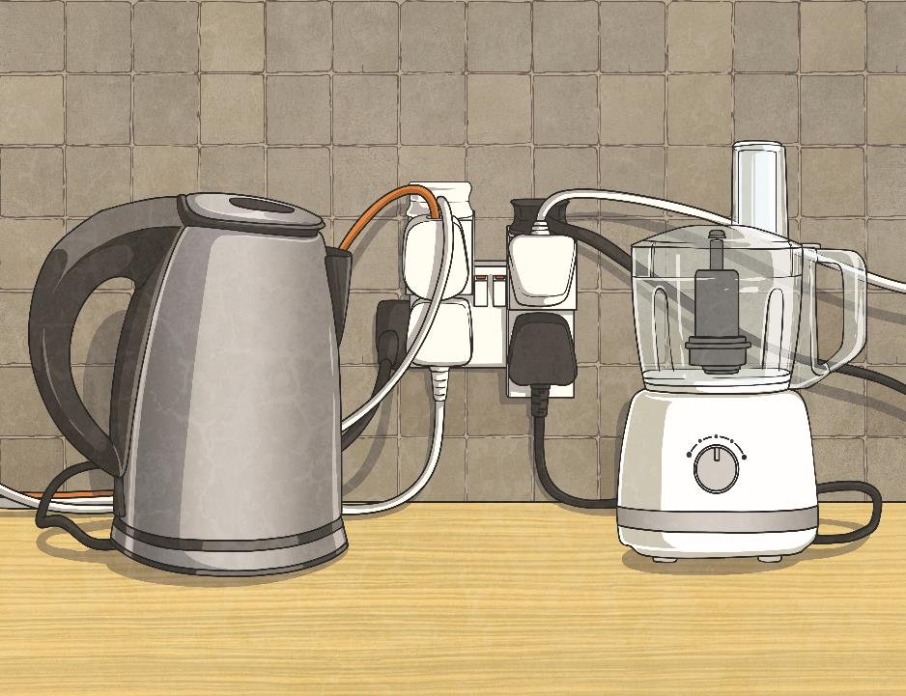
Go Carbon Net Zero
What Is Energy?
When we talk about energy here, we mean the energy that is used to provide us with electricity, heat and transport.

Slide 10
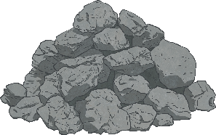
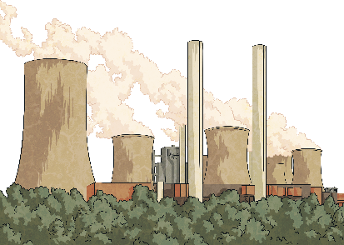
Where Does Our
Energy Come From?
Most of the energy we use on earth comes from fossil fuels (oil, coal and natural gas). These are natural fuels that have formed from the fossilised remains of plants and animals that lived millions of years ago. These fuels are high in carbon.
We depend on these fuels to provide us with electricity, to heat our homes, to run our vehicles and to power manufacturing.
Did You Know…?
In 2019, over 80% of our global energy came from fossil fuels.
Think About It
What are the disadvantages of fossil fuels?

Slide 11
How Does Our Energy
Use Affect the Planet?
Our reliance on fossil fuels for energy has had a negative effect on life on earth.
Did you think about any of these disadvantages?
Land Degradation
Water Pollution
The process of unearthing fossil fuels, which destroys vital wildlife habitats.
Oil spills, acid run-off and waste water can pollute freshwater and ocean ecosystems.
Global Warming
When burnt, fossil fuels release carbon dioxide. This traps heat in the atmosphere and leads to climate change.

Slide 12
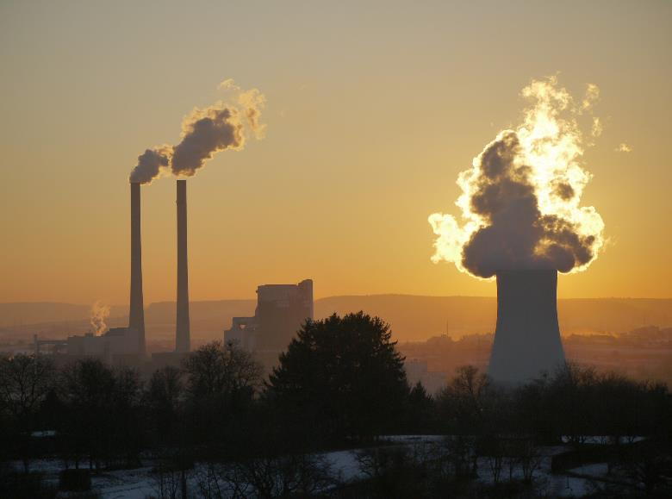
How Does Our Energy
Use Affect the Planet?
Air Pollution
Other harmful chemicals are emitted into the air when fossil fuels are burnt, including mercury, sulphur dioxide, carbon monoxide and nitrogen oxide.
Ocean Acidification
Our seas absorb up to 25% of carbon emissions, causing it to become more acidic. This can affect the growth of marine life.

Slide 13
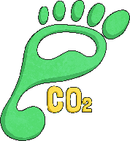
How Does Our Energy Use Affect the Planet?
Carbon Footprint
Our ‘carbon footprint’ is the total amount of greenhouse gases that are produced and released into the atmosphere to support our individual lifestyle.
In modern society, our day-to-day lives rely on using lots of energy. Things like driving the car, watching TV, cooking dinner, playing computer games, washing clothes and showering all use energy. Most of us have a high carbon footprint.
Think about your day so far.
Make a list of everything you have done that has used energy.
Keep this list - we will use it later.
As we know, at the moment much of our energy comes from fossil fuels, which contribute to a high carbon footprint.
We can help to reduce this if we use alternative sources of energy.

Slide 14




What Is Renewable Energy?
The good news is that our planet does have alternative sources of energy.
Renewable energy is the fastest-growing energy source in the world.
Think About It
What does renewable mean?
If something is renewable, it means it can be replaced or has an endless supply.
Renewable energy sources can’t be used up and will never run out.
Are fossil fuels renewable?
Do you know any renewable energy sources?

Slide 15
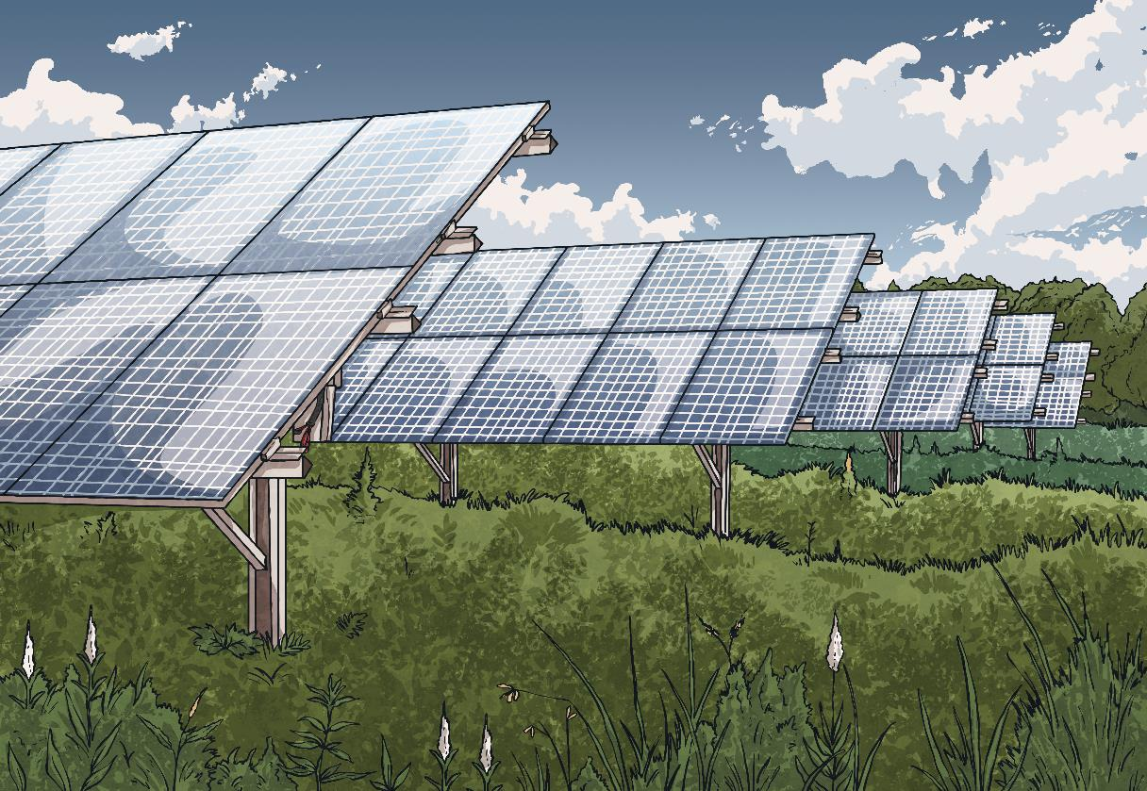
What Is Renewable Energy?
Watch this video for an introduction to renewable energy sources.

Slide 16
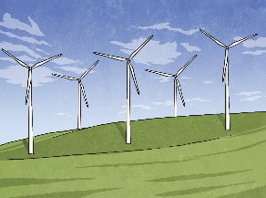
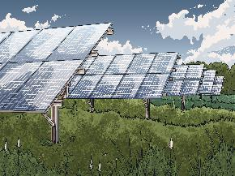
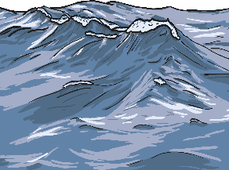
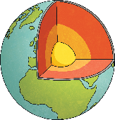

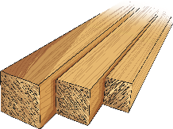
Time to Think
Can you remember the different types of renewable energy?
wind
solar
(the sun)
hydroelectric (water)
geothermal
(earth’s heat)
These are the four most common sources of renewable energy. Can you think of the other two?
Have you seen any of these renewable energy sources being used?
biomass
(plants and animal material)
wood

Slide 17
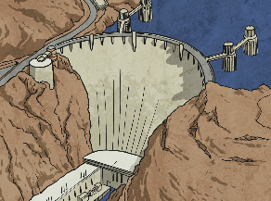
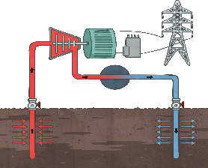
How Does Renewable Energy Work?
Click on each type of renewable energy to discover how each one works.
wind
solar
Have you watched all the videos?
hydroelectric
geothermal
continue

Slide 18
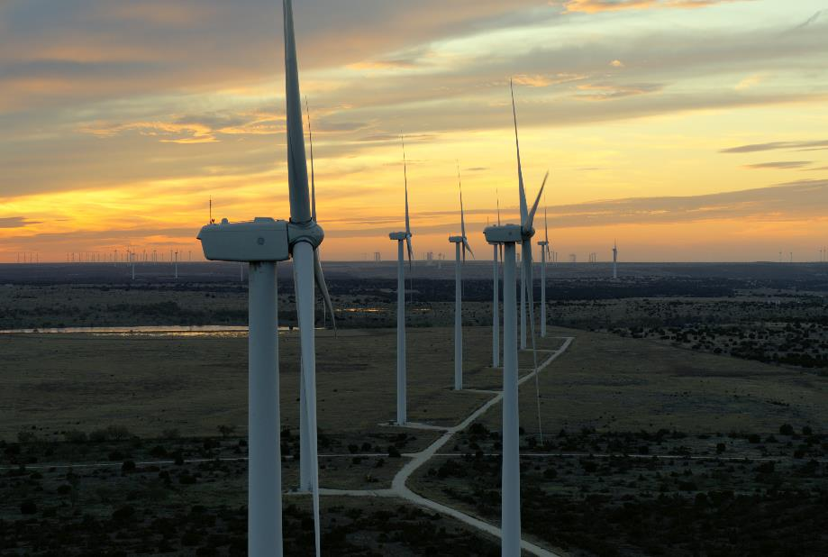
Wind Power
Watch this video to learn more about wind power.
As you’re watching, think about:
How is the energy collected and stored?
What are the advantages and disadvantages of wind power?
WWF-UK / David Attenborough: A Life On Our Planet
Back

Slide 19
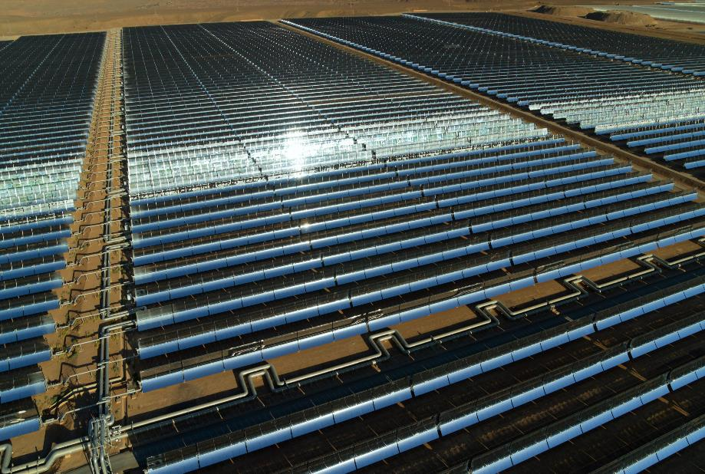
Solar Power
Watch this video to learn more about solar power.
As you’re watching, think about:
How is the energy collected and stored?
What are the advantages and disadvantages of solar power?
WWF-UK / David Attenborough: A Life On Our Planet
Back

Slide 20
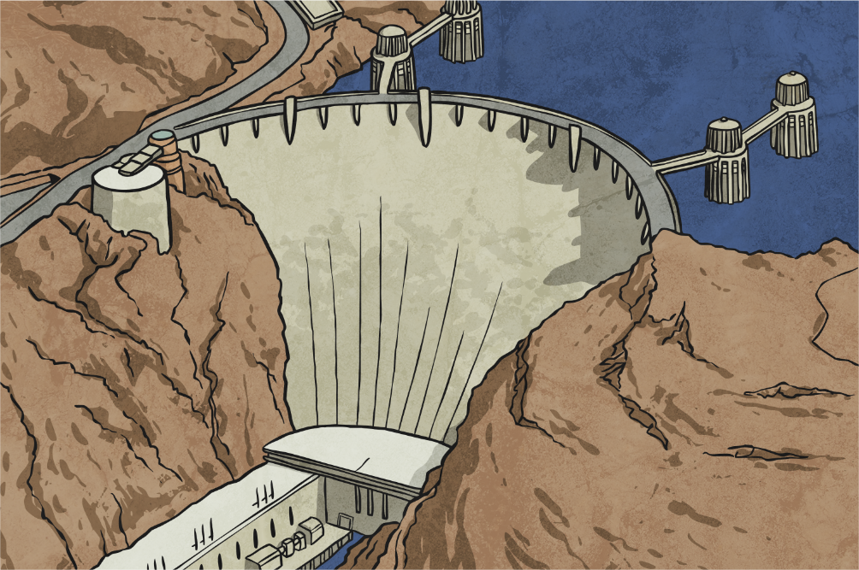
Hydroelectric Power
Watch this video to learn more about hydroelectric power.
As you’re watching, think about:
How is the energy collected and stored?
What are the advantages and disadvantages of hydroelectric power?
Back

Slide 21

Geothermal Power
Watch this video to learn more about geothermal power.
As you’re watching, think about:
How is the energy collected and stored?
What are the advantages and disadvantages of geothermal power?
Back

Slide 22
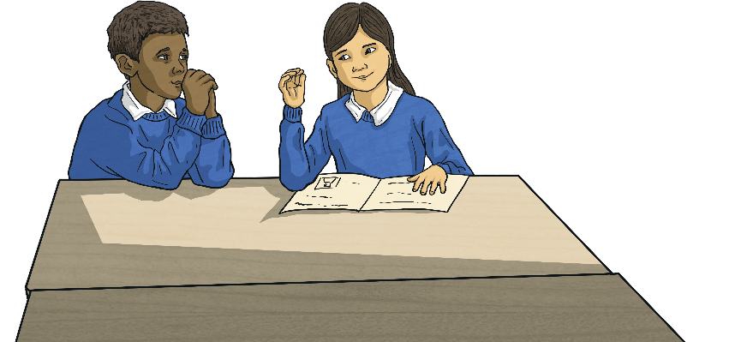
Why Is Renewable Energy Better for Our Planet?
Think, Pair, Share
Think about what you have learnt so far about renewable energy sources.
Talk to a partner about why renewable energy sources are better for our planet than fossil fuels.
Share your thoughts with the class.

Slide 23


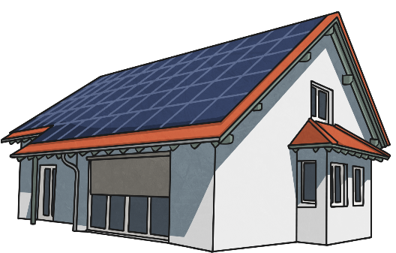
Why Is Renewable Energy Better for Our Planet?
How many benefits of renewable energy sources did you think of?
Renewable energy has many advantages for our planet:
  It is a reliable source of power (it will never run out).
  It produces no direct emissions (zero carbon) so helps combat climate change.
  It creates very low air pollution so is better for our health and the environment.
Did You Know…?
A home can run entirely on solar power and reduce carbon emissions by 80%.
Relying more heavily on renewable energy sources will help our planet to recover from the years of damage caused by our dependence on fossil fuels. How can we make the best use of renewable energy?

Slide 24
Where Is the Best Place for Each Renewable Energy Source?
The information videos you watched earlier mentioned suitable geographical locations for harnessing each type of renewable energy.
Click on the images if you’d like to watch any of the videos again.
wind
solar
geothermal
hydroelectric

Slide 25
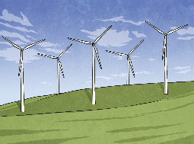
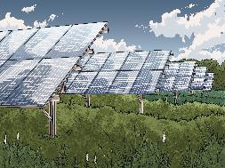
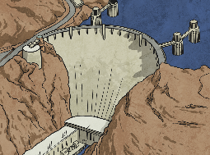

Where Is the Best Place for Each Renewable Energy Source?
Can you match the renewable energy source to the location that is most suitable?
wind
solar
hydroelectric
geothermal
areas with sustained high winds
open terrain with low winds
along the path of a river
near areas of high volcanic activity
open terrain with low winds
near areas of high volcanic activity
unpopulated areas (away from people)
areas that get a lot of sunlight
where there are geysers and hot water springs
areas with high water flow
where there are geysers and hot water springs
unpopulated areas (away from people)
areas that get a lot of sunlight
areas with high water flow
along the path of a river
areas with sustained high winds

Slide 26
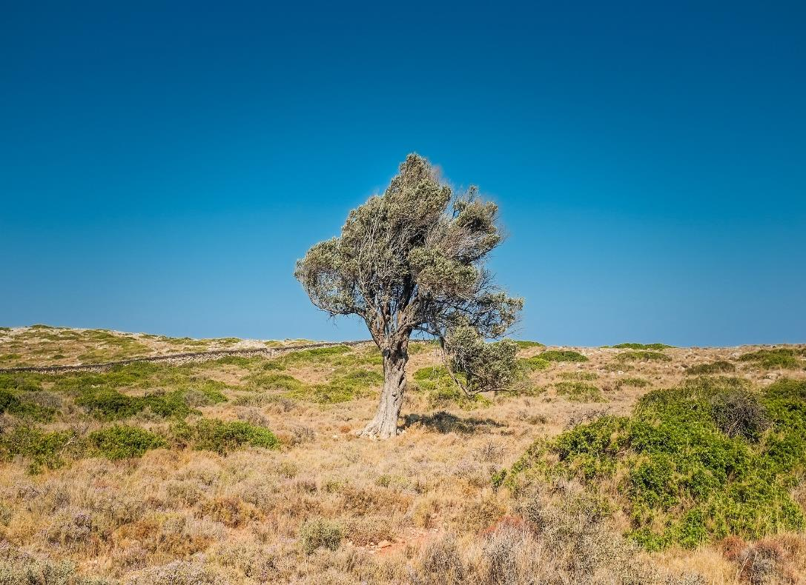
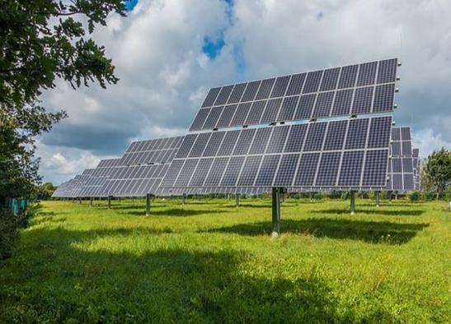
Where Is the Best Place for Each Renewable Energy Source?
Look closely at the features of the locations on the next few slides.
Which type of renewable energy would they suit best?
An open, sunny landscape is ideal for harvesting solar energy.

Slide 27
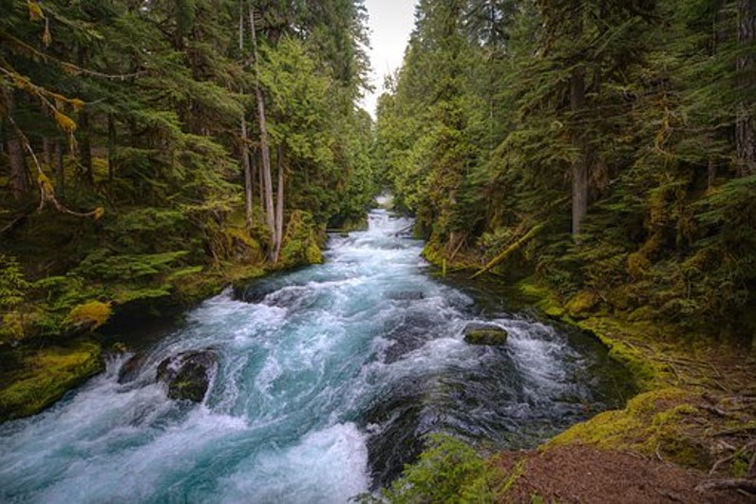
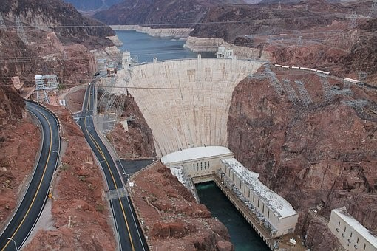
Where Is the Best Place for Each Renewable Energy Source?
A river with a drop in elevation is an ideal location for harvesting hydroelectric power.

Slide 28
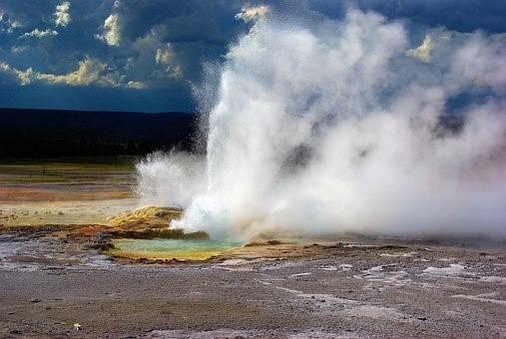
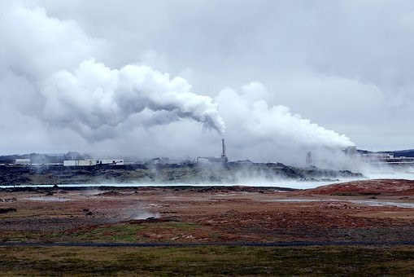
Where Is the Best Place for Each Renewable Energy Source?
An area with geysers and hot springs is an ideal location for harvesting geothermal energy.

Slide 29
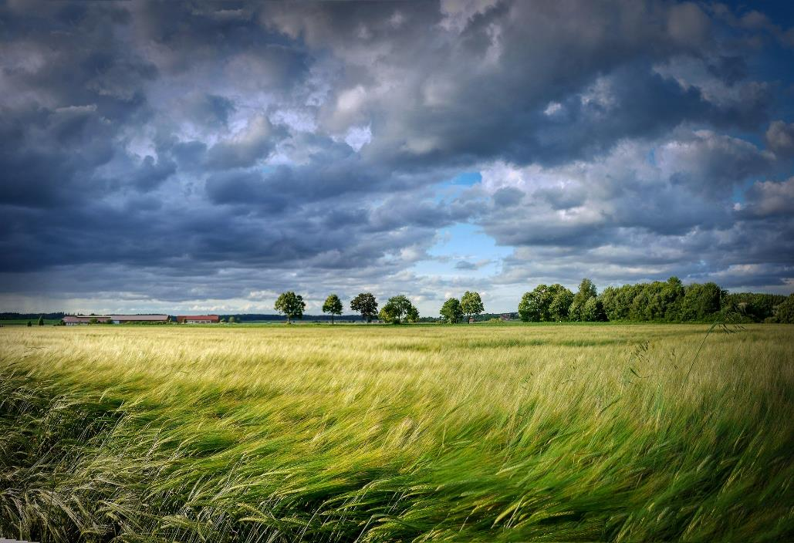
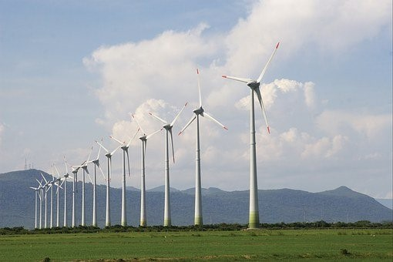
Where Is the Best Place for Each Renewable Energy Source?
An unpopulated, windy area is perfect for harvesting wind power.

Slide 30
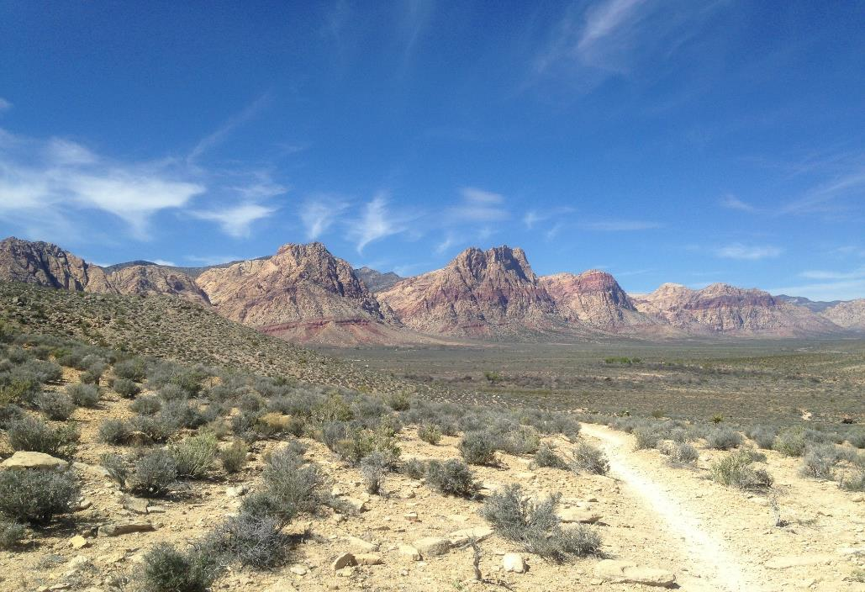
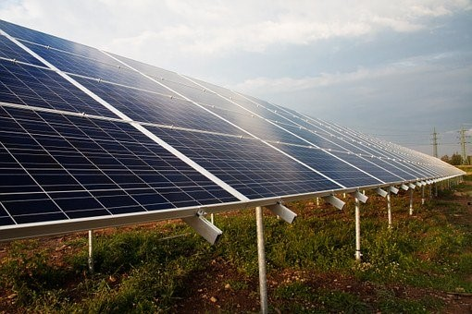
Where Is the Best Place for Each Renewable Energy Source?
An open terrain, with high sun and low winds, is perfect for harvesting solar energy.

Slide 31
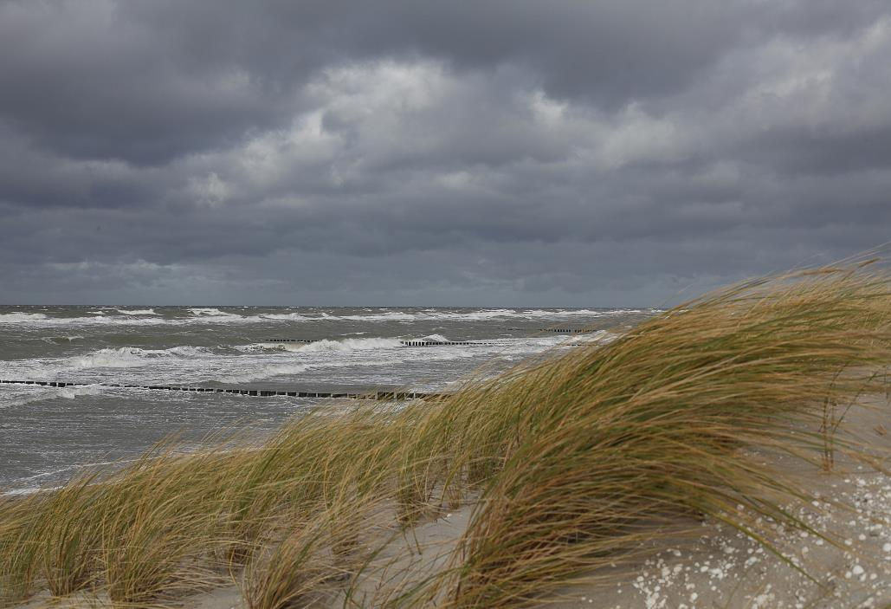
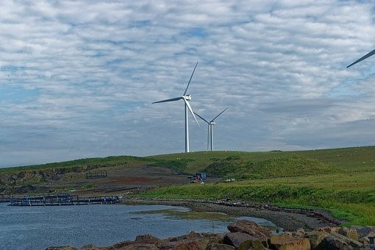
Where Is the Best Place for Each Renewable Energy Source?
A coastal area with sustained winds is an ideal location for harvesting wind energy.

Slide 32
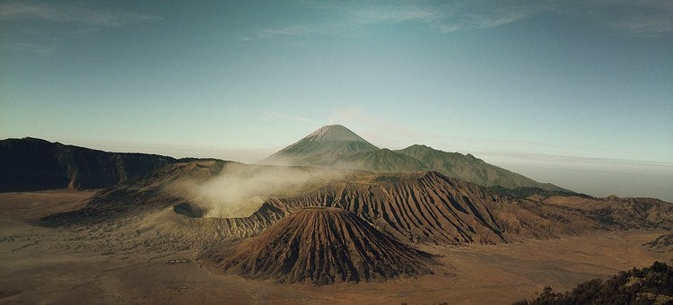
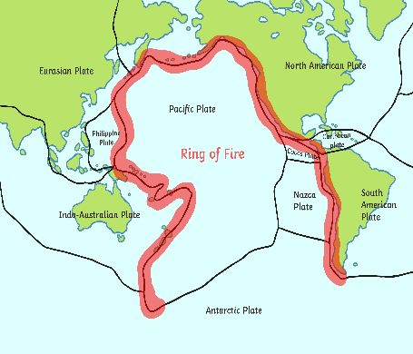
Where Is the Best Place for Each Renewable Energy Source?
Volcanic regions are well suited to geothermal power plants.
Did You Know…?
85% of current geothermal energy plants are in countries that lie on the ‘Ring of Fire’

Slide 33
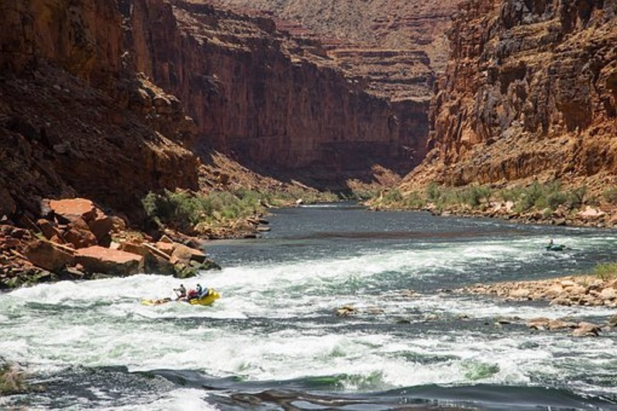
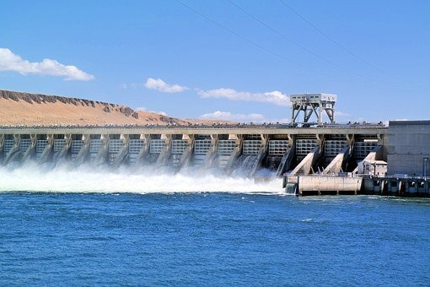
Where Is the Best Place for Each Renewable Energy Source?
A fast-flowing river is an ideal source of hydroelectric energy.

Slide 34
Go Carbon Net Zero
Think about everything you have learned about sources of renewable energy and its benefits.
What does it mean to ‘Go Carbon Net Zero’?
Relying on fossil fuels for our energy needs has resulted in high emissions of greenhouse gases that are harming our planet.
We can help reduce and even eliminate these harmful emissions by using renewable energy sources.
The four main types of renewable energy are solar, wind, hydroelectricity and geothermal.
By carefully choosing where we harvest these energy sources, we can maximise the amount of renewable energy we are able to use.

Slide 35
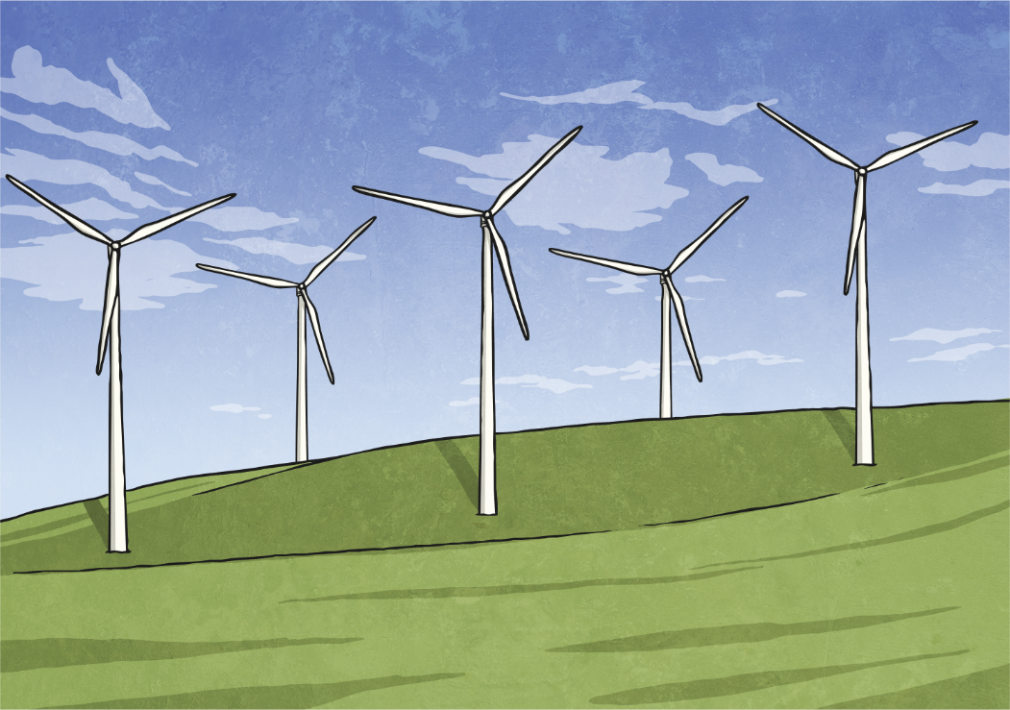
Go Carbon Net Zero
Time to Think
What are the disadvantages of renewable energy?
Do you think the disadvantages should prevent us from using renewable energy sources?

Slide 36

Time to Take Action
What Can We Do to Reduce Our Own Carbon Footprint?
As children, installing your own solar panels or wind turbine at home is not an option. However, there are things you can do to help reduce your energy use and decrease your carbon footprint.
Think About It
Look back at the list you created at the start, which contains all of the different ways you have used energy so far today.
All of those things have contributed to your carbon footprint.
What changes could you make to reduce the amount of energy you use?

Slide 37
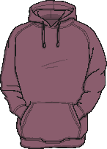
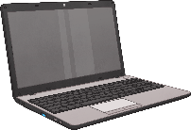
Time to Take Action
Why not try reducing your energy use to help you ‘Go Carbon Net Zero’?
Could you use a scooter, cycle or walk to school instead of driving?
Could you turn out the lights when you leave a room?
Could you wear a jumper instead of turning on the heating?
Could you challenge yourself to have a two minute shower?
Could you turn off your laptop or computer when it isn’t being used?
How many more ways did you think of??

