Slide 1
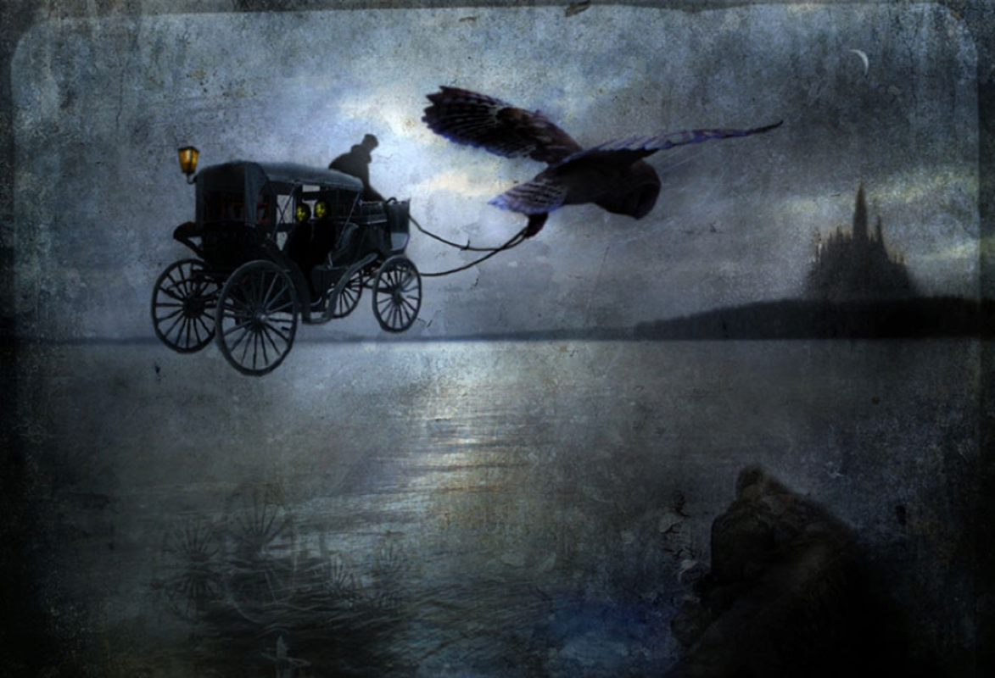
Castle Midnight
What kind of person do you think the coachman is?
Why does everyone fear the Master?
Who are the two strangers in the back? Why do you think they are going to Castle Midnight?
What kind of place do you think Castle midnight is?
Is the owl ‘normal’ in size?
Where/when do you think this story is set?

Slide 2
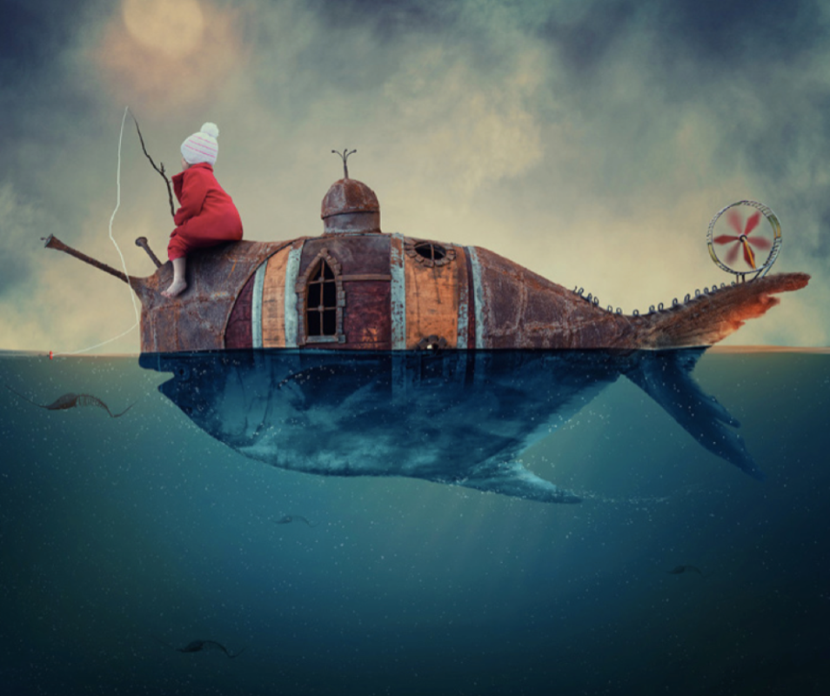
A New World 2
Where do you think the land has gone?
How will people survive in this ‘water-world’?
Is there more land or water on Earth?
Is it better to live in a place with too much water or not enough water?
What do you think the girl had to drink when she was out at sea?

Slide 3
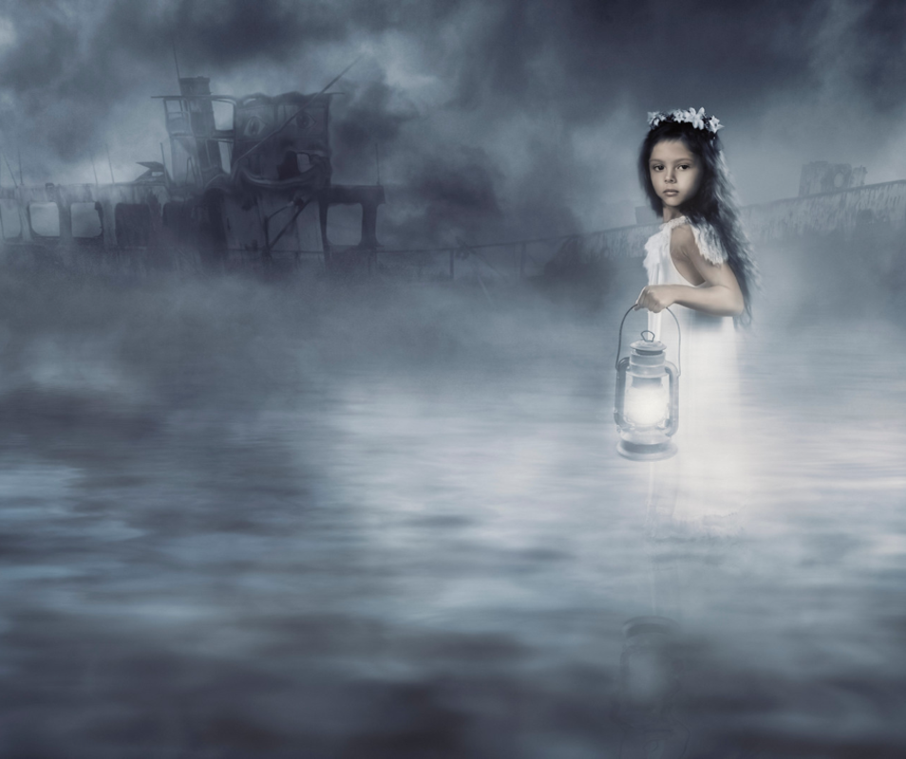
Into the mist
What does the word ‘solace’ mean?
Who is the girl in the picture?
Can you give her a name?
Why is she dressed in the way she is?
What has she left behind on the shore?
What does it mean by ‘that light was her only comfort’?
What is the ship? Why has it been described as a ‘silent predator?
Why does the girl want to reach the ship?
What will happen once she does?

Slide 4
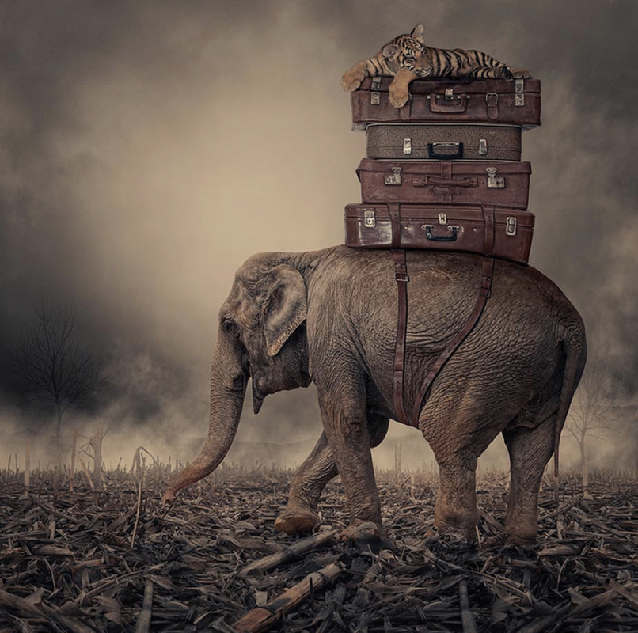
Nellie the Elephant
Where do you think she is heading?
What does she have packed in her trunks?
Should animals have rights?
Should ALL animals have rights?
Which animals shouldn’t have rights?
Should animals have the same rights as humans?
Are two legs better than four?

Slide 5
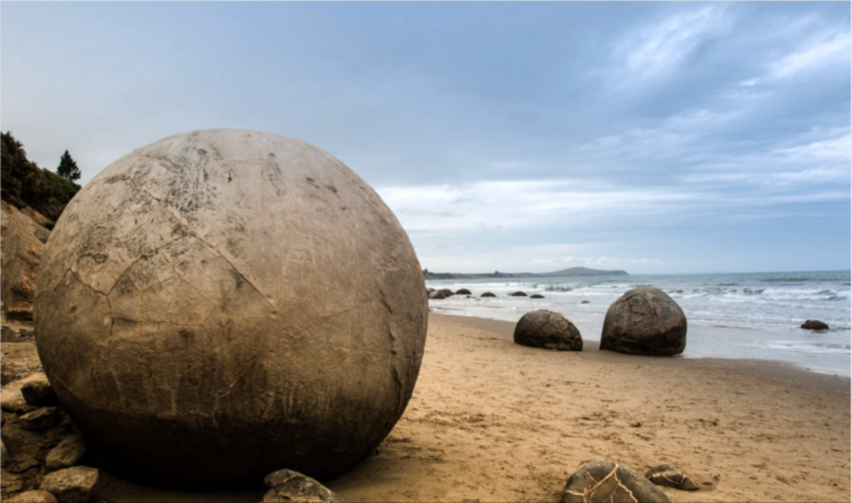
About to hatch…
Where might these objects have come from?
Why is the surface of the nearest object cracking?
What is inside the objects? Are all of the objects the same?
What will happen next?
If you came across one of these, how would you react?
Do these objects remind you of anything?
Why have these objects landed on the beach? Is it by chance or is it deliberate?

