Slide 1



Short-term memory
Name a part of a plant and its purpose.
Can you remember things from a while ago?
When do humans start of age?
Question from the last topic – good long term memory
What type of force is gravity?

Slide 2
Sticky knowledge!!
The giraffe has no set mating season and young can be born year-round, with the typical pregnancy lasting 15 months. The young are born at already around 6 feet in height at birth. In the wild they typically live for around 15 years, but can live longer in captivity.

Slide 3
LO: To identify the differences in asexual and sexual reproduction in plants.

Slide 4


Slide 5
https://www.youtube.com/watch?v=W9OiGA5_mVs

Slide 6
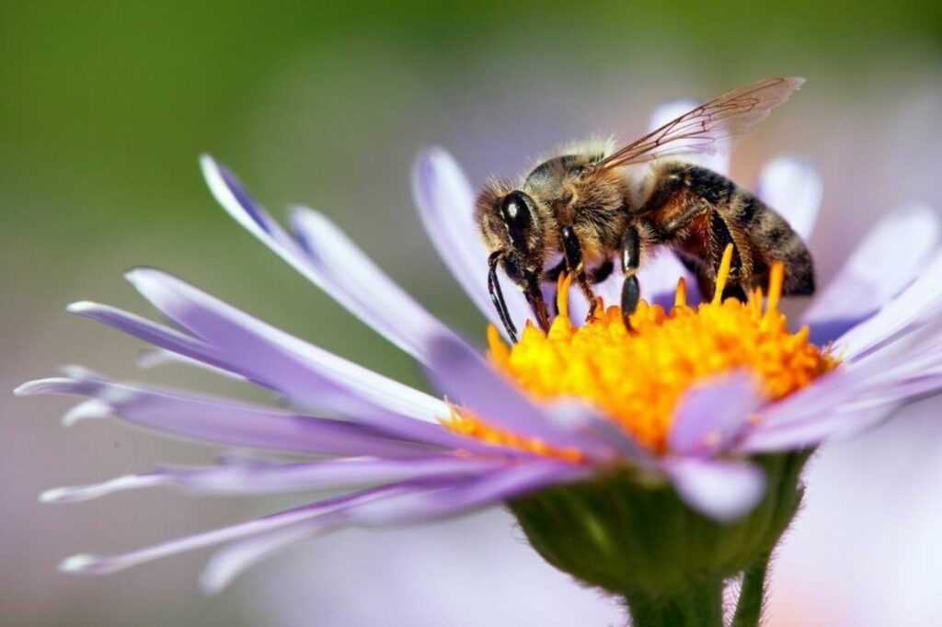
Some plants use sexual reproduction to make seeds, which grow to make new plants. These plants need pollen (containing the male gamete or sex cell) from one flower to fuse with the ovule (the female gamete) of another flower, which makes a seed.
However, some plants use asexual reproduction to make new plants.
Unlike sexual reproduction, asexual reproduction only needs one parent plant to make new plants.
Because there is only one parent plant, there is no fusion of gametes, and no mixing of genetic information. The new plants are identical to the parent plant. They are clones.

Slide 7
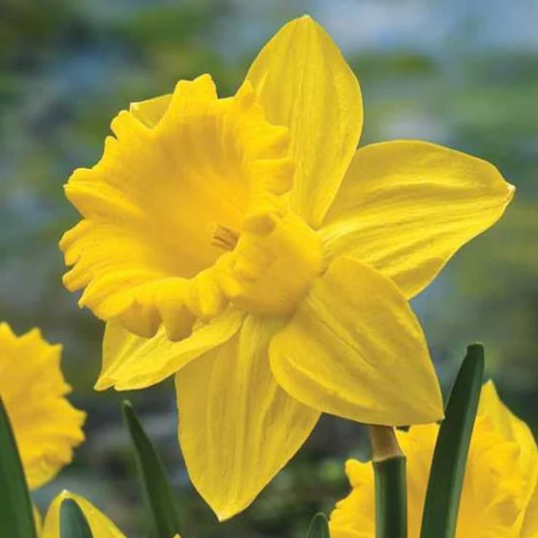
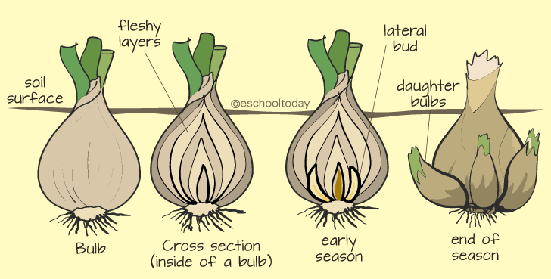
Asexual Reproduction
Daffodil bulbs store energy underground. Once the daffodil plant has died back, the bulb develops side shoots that will grow into new daffodils for next year.

Slide 8
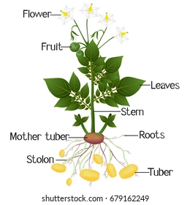
Asexual Reproduction
Potato plants grow tubers underground during the spring and summer. These tubers will grow into new plants the following spring if they are left undisturbed.

Slide 9
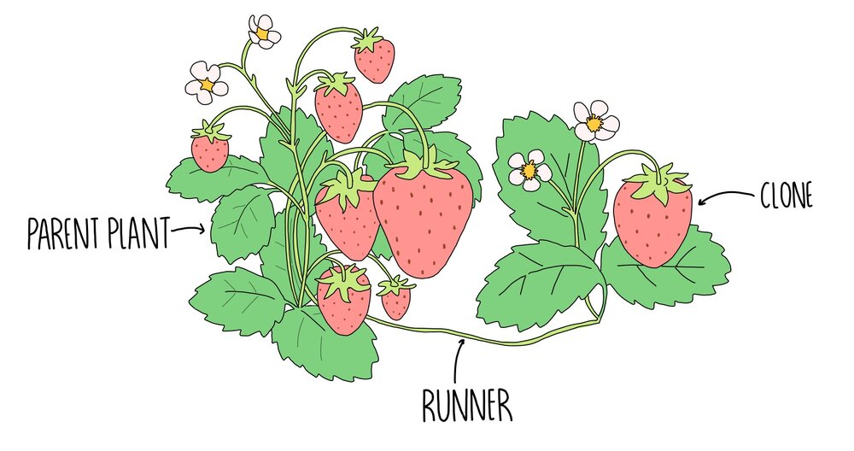
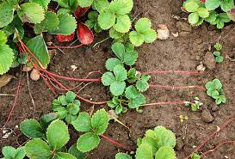
Asexual Reproduction
Strawberry plants send out runners with small plantlets on. These will each grow into a new strawberry plant.

Slide 10
Sort the characteristics into sexual and asexual.
A seed is produced from the ovule (the female gamete) of the female plant
Needs two parents
Offspring are similar to their parents, but not identical
Requires just one parent
Produces identical offspring
Can develop shoots that grow into new plants the following year
Requires pollen to reproduce
Can grow tubers

Slide 11
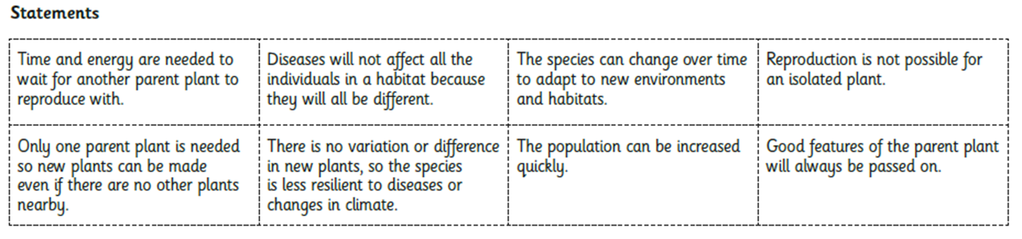
Advantages and disadvantages

